Slide 1

MPFC in collaboration with COSIDICI presents
National Award Function – 2017 for
“Outstanding Entrepreneurs”
Funded By State Level Financial Institutions
(On February 10, 2017 At 07:30 p.m. Hotel Sayaji, Indore)

Slide 2
APSFC, Hyderabad
Bharathi Consumer Care Products Pvt. Ltd.
M/s Bharathi Consumer Care Products Pvt. Ltd., was established in the year 2009 by Smt. Parimala Manikvel and Sri Arunachalam Manickavel with financial assistance from APSFC, Hyderabad to manufacture detergent cakes. The Company is regular in its repayment schedule and has a good track record. The products are being sold under the Brand names “XXX”, “SAREGAMA” and “DIAMOND” (Blue Diamond, Green Diamond & Pink Diamond) with XXX brand being the most popular one.

Slide 3
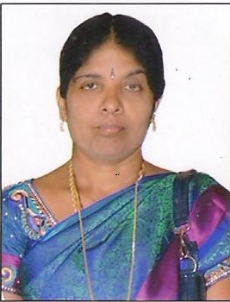
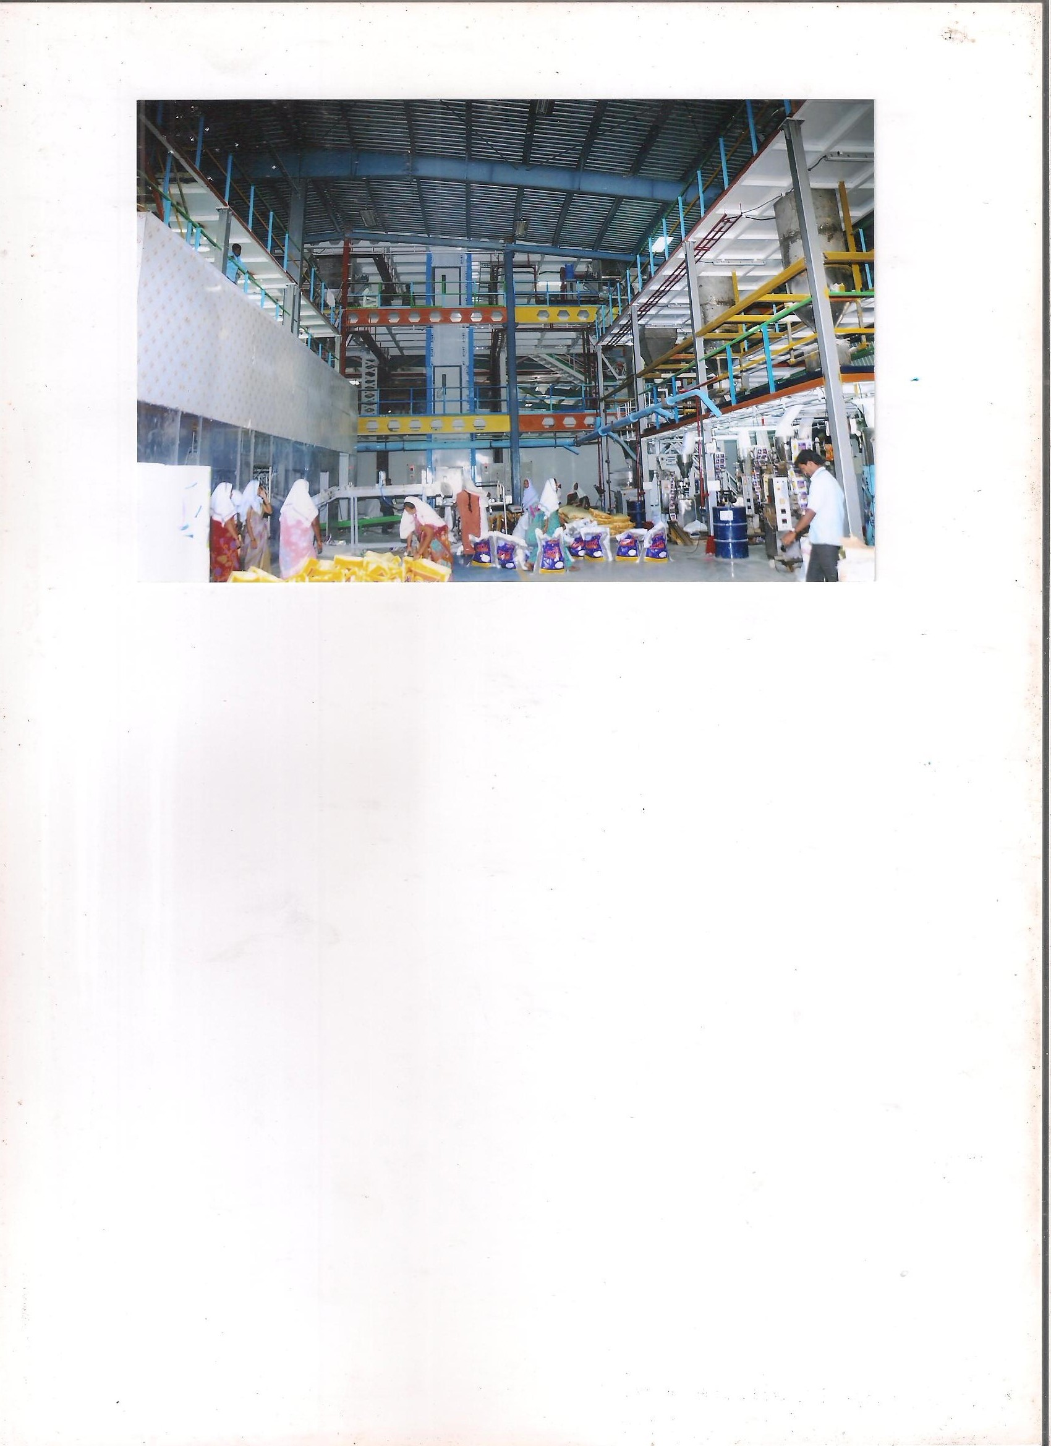
APSFC, Hyderabad
Bharathi Consumer Care Products Pvt. Ltd.
Smt. Parimala Manikvel

Slide 4
AFC; Guwahati
M/s Maibong Eco Resort
M/s Maibong Eco Resort was set up in Pobitora, Assam by Shri Nripen Nath, a young entrepreneur near Pobitora Wild Life Sanctury, which is famous for the great Indian One –Horned Rhinoceros and home to more than 2000 migratory birds and various reptiles. A large number of local and foreign tourists from across the globe come to visit the sanctuary. Due to its efficient and good services the Resort has earned a good reputation and enjoys a good occupancy rate. The unit is regular in its repayment schedule.

Slide 5
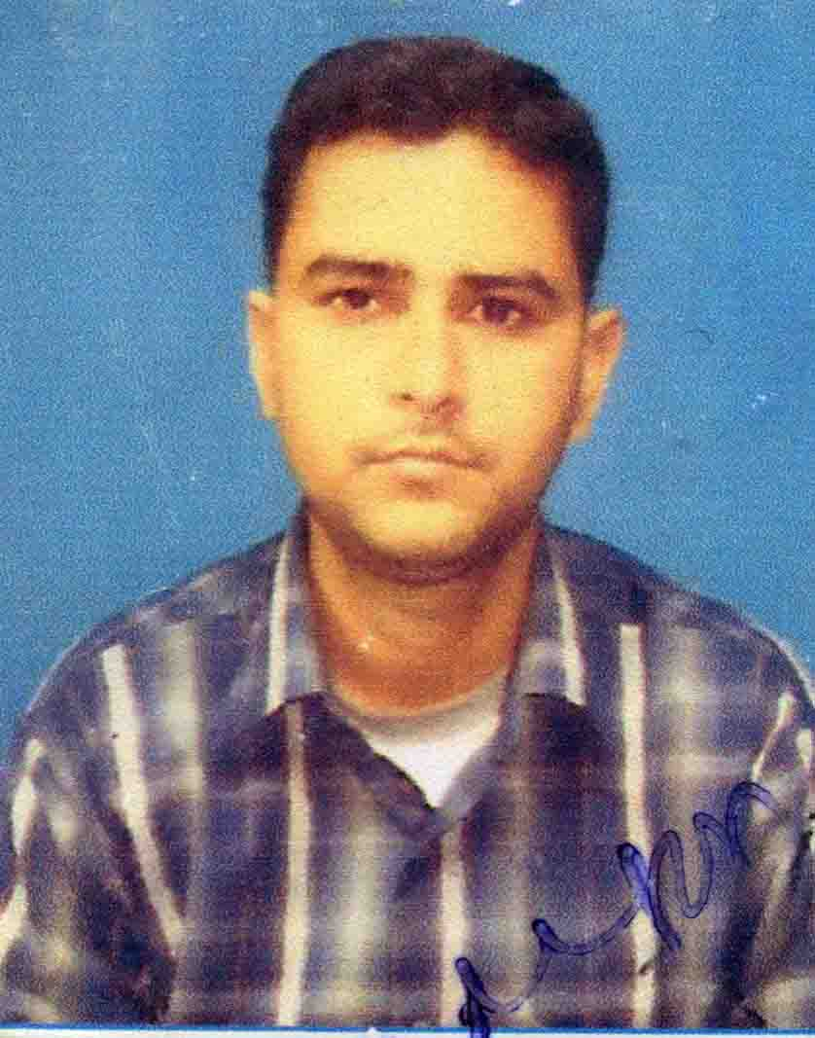
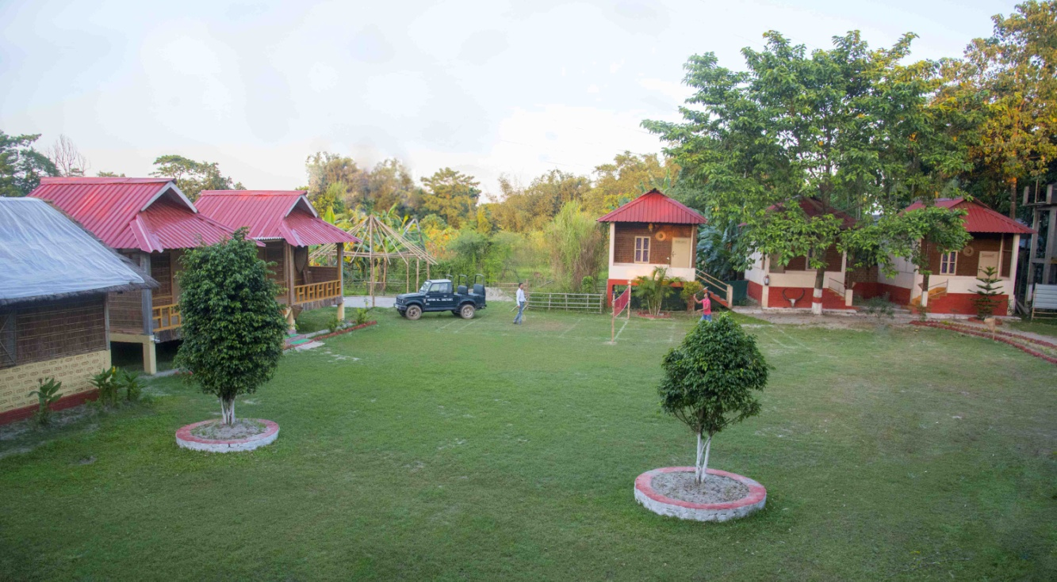
AFC; Guwahati
M/s Maibong Eco Resort
Shri Nripen Nath

Slide 6
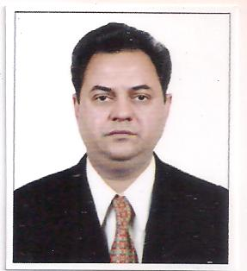
DFC; New Delhi
M/s Punjab Machine Tools
M/s Punjab Machine Tools was established in the year 1980 at New Delhi by Shri Jagdeep Singh with financial assistance from Delhi Financial Corporation (DFC), New Delhi. The unit manufactures electrical parts viz electrical lamination and stamping; DOL starter parts; electrical motor starter parts; sheet metal components etc. The unit has advanced production technology and optimally uses the finest grade raw material as well as adherance to quality parameters to ensure their conformity with the international standards.
Advanced equipment and cutting-edge technology help the unit in completing bulk and urgent orders of its clients within the promised time schedule of delivery. Backed by a widespread warehousing facility, the unit is able to store the finished products in safe environmental conditions. This facility is well connected with transport facilities enabling it to deliver the ordered consignment in the minimum possible time.
The products are packed with sturdy and rust and dust proof packaging material ensuring their safety during transportation. Due to client-centric approach, flexible mode of payment and cost effective prices, the unit has established strong base of clients across the nation.
Shri Jagdeep Singh

Slide 7
EDC Ltd., Goa
M/s Chodankar Nursing Home
Chodankar Nursing Home, a 60 bedded Hospital located at Porvorim was promoted by Dr. Ravindra G. Chodankar in 1984 with financial assistance from EDC Ltd. Goa. The hospital is ISO certified and has advanced Operation Theatre with sophisticated equipment of international standards. The hospital also has an associate concern “Goa Scan Centre` (started in 2003) which provides Diagnostic facilities.
The hospital extends routine and super specialty treatment in all the branches of medicine and has a well developed ICU / NICU managed by a team of dedicated doctors. The hospital has a well developed support infrastructure like Pharmacy, superstore and hotels around the area for the relatives coming from distant places and other states. Its canteen provides all the necessary requirements to patients and their relatives.
The Scan Centre is equipped with CT Scanner; MRI machine and Doppler machine. Dr. Chodandar had availed loan assistance of Rs.100.00 lakh from EDC Ltd. for the hospital which has been repaid. Additional loan assistance of Rs. 264.00 lakh was availed from EDC Ltd. in 2014 for setting up the Scan Centre. Both the hospital and the Scan Centre enjoy a good reputation and are growing rapidly.

Slide 8
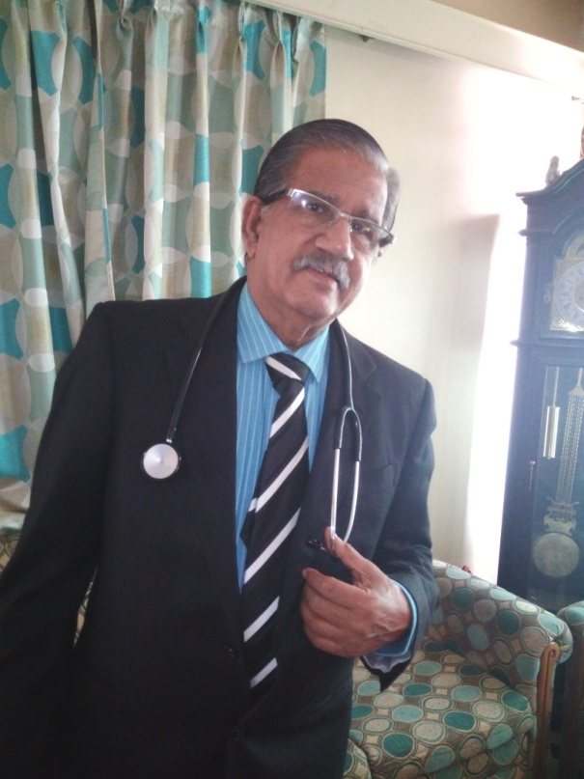
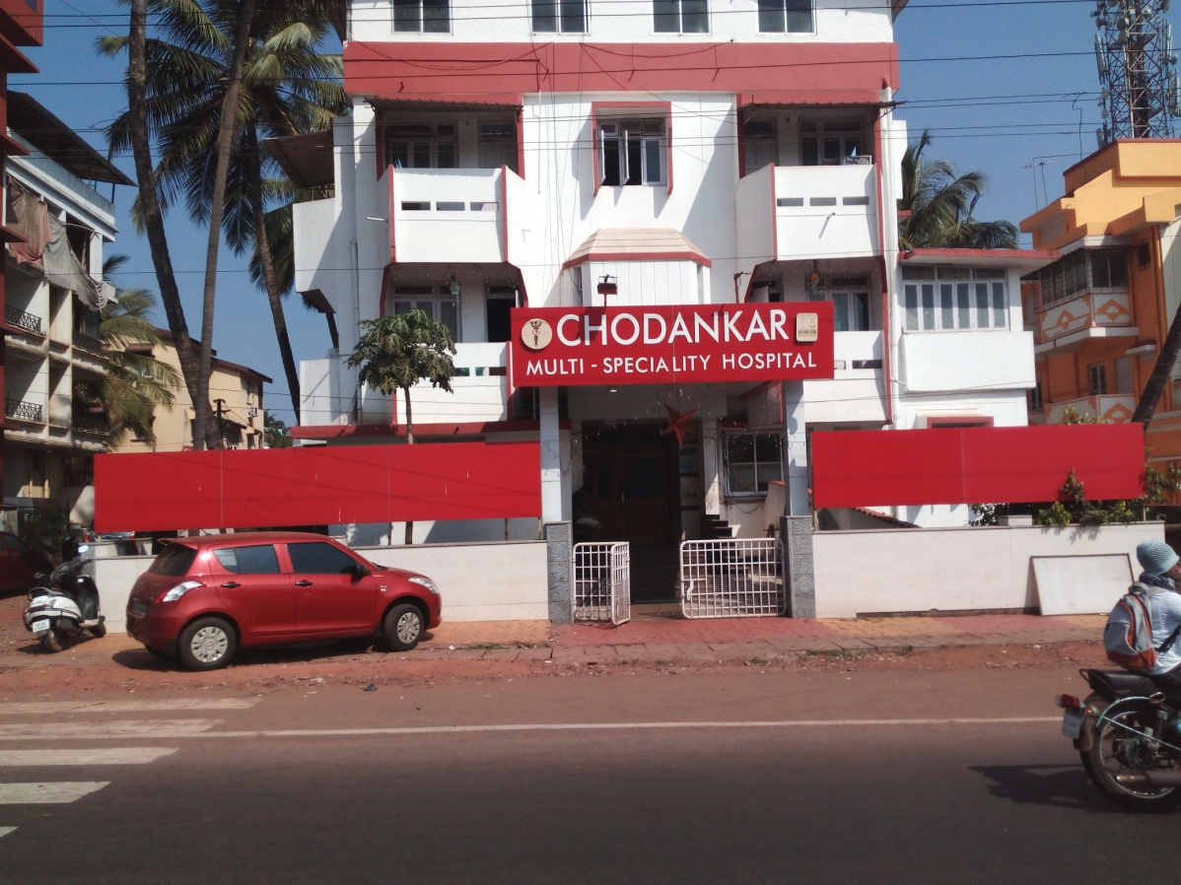
EDC Ltd., Goa
M/s Chodankar Nursing Home
Dr. Ravindra G. Chodankar

Slide 9
EDC Ltd., Goa
Gulf Goans Hotels Company Pvt. Ltd.
M/s Gulf Goans Hotels Company Pvt. Limited was established in the year 1979 by Shri Antonio A. Correia with financial assistance from EDC Ltd., Goa. Hotel Goan Heritage is located in Calangute on the beach front. This 3 star hotel has 66 deluxe and 9 suite rooms, swimming pool, wellness centre and facilities for conferences and weddings. The hotel is spread over an area of about 12,000 m² and employs around 145 persons. Due to maintaining the highest standards in the hospitality industry the hotel has achieved an average occupancy rate of over 70 % and is patronised by both national and international tourists.
The company posted a turnover of Rs.804.59 lakh in 2016 and has won many awards for hospitality viz. Silver – Customers Choice Award 2014/15 from Apollo Travel Group; Holiday Award from Holiday IQ in 2016 and Certificate of Excellence for 2012 & 2013 from Trip advisor. The management has again approached EDC to finance their expansion plans wherein the hotel room capacity will be increased by 35 rooms and the facility upgraded to 5 star.

Slide 10
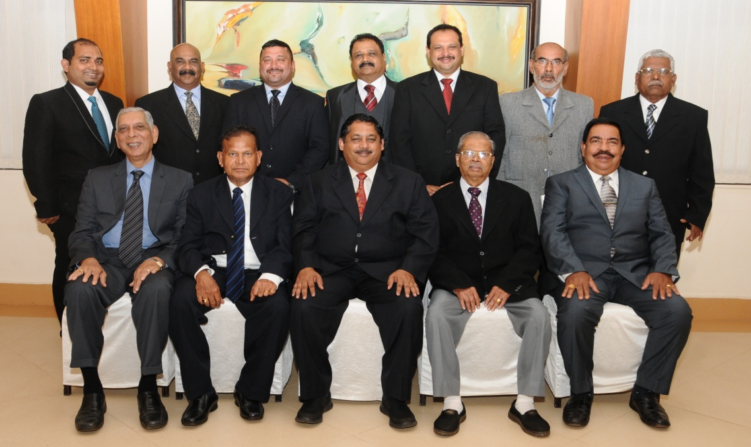
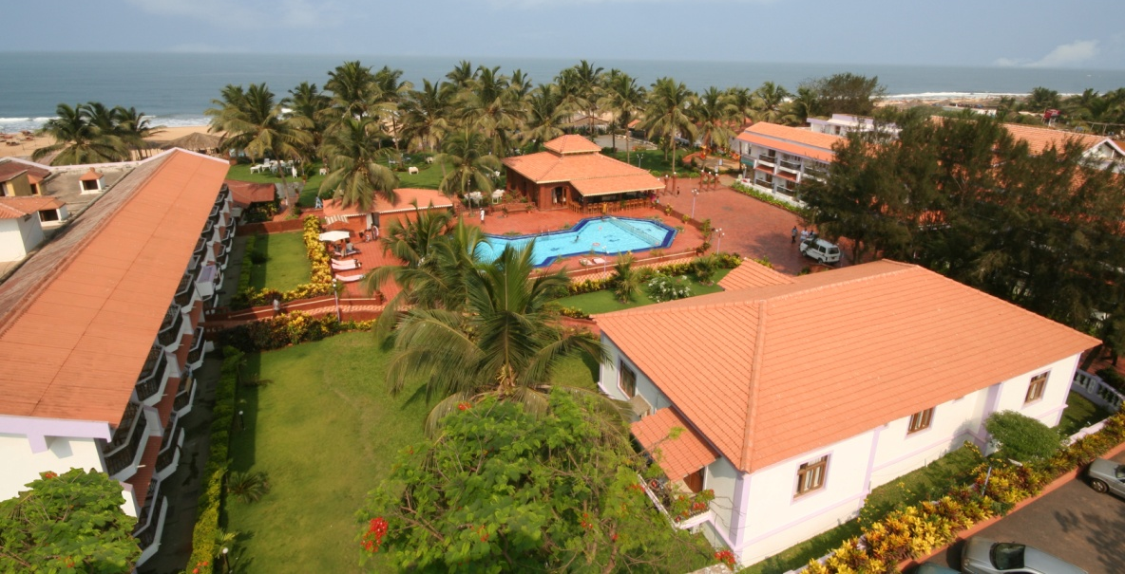
EDC Ltd., Goa
Gulf Goans Hotels Company Pvt. Ltd.
Directors of Gulf Goans
Hotels Company Pvt. Ltd

Slide 11
EDC Ltd., Goa
M/s Phoenix Park Inn Resort
M/s Phoenix Park Inn Resort located in Candolim, along the coastal belt of North Goa was setup by Dr. Prafulla R. Hede and Shri Samit Hede in the year 2003 with financial assistance from EDC Limited, Goa. It initially had 58 rooms. Subsequently rooms were added in phases along with other facilities and restaurants. The expansion/renovation plans have also been financed by EDC Limited and the present room inventory is 128 rooms. The Resort has neo-colonial style setting and was built under technical collaboration of Carlson Rezidor Hotels (A premier International Brand) and managed by Sarovar Hotels & Resorts. It has achieved high occupancy rate with an overall average year round occupancy of about 85%.

Slide 12
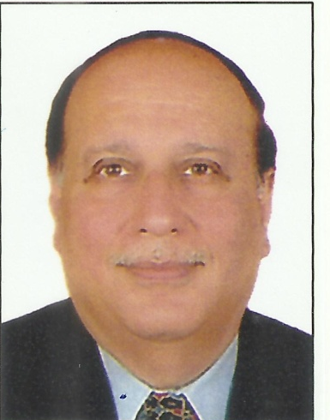
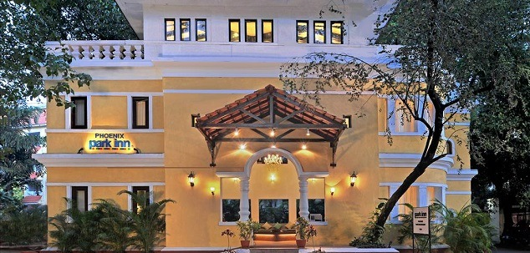
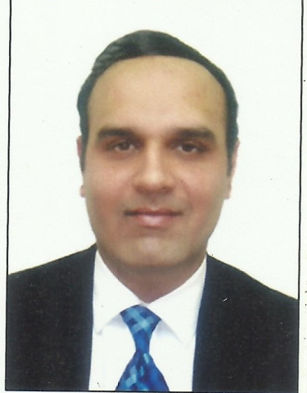
EDC Ltd., Goa
M/s Phoenix Park Inn Resort
Dr. Prafulla R. Hede
Shri Samit Hede

Slide 13
EDC Ltd., Goa
M/s Cyratron Techmation & Oilex Systems Pvt. Ltd. (CTOS)
M/s Cyratron Techmation & Oilex Systems Pvt. Ltd. (CTOS) is an Indo-German Joint Venture with eh-Electronics GmbH Hanover – Germany. The company was promoted by Mr. Cyril Pereira in the oil exploration sector in the year 1986 with financial assistance from EDC Ltd., Goa. It initially started providing Mud Logging services to ONGC by undertaking operations in the NRBC region in Jammu for their very deep and highly complex exploratory wells. The company has about 30 years experience in the field of Mud Logging and has produced about 800 wells incorporating all the latest real time online technologies adhering to DNV safety norms compliance.
The state-of-art 5,000m² facilities at Goa encompass Manufacturing (Mechanical & Electronics), Corporate Offices, R & D Centre and Software Development Center employing around 50 Instrumentation, Electronics, Mechanical, Petroleum Engineers, Geologists and Software Professionals. The company has a strong base in the development of embedded software for any kind of application. It is an established manufacturer of Process Control Systems, Instrumentation accessories for the Process Industry and Mud Logging / Hydrocarbon analysis, Rig Instrumentation for Oil Exploration and provides services to the European Union and US. Some of its clients in the country are Gujarat State Petroleum Corporation Ltd., ONGC Mumbai, Adani Welspun Exploration Ltd., Jubilant Oil & Gas Pvt Ltd.

Slide 14
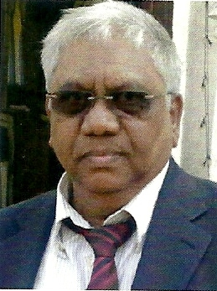
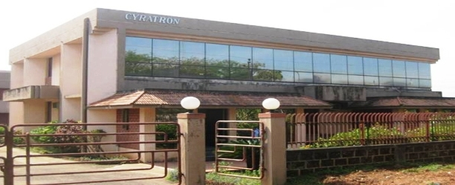
EDC Ltd., Goa
M/s Cyratron Techmation & Oilex Systems Pvt. Ltd. (CTOS)
Mr. Cyril Pereira

Slide 15
KFC, Thiruvananthapuram
M/s Era Doors
Shri Rejeesh Puchali set up M/s Era Doors to manufacture Panel Doors with financial assistance from Kerala Financial Corporation (KFC) Thiruvananthapuram. The unit is prompt in its repayment schedule. The quality of the product has been much appreciated. Shri Puchali is relentless in his pursuit of improving the quality of the Panel Doors. As a result the unit has been awarded ISO 9001-2008 certification.

Slide 16
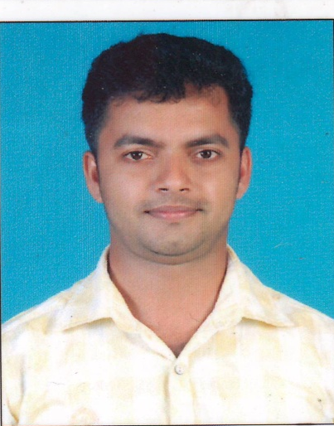

KFC, Thiruvananthapuram
M/s Era Doors
Shri Rejeesh Puchali

Slide 17
KFC, Thiruvananthapuram
M/s Black Diamond Rock products
M/s Black Diamond Rock Products was founded by Shri George V. Mangaly in the year 2013 in Ernakulam district with financial assistance from Kerala Financial Corporation (KFC) Thiruvananthapuram with the vision of providing superior quality manufactured sand, produced in compliance with the highest standards of sustainable manufacturing. Due to fast growing construction industry, the demand for sand has increased tremendously, causing deficiency of suitable river sand in most parts of the world. An alternative solution to the depleting river sand is manufactured sand (M- sand) procured from the crushed remains of quarry stone. The state of the art Black Diamond Facility can manufacture up to 200 tonnes of rock products per hour. Manufactured sand is not only a viable alternative to natural sand, but is superior in many ways. River sand is not graded properly and has excessive silt and organic impurities like coal, bones, shells and mica. These can be detrimental to durability of steel and concrete, whereas manufactured sand is properly washed sand to reduce any impurities, which in turn strengthens the cement’s properties in concreting. Also, Mortars with M-sand exhibit better workability and water retention characteristics.

Slide 18
KSFC; Bangalore
M/s Deccan Hydraulics Pvt. Ltd.
Shri B G Ramakrishnappa, established M/s Deccan Hydraulics Pvt.Ltd., Kolar District Karnataka with financial assistance from Karnataka State Financial Corporation (KSFC) in the year 1992. The unit is a pioneer in manufacture of Hydraulic Equipment like Hydraulic Cylinders, Checkvalves, CNG Carburetors, Fuel Tanks, Hydraulic tanks, Tubular Structures etc. The firm had taken 17 loans aggregating to es13.62 crore from KSFC over the years. It has been prompt and regular in repayment. The unit has achieved a turnover of Rs.33.71 crore. Some of its clients include Valvo, TATA Motors, Dalmler, Ashok Leyland, Asia motor Works, BEML, KIPT etc. The firm exports hydraulic Equipments to USA, France, Italy, Sweden.
M/s. Deccan Hydraulics an Engineering unit is a pioneer in manufacturing Hydraulics equipment. For its outstanding performance the unit has been conferred with State Level Export Award for 2006-07, 2007-08 & 2008-09. It has also received the National Export Award-as Star Performer Award - 2013-14.

Slide 19
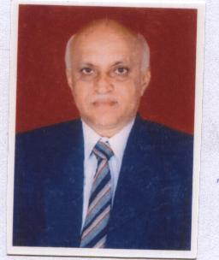
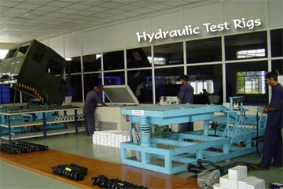
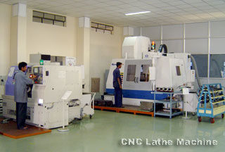
KSFC; Bangalore
M/s Deccan Hydraulics Pvt. Ltd.
Shri B G Ramakrishnappa

Slide 20
KSFC; Bangalore
M/s Karnataka Engineering Works
Shri Mohammad Iliyas Savanur established M/s Karnataka Engineering Works in Hubli, Karnataka in the year 2016 with financial assistance from Karnataka State Financial Corporation (KSFC). The unit is engaged in manufacture of Bodybar building & Engineering Works. The unit has availed of an aggregate loan of Rs.1.6 crore and has already achieved a turnover of Rs.6 crore due to the good quality of the products. Some of its clients include Mohan Travels, Kolhapur; Koduskar Motors, Kolhapur; and Astavinayak, Pune.

Slide 21
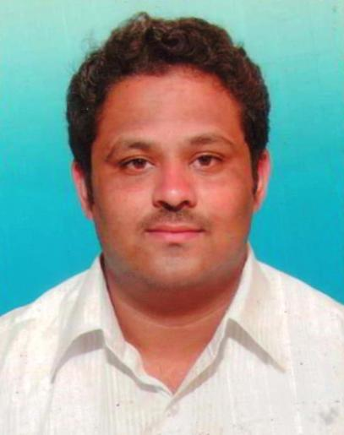
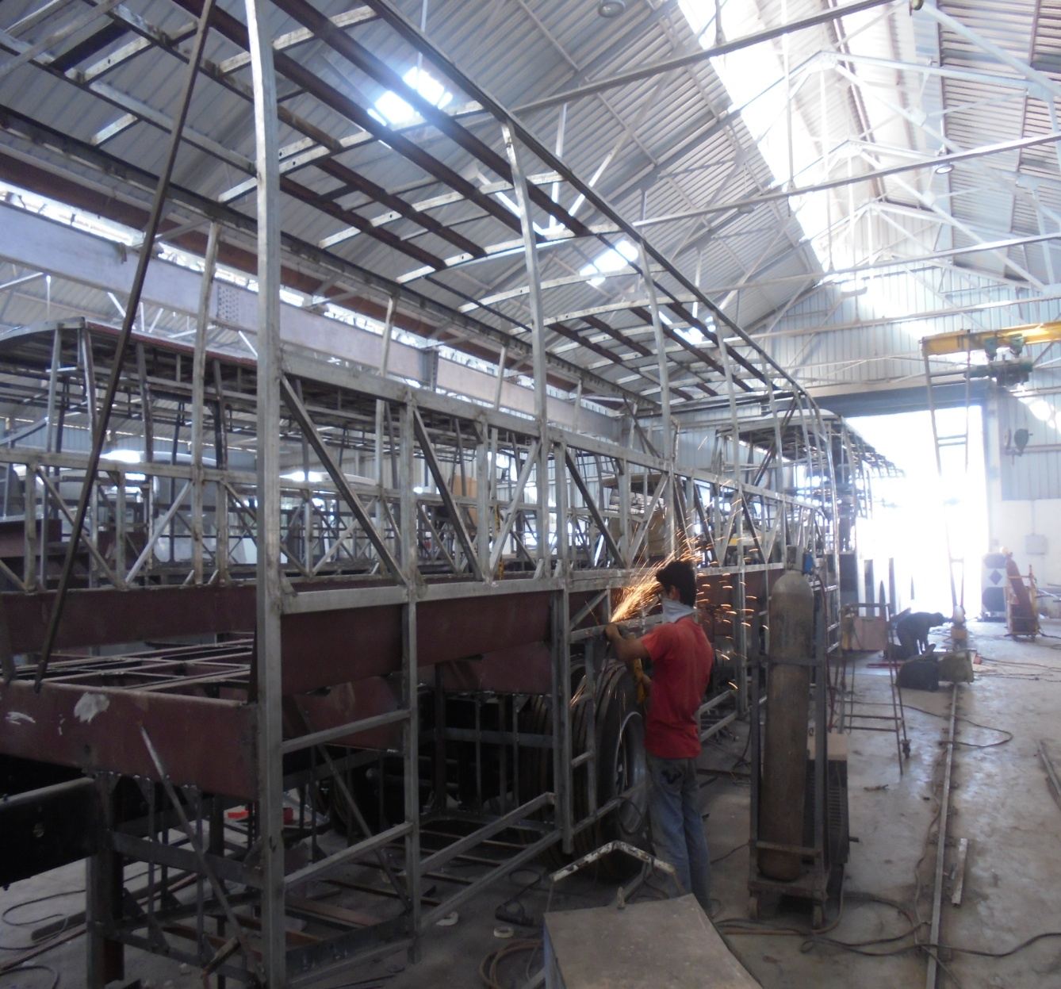
KSFC; Bangalore
M/s Karnataka Engineering Works
Shri Mohammad
Iliyas Savanur

Slide 22
KSFC; Bangalore
M/s Dharani Pipes Pvt. Ltd.
Shri Basavaraj S Dambal established M/s Dharani Pipes Pvt. Ltd. in Koppal, Karnataka in the year 1991. The Unit is engaged in manufacture of PVC Rigid Pipes & Allied Pipes. The unit availed of a loan aggregating Rs.3.67 crore from Karnataka State Financial Corporation (KSFC) Bangalore. The Company supplies to local and surrounding districts and has excellent network of marketing due to which it has already achieved a turnover of Rs.12.21 crore.

Slide 23
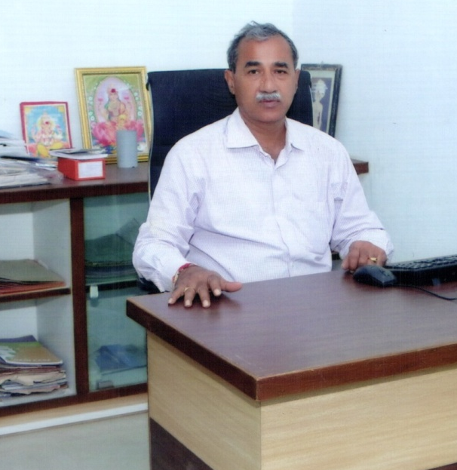
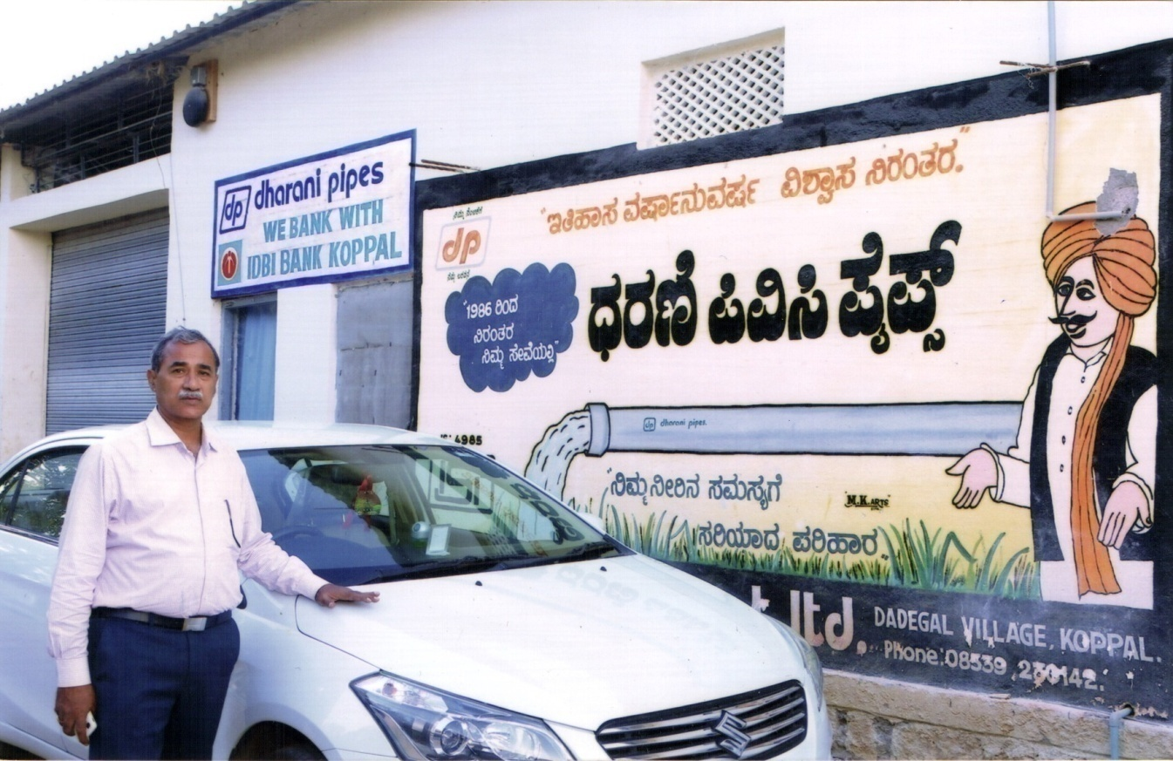
KSFC; Bangalore
M/s Dharani Pipes Pvt. Ltd.
Shri Basavaraj S Dambal

Slide 24
KSFC; Bangalore
M/s Bharthi Associates
Smt. Amoolya V established M/s Bharthi Associates in Hassan (Karnataka) in the year 1994 with financial assistance from Karnataka State Financial Corporation (KSFC) Bangalore. The unit is engaged in Vegetable Processing and is one of the major producer of pickled gherkins in India. It is a major exporter to USA, France, Germany, Holland, Australic, Russia. Their products are Gherkins processed in Barrels, pickled gherkings in glass bars, Gherkins in Tins; Baby Corn in Jars, Tins, Barrels; Cherry Tomoto in Jars, Tins. Its turnover is Rs.35.67 crore. The unit is equipped with State of the art infrastructure and is certified by the Dutch National Board of Exports HACCP. It has received certificates from International Food Safety Standards & British Retail Consortium.
M/s Bharathi Associates has been conferred with the Best District Exporter Award since the past 10 years by Vishweshwaraiah Trade Promotion Centre, Government of Karnataka.

Slide 25
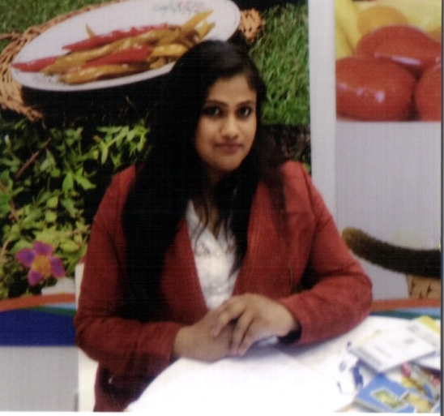
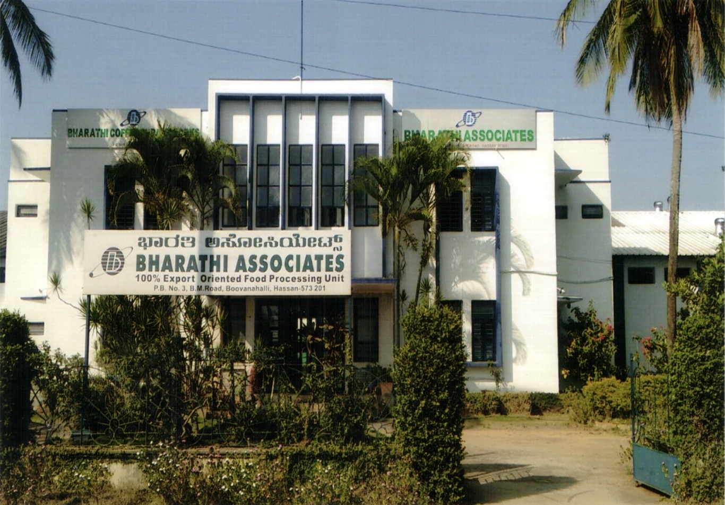
KSFC; Bangalore
M/s Bharthi Associates
Smt. Amoolya V

Slide 26
KSFC; Bangalore
M/s Madhuban Industries
Smt. Swarooparani S Happalad set up M/s Madhuban Industries at Dharwad, Karnataka in the year 2012 with financial assistance from Karnataka State Financial Corporation (KSFC) Bangalore. The Promoter started her career in seed processing industry and later set up a Solar Plant. Its main client is M/s.Hubli Electricity Supply Ltd., Hubli.

Slide 27
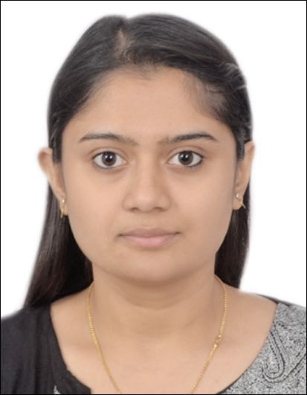
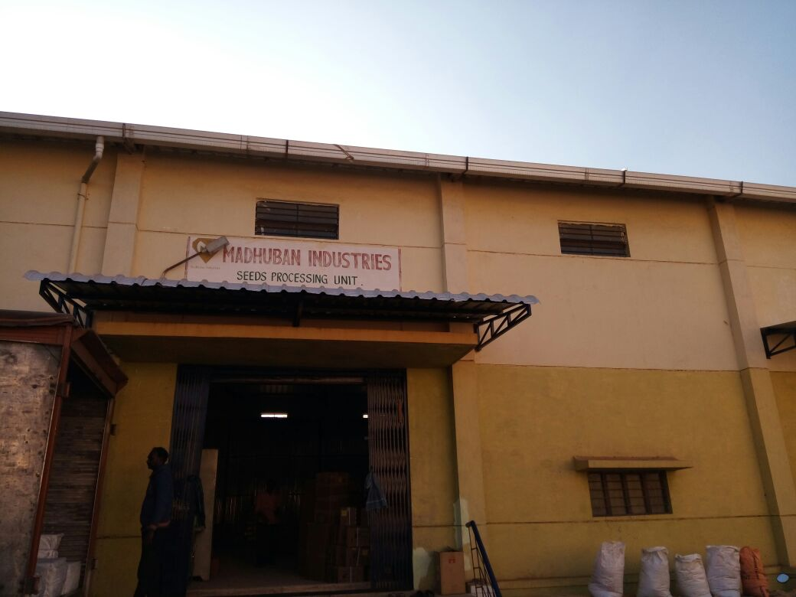
KSFC; Bangalore
M/s Madhuban Industries
Smt. Swarooparani S Happalad

Slide 28
KSFC; Bangalore
M/s Sri G. Balraj
Shri G. Balraj started a proprietary concern under his own name in 1980 in Mangalore, Karnataka. The concern is engaged in the activities of Road Construction. Over the years Sri G. Balraj took loans aggregating Rs.4 crore from Karnataka State Financial Corporation (KSFC) Bangalore. Over time he has established himself as one of the leading Class-1 contractor in Dakshina Kannada. His major contribution is building of Roads and Industrial Layouts. He has built roads for National Highway Department, Public Works Department, Zilla Panchayath & Mangalore City Corporation and has achieved a turnover of Rs.17.22 crore.

Slide 29
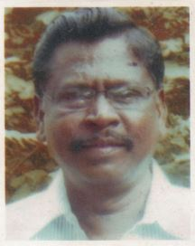
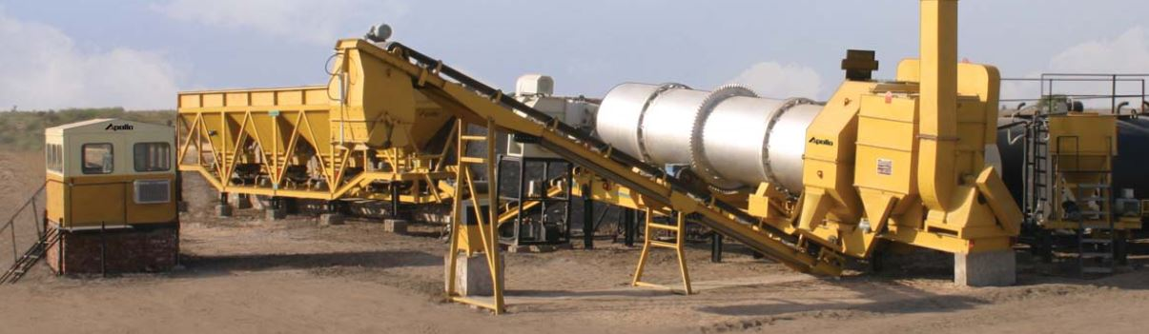
KSFC; Bangalore
M/s Sri G. Balraj
Shri G. Balraj

Slide 30
KSFC; Bangalore
M/s Sri Venkateshwara Engineering Works
Shri C. Venkatesh Naik, established M/s Sri Venkateshwara Engineering Works in Davangere District, Karnataka in the year 2015. The firm is engaged in manufacture of Agricultural implements & General Fabrication Works. He took financial assistance of Rs.1.30 crore from Karnataka State Financial Corporation (KSFC) Bangalore under interest subsidy scheme of GoK for SC/ST entrepreneurs. The products of the unit enjoy a good reputation in the market. The unit has already achieved a turnover of Rs.2.44 crore.

Slide 31
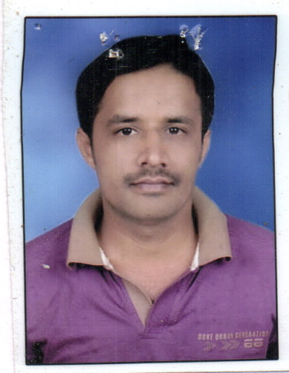
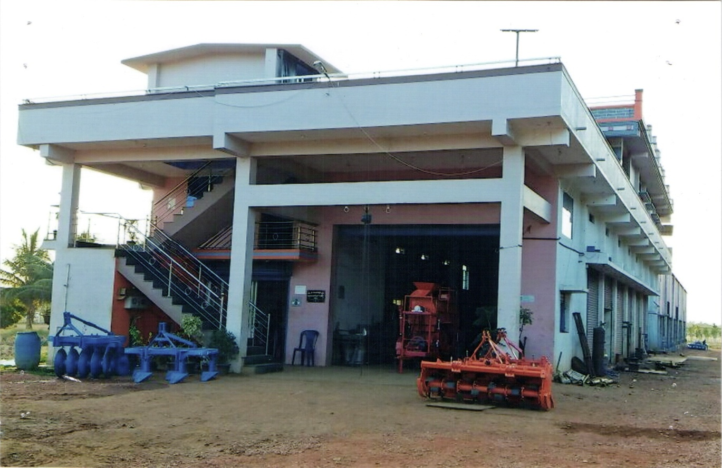
KSFC; Bangalore
M/s Sri Venkateshwara Engineering Works
Shri C. Venkatesh Naik

Slide 32
KSFC; Bangalore
M/s Coorg Cliffs Resorts India (P) Ltd.
M/s.Coorg Cliffs Resort India (P) Ltd., was established by Shri T.T. John in Madikeri, Karnataka in the year 2013 with financial assistance from Karnataka State Financial Corporation (KSFC), Bangalore. Madikeri being the most popular tourist location in the District caters to both the corporate sector as well as individuals.

Slide 33
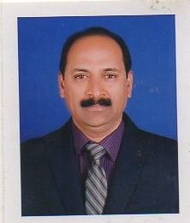
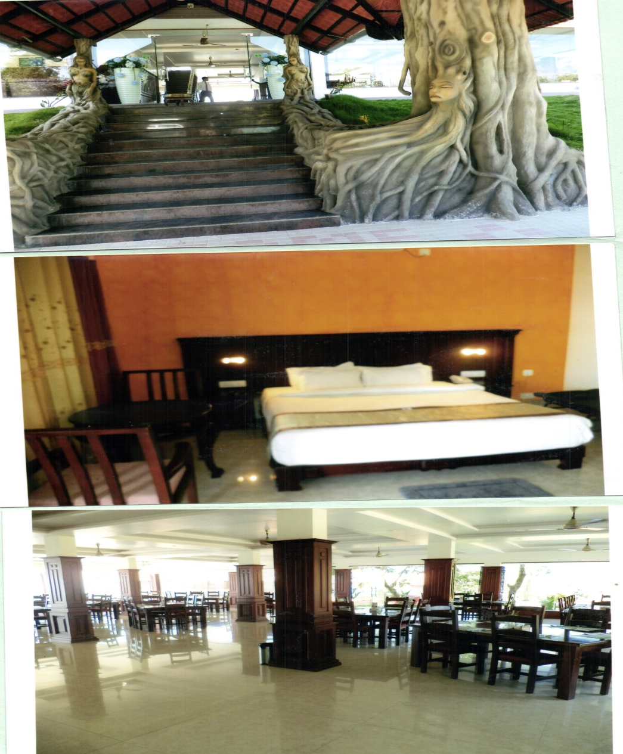
KSFC; Bangalore
M/s Coorg Cliffs Resorts India (P) Ltd.
Shri T.T. John

Slide 34
KSFC; Bangalore
M/s Phoenix Products
M/s Phoenix Products was established in the year 1992 with financial assistance from Karnataka State Financial Corporation (KSFC) Bangalore. The unit is engaged in manufacture of Non Farm Rural Equipments & Biomass Based Energy efficient devices (Water Heaters, Charcoal Cooker, Three Pan Cook Stoves, Dosa Tava, Biomass Driers, Gasifiers etc. which are commercially viable.
The promoter Shri Sameer S. Kanabargi, believes in making biomass energy as a primary fuel source to replace fossil fuels as well as increase the use of local resources of renewable energy efficiently. Biomass fuels provide a sustainable renewable energy source; are energy efficient; their cost is less and they reduce pollution. The unit has introduced many innovative features in its products which are easy to maintain even at rural levels. Some of their associates are Technology Informatics & Design Endeavour - (TIDE) Bangalore; Indian Institute of Science - (IISC) Bangalore; The Energy and Resources Institute - (TERI); TOOL - Netherlands etc.
The unit has received award as "BEST TINY INDUSTRY" from Directorate of Industries & Commerce. The unit has a well defined quality control policy and procures the best raw materials, testing them at every stage of production, maintaining international quality standards, and delivering the products to the clients on-time. The unit also provides technical assistance for after sales service.

Slide 35
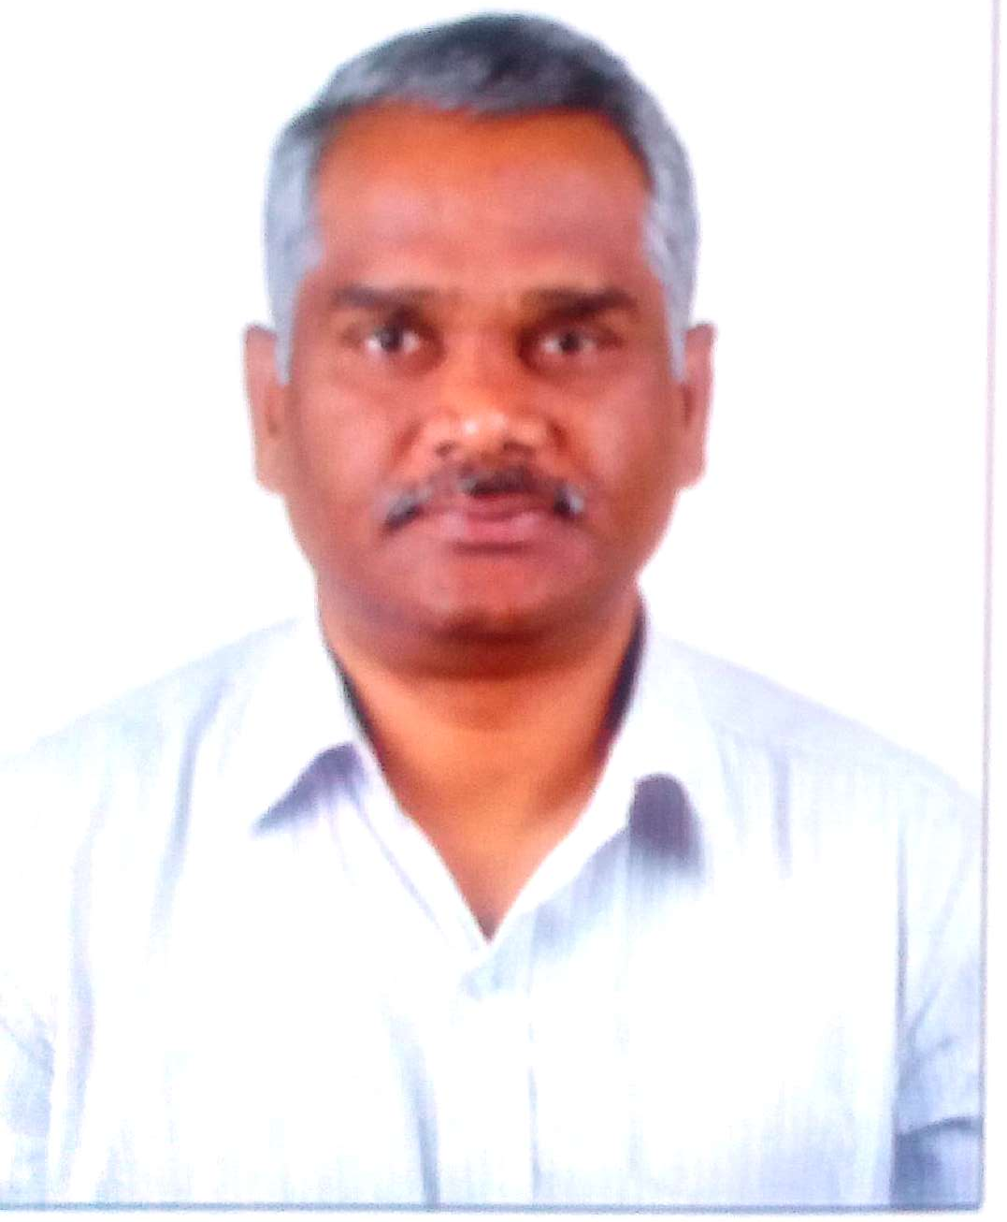
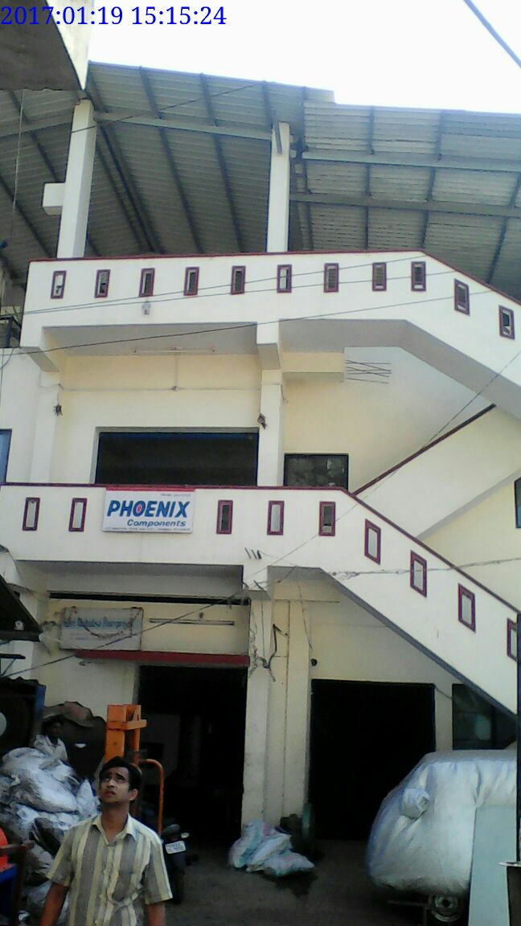
KSFC; Bangalore
M/s Phoenix Products
Shri Sameer S. Kanabargi

Slide 36
KSFC; Bangalore
M/s Sea Shell Plastics
Shri Subramanya established M/s Sea Shell Plastics in the year 1997 with financial assistance from Karnataka State Financial Corporation (KSFC) Bangalore. The unit is a specialised manufacturer of Blow & Injection Moulded Plastic Components & Packaging Containers, Closures, Measuring Cups, Applicators etc. The unit took loans aggregating Rs.2.02 crore from KSFC. Its clients include M/s Himalaya Drug Co., Bangalore; M/s Bal Pharma Pvt.Ltd., Bangalore; M/s Mysore Paints & Varnish Pvt. Ltd., Bangalore; M/s.Natural Remedies Pvt. Ltd., Bangalore; Karnataka Soaps & Detergent Ltd. Bangalore. The unit is exporting its products to the Gulf Country viz to BLCSC, Dubai. The turnover of the company is Rs.11 crore now.

Slide 37
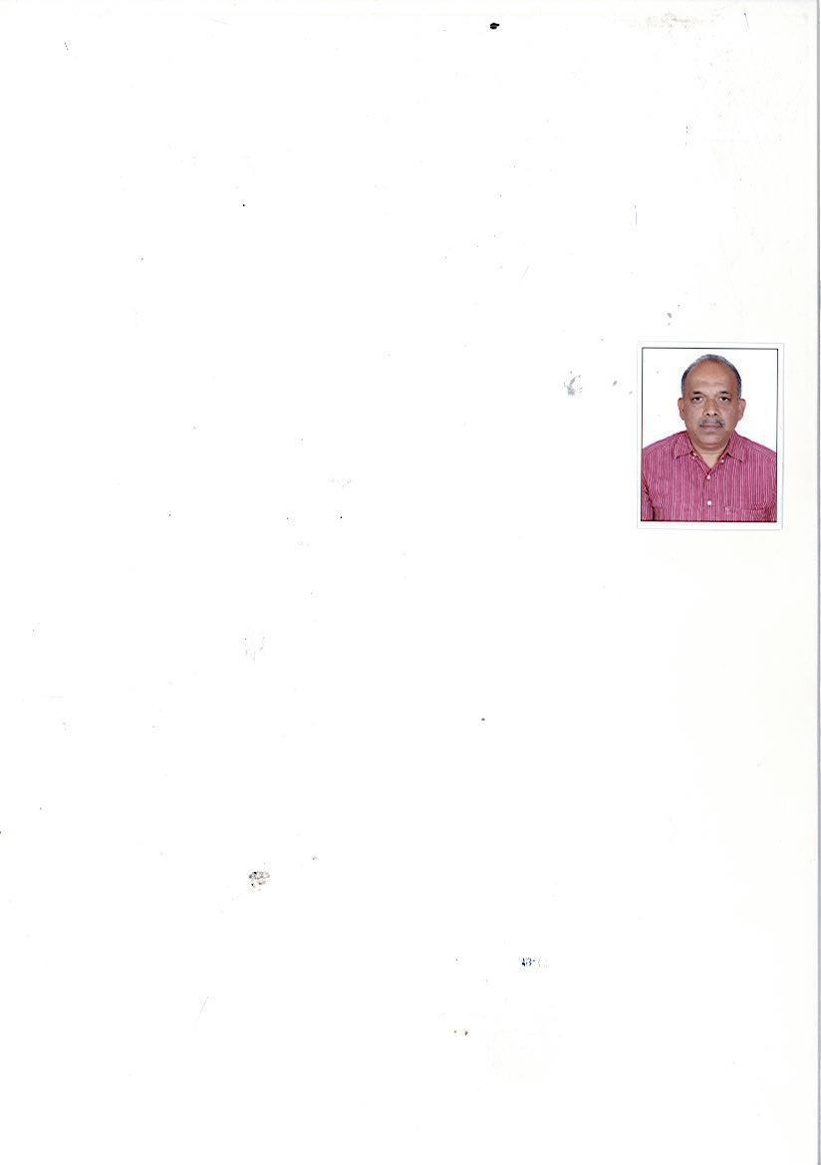
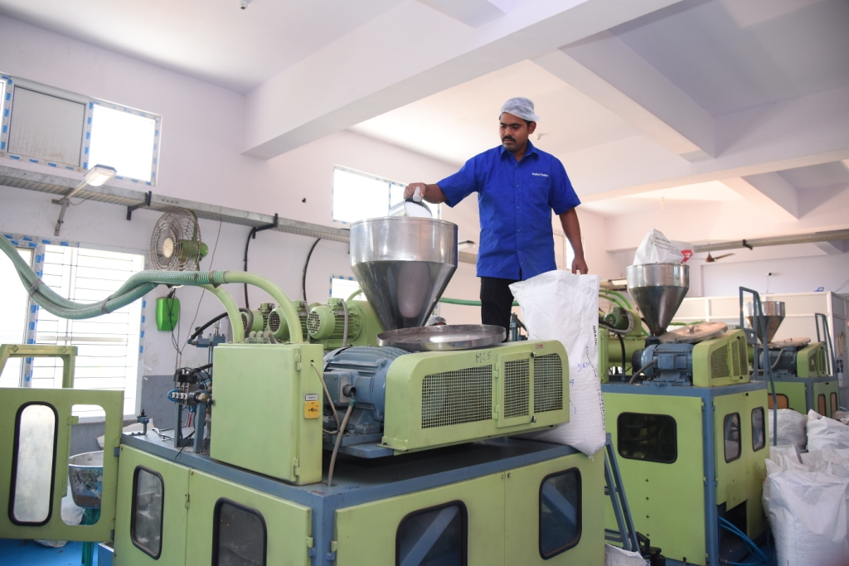
KSFC; Bangalore
M/s Sea Shell Plastics
Shri Subramanya

Slide 38
MPFC; Indore
M/s Krasoma Biochem Pvt. Ltd.
M/s Krasoma Biochem Private Limited was established in the year 2006 at Pithampura by Shri Kamal Shyamsukha & Shri Ravi Shyamsukha to manufacture water treatment chemicals with financial assistance from Madhya Pradesh Financial Corporation.
The unit utilises the Waste generated by Iron and Steel Industry and converting it to an environment friendly product. The recycled product is sold globally. The Company has set up another facility at Howrah. During the last 5 years its turnover has increased from Rs.13.70 Crore in the year 2011 to Rs.126.54 Crore in the year 2016. The company also has plants in Central and Eastern India to manufacture Ferric Chloride solution—an import substitute.
The company has received The Environmental Award (Paryavaran Puruskar) for the year 2012-2013 from MP State Pollution control Board. It has also been awarded ISO 9001:2008 and ISO 14001:2004 certification. It is the only Company in India authorised by Central Pollution Control Board for manufacture of Ferric Chloride solution. The unit is regular in its repayment schedule.

Slide 39
MPFC; Indore
M/s Galaxy Components Pvt. Ltd.
M/s Sadashiv Engineers P.Ltd
M/s Galaxy Components (P) Ltd Company was established by Shri Sudhanshu Sharma a first generation entrepreneur in the year 1991 to manufacture of Sheet Metal , Fabricated & Machined items etc. for the various Auto mobile units in and around Pithampur with financial assistance from Madhya Pradesh Financial Corporation.
Its clients include M/s VE Commercial Vehicles; Tafe Tractors & Motors Ltd.; Mahindra & Mahindra etc. The company has developed various auto components for VECV for their New vehicles and has won the ancillary awards from M/s Volvo Eicher Comm Vehicles Ltd &Tafe Tractors Ltd.
Due to demand for the unit’s products Mr. Sharma set up another unit viz. M/s Sadashiv Engineers P. Ltd in the year 2001 with financial assistance of MPFC which also supplies components to VECV Bus Plant as well as to Force Motors Ltd. Both the units are ISO/TS 16949 and ISO 14001 certified and generating profit continuously. The turnover for the year 2015-16 was at Rs.26.92crore for Galaxy Components & Rs.11.56 crore for Sadashiv Engineers P. Ltd.

Slide 40
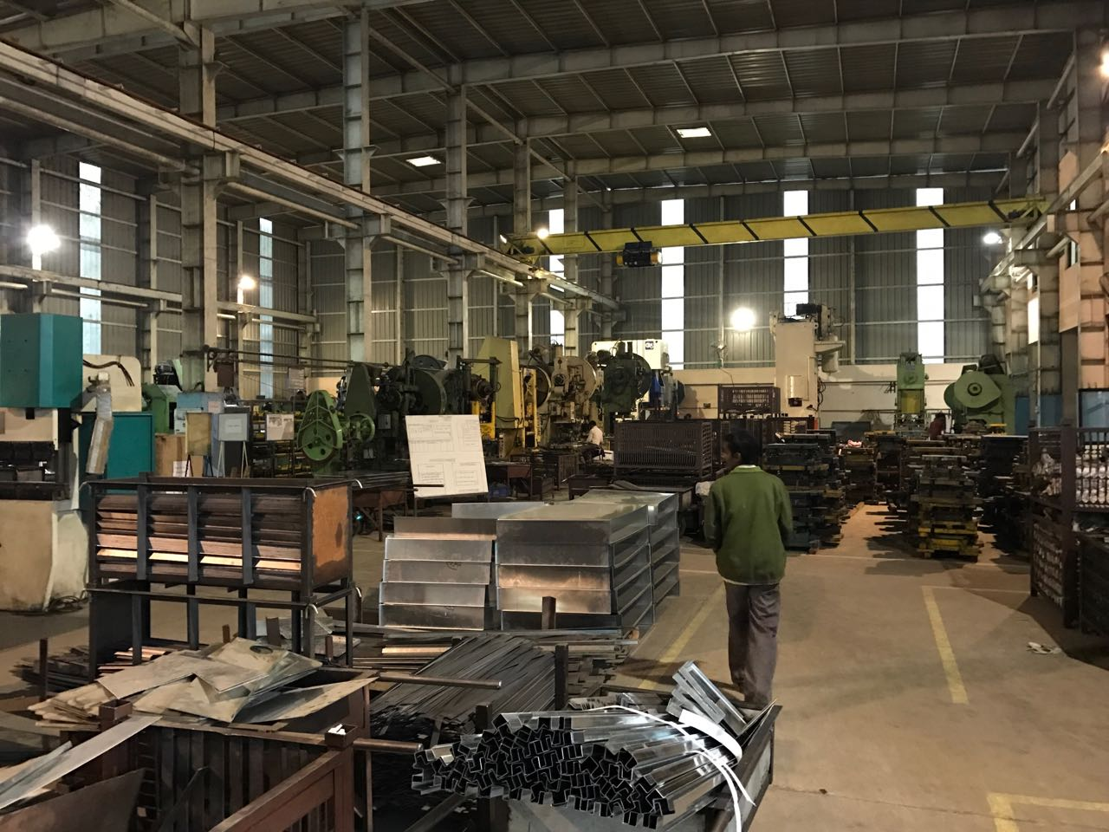
MPFC; Indore
M/s Galaxy Components Pvt. Ltd.
M/s Sadashiv Engineers P.Ltd

Slide 41
MPFC; Indore
M/s Prem Textiles (International) Pvt. Ltd.
M/S Prem Textiles (International) Pvt. Ltd. Company-a textile processing unit was incorporated in the year 2006 by Shri Subhash Jain with financial assistance from MPFC. PTIPL is 100% export oriented organisation running its manufacturing activity mainly at Indore and nearby Barwaha close to the proximity of cotton belt. It exports to Germany, Australia, USA, Italy, Sweden, Hongkong, Switzerland, Poland and also to worldwide companies like Disney, Wal-Mart.
The company is a composite textiles organisation in which entire manufacturing activities i.e. from cotton to yarn, sizing of yarn, dyeing, bleaching, printing and processing ,cutting stitching and export of made up articles are done in house. It has 100 projectile looms and machines with latest technology.
The unit is environment friendly and has reduced its consumption of coal. With the help of modern technology adopted by the plant, treatment of effluent water is carried out.

Slide 42
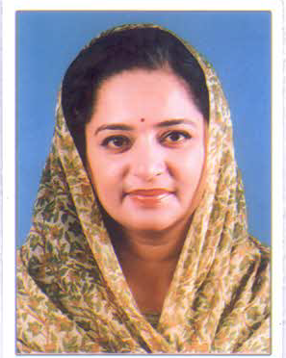
MPFC; Indore
M/s Aaron Hotels Private
Smt. Uma Devi Jadhav with her husband Shri Dhananjay Deorao Jadhav ,in February 2009 incorporated M/s Aaron Hotels Private to carry out the business of Hotels and Restaurants. The promoters belong to a royal family. They have a well maintained heritage ancestral building at Gwalior “ DEO BAGH” which they decided to convert into a heritage hotel . The building is around 100 years old and has heritage construction of Baradari and Dalaan. The company renovated the property with financial assistance from Madhya Pradesh Financial Corporation (MPFC). The property has 16 rooms with all the amenities. An agreement was entered into with M/s Neemrana Hotels Pvt. Ltd. to market and operate the hotel.
The “Deo Bagh” was classified as a “ Heritage Classic Hotel “ in the year 2016. Any new construction has been done to match the design of the old. This is one of the only two hotels in the Madhya Pradesh in heritage category. It is surrounded by orchards and is a verdant paradise in the middle of the city. In her interview with “HI BLITZ” Smt. Uma Devi said that “Civilisation is not just about creating new high rise buildings. It is equally about the way a particular society or people treat their ageing population and how they preserve their old buildings, traditions and heritage. We saw no other way to preserve this family heritage than to convert it into a lovely hotel. If we had not committed to this, the place would have got sold”.
Smt. Uma Devi Jadhav

Slide 43
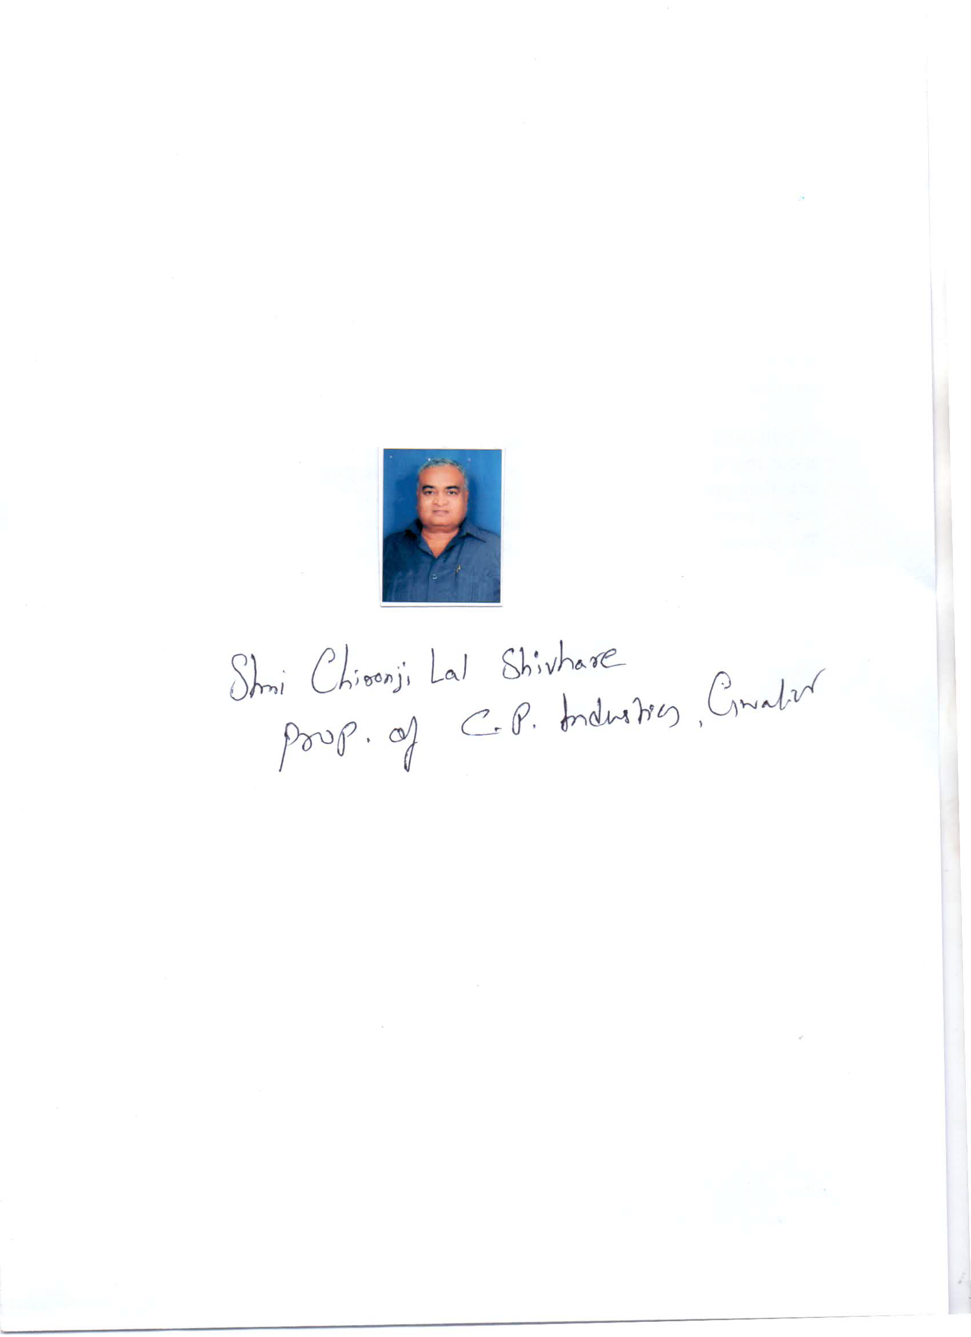
MPFC; Indore
M/s CP Industries
Shri Chironji Lal Shivhare aged 66 years is a successful industrialist. He started his career at the age of 10 by devoting time to the family business of Wheat Trade & at the age of 20 became an owner of two shops engaged in Wheat Trade activity. In 1971 he started an Oil Mill at Micro Level at Hazira, Gwalior. From 1974 to 1988 he worked as commission agent for grains (Mustard, Wheat etc.). In 1988 he started Oil Trade Business after getting adequate experience in Mustard & Oil Trade.
In the year 1990 he purchased a sick unit of MPFC situated in Industrial Area, Maharajpura, Gwalior and established an oil mill there. The unit was started with 1 Expeller. The products of the market got good response. For further expansion Madhya Pradesh Financial Corporation provided financial assistance. The loans were paid in time. The unit flourished & now 15 heavy duty oil expellers & 210 Kohlus. The unit has been awarded with ISI Mark. It has got a regular order from Adani Group for manufacturing the product under their brand name. The present turnover of the unit is approx. Rs.100.00 Crore.
Shri Chironji Lal Shivhare is involved in many philanthropic activities like distribution of free food to approx. 200 persons daily. He has also started an Old Age Home. In 2013 he got the ‘Entrepreneurs Excellence Award’ from Gwalior Management Association, Gwalior.
Shri Chironji Lal Shivhare

Slide 44
MPFC; Indore
M/s Meenesh Irrigation India Pvt. Ltd.
M/s Meenesh Irrigation India Private Limited was established by Shri Hari Singh Meena and his younger brother Shri M.K. Meena in the year 2012 with financial assistance from Madhya Pradesh Financial Corporation. This company traded in HDPE, PVC, LLDPE pipes , drip lines and Agriculture Inputs with sprinkler and new generation irrigation system.
In the year 2016 Meenesh Irrigation started manufacturing and marketing the best quality and highly advanced irrigation equipment, pipes and fittings with its own brand name OSHNIC which has received ISI Certification.
Shri Hari Singh Meena works hard to provide the highly innovative and best quality products to farmers as he always says “per drop more crops”. The turnover of the Company increased from Rs.2.14 crore in 2014-15 to Rs.5.23 crore in 2015-16. His future plans are to have a Pan India presence for his products.

Slide 45
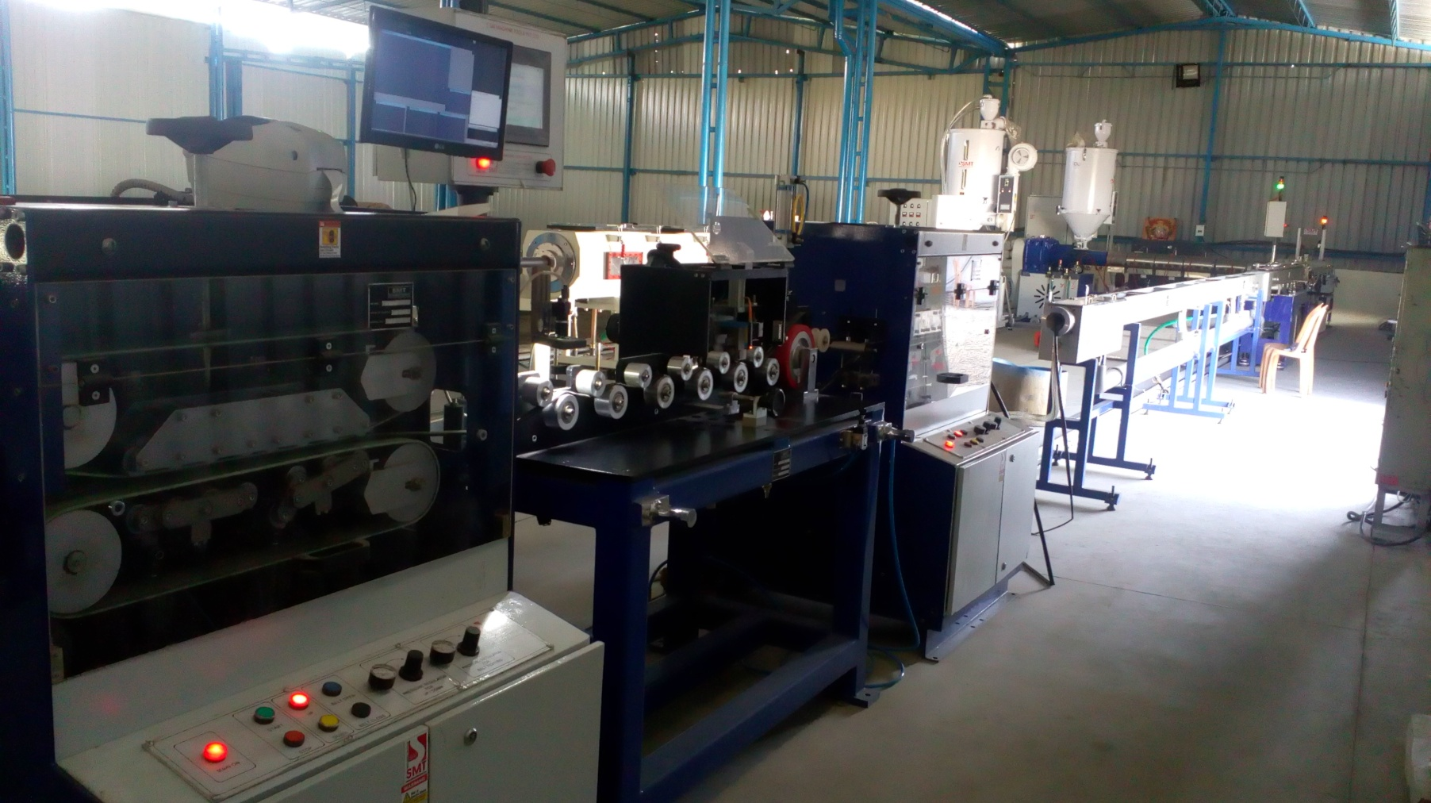
MPFC; Indore
M/s Meenesh Irrigation India Pvt. Ltd.

Slide 46
MPFC; Indore
M/s Shripaper Product Indore Pvt. Ltd.
M/s Shripaper Product Indore Pvt. Ltd. was incorporated by Shri Bhagwandas Patel and his partners in the year 2010 to manufacture Kraft Paper by recycle of waste with financial assistance of Rs. 10.00 crores from the Madhya Pradesh Financial Corporation. The project was implemented well on time and started its commercial production in the month of February 2013 with the installed capacity of 50TPD. It utilized 60% of its installed capacity in the first year of its operations. The company from the initial year of operation has posted profit and has achieved a turnover of Rs. 50.46 crore in the FY 2015-16. The product enjoys a good reputation in the market. The unit has recently expanded its capacity and doubled it to 36000 MT.

Slide 47
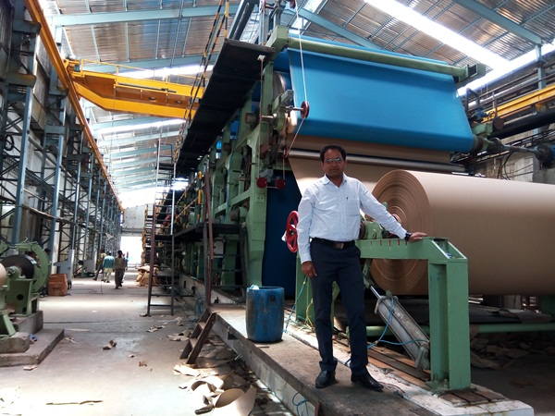
MPFC; Indore
M/s Shripaper Product Indore Pvt. Ltd.

Slide 48
MPFC; Indore
M/s Krishna Belts Pvt Ltd
Shri Deepak Himmatramka, established M/s Krishna Belts Pvt. Ltd. at Saunsar, Chindwara in the year 2008-09 with financial assistance of Rs. 750.00 lacs from the Madhya Pradesh Financial Corporation. The company is engaged in manufacture of conveyor belts of different dimensions. The belts are used in various large scale industries, public and private companies which are mostly engaged in mining, production of power, cement, fertilizers. The unit started its commercial production in the first half of 2009 and is running successfully. Within two years, it started exporting its products to Ghana, Australia and UK. The domestic buyers include M/s Bhilai Steel Plant, M/s Lafarge India Pvt. Ltd., M/s JSW Ispat Ltd., M/s ACB India Ltd. and M/s Ultratech Cement Ltd., etc.
The products enjoy a very good reputation. For expansion more loan amounting to Rs.9050.00 lacs was taken from MPFC. The unit is regular in its repayment to the Corporation.

Slide 49
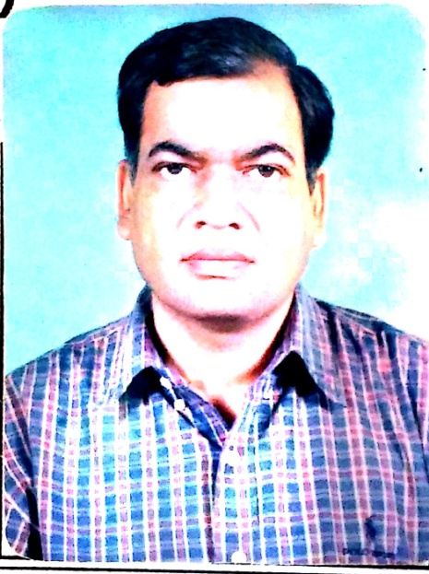
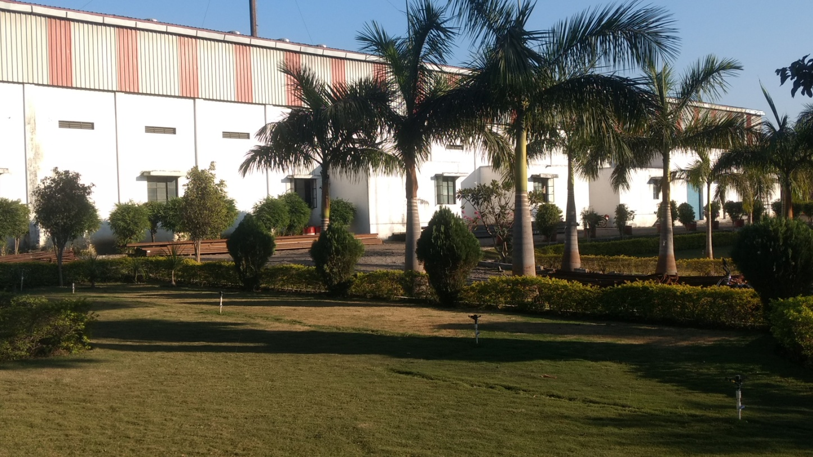
MPFC; Indore
M/s Krishna Belts Pvt Ltd
Shri Deepak Himmatramka,

Slide 50
MPFC; Indore
M/s Zazen Industries
Shri Prateek Jain a young first Generation entrepreneur established M/s Zazen Industries in 2012 for manufacture of Bottles/Jars at Rajgarh with financial assistance from Madhya Pradesh Financial Corporation.
The business grew steadily and he took an additional loan from MPFC in 2014. He then started a trading business for trade of household products like buckets, pipes, mugs, etc. By March 2016, the turnover of Zazen Industries was Rs. 65.00 lacs.
Now, Zazen Industries has 4 wholesale dealers and 110 buyers. The Unit also sells its products to other different states such as Chhattisgarh, U.P, Maharashtra, Kerala, Rajasthan.

Slide 51
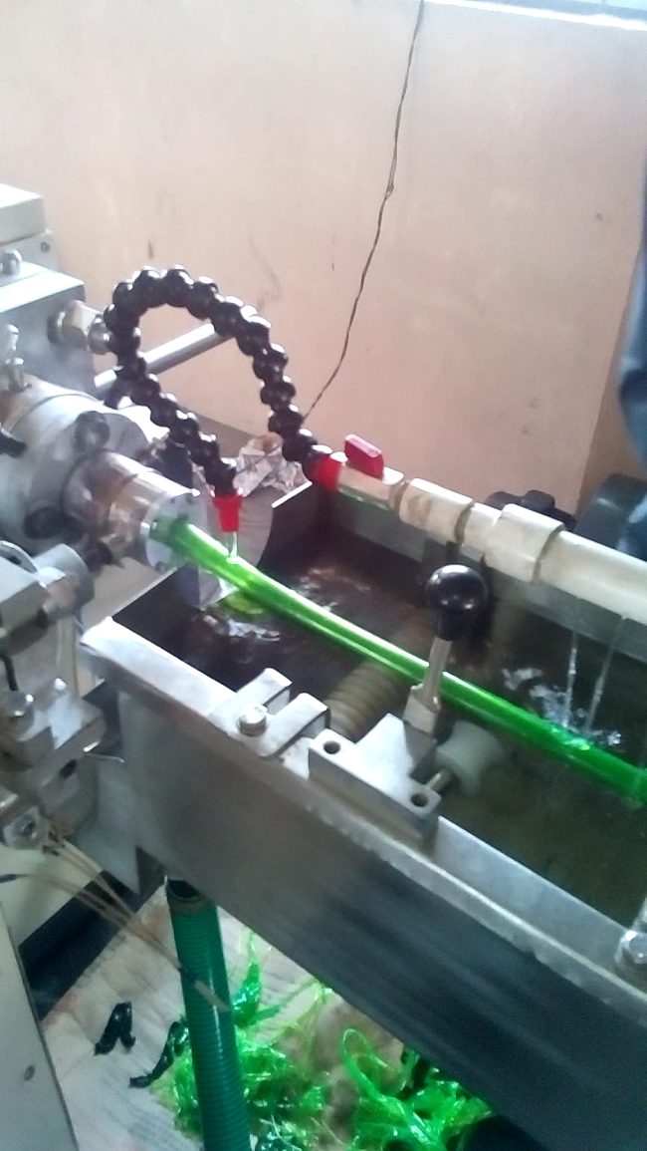
MPFC; Indore
M/s Zazen Industries

Slide 52
MPFC; Indore
M/s Simran Industries
Shri Dheeraj Goel, a first generation Entreprenuer set up M/s Simran Industries in the year 2014 with Partner Mr. Suresh Goel and Partner Mr. Dheeraj Goel with financial assistance from Madhya Pradesh Financial Corporation (MPFC). It manufactures Decorative Laminates and has had a good response from the market which is spread across the country.
M/s Simran Industries has become a name to be reckoned with for quality as well as timely delivery. It manufactures about 1,00,000 sheets/month and has achieved a turnover of around Rs.15cr in 2 years.

Slide 53
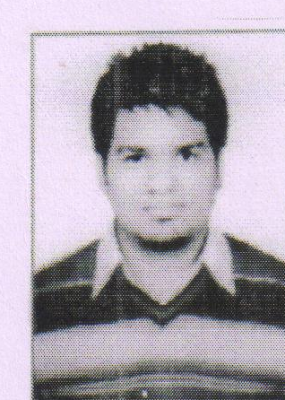
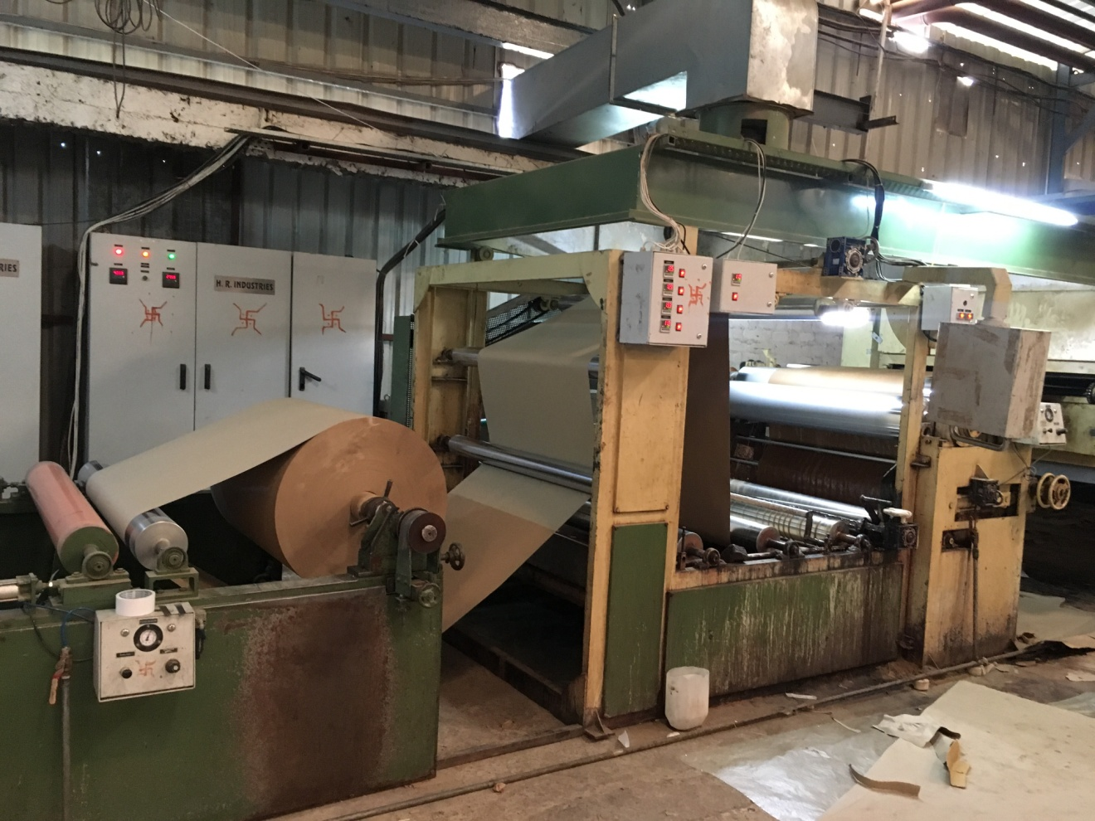
MPFC; Indore
M/s Simran Industries
Shri Dheeraj Goel

Slide 54
MPFC; Indore
M/s Kanchan Precisions Pvt. Ltd.
M/s Kanchan Precisions Pvt. Ltd., a Private Limited Company was incorporated in the year 1992 by Shri Rajesh Rath to manufacture automobile components with financial assistance from Madhya Pradesh Financial Corporation (MPFC). The unit is located Pithampur.
The company is doing job-work of machining for major automobile companies viz. M/s Avtec Ltd.; M/s Man Force Trucks Ltd. & M/s Mahindra 2 Wheelers Ltd.
This job requires high precision and accuracy in its dimensions and specifications. Presently, the company has 58 CNC Lathe machines and 21 VMC machines alongwith other equipment. Due to high demand, Shri Rath set up another machine tool shop viz Shri Sai Enterprises in Pithampur. The company is regular in its repayment schedule. The company has been awarded with Udyog Ratna from Central Government.

Slide 55
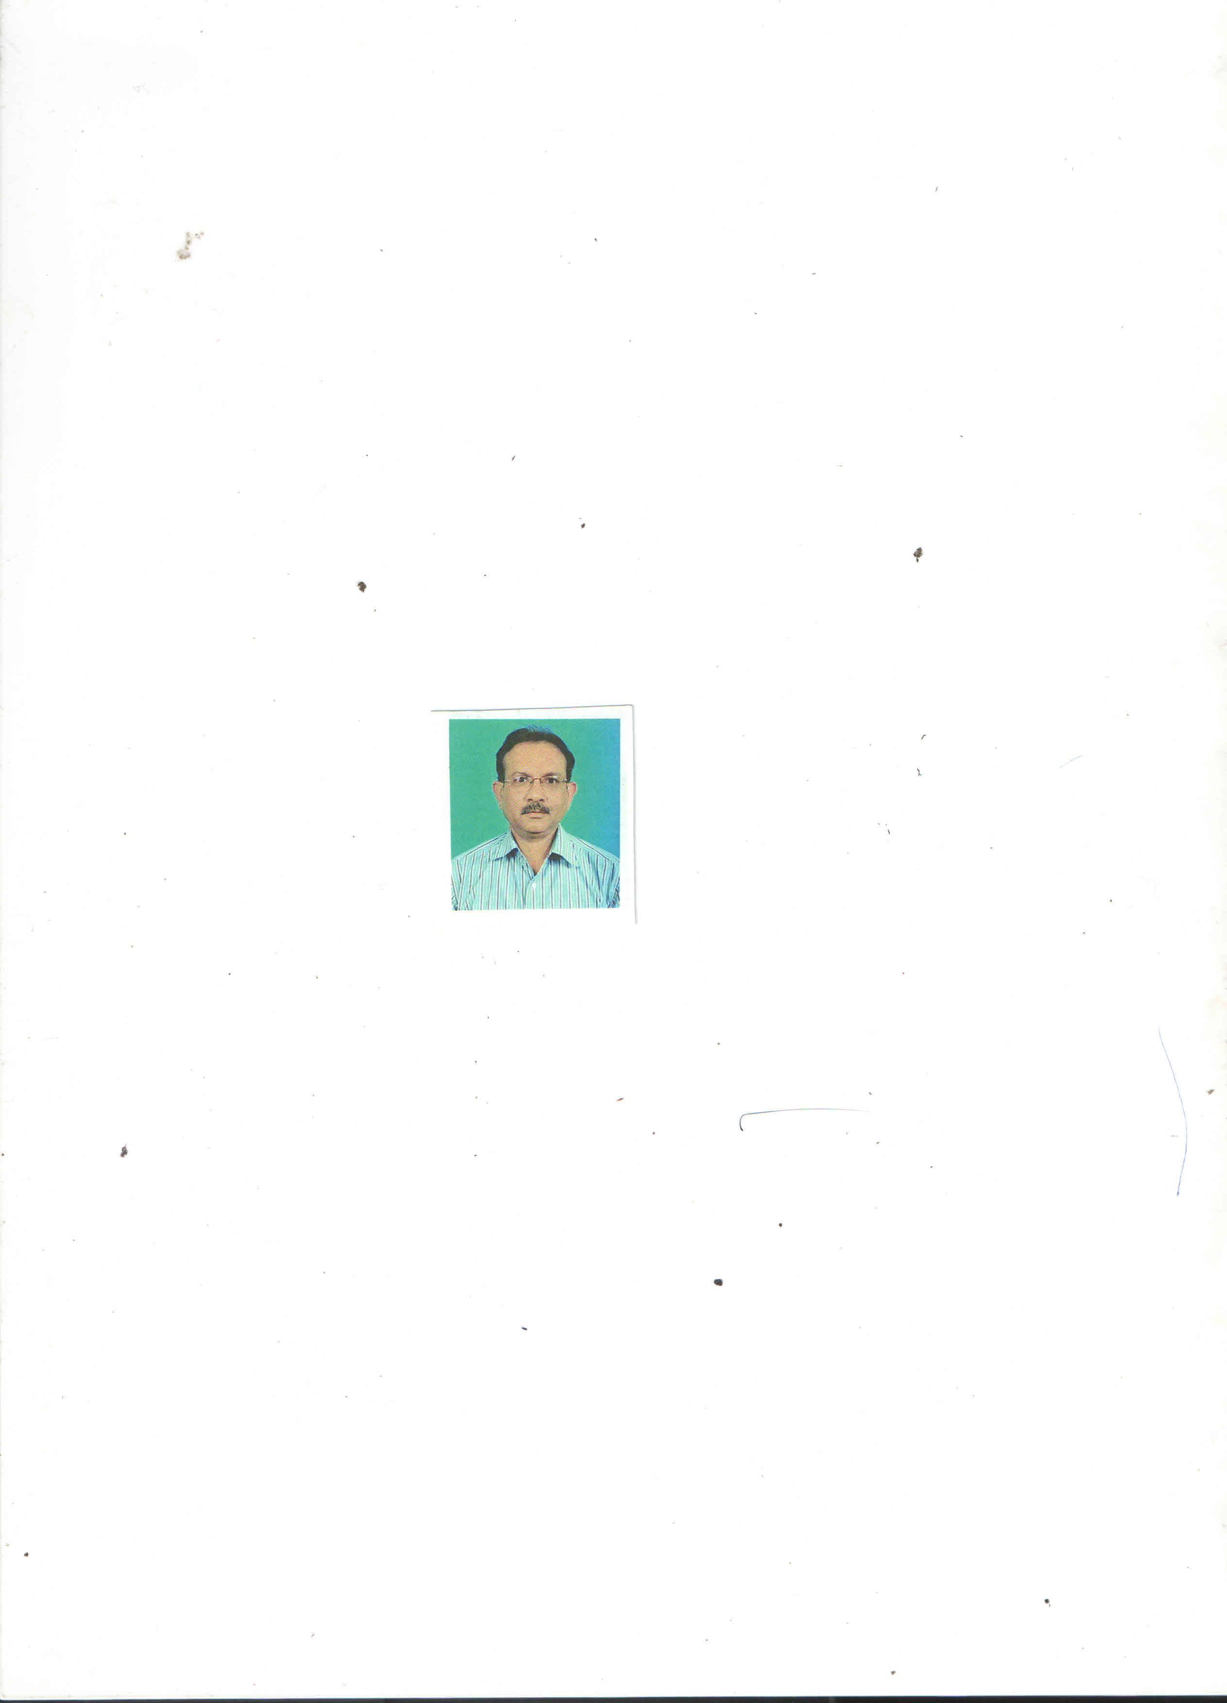
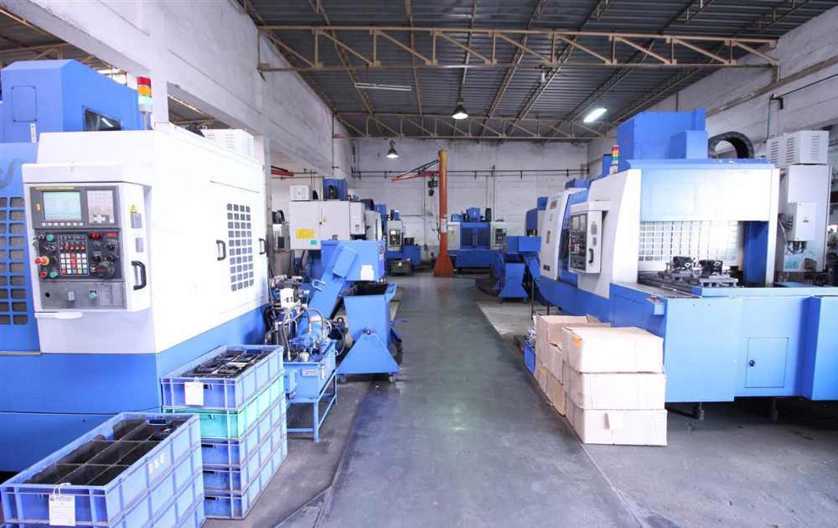
MPFC; Indore
M/s Kanchan Precisions Pvt. Ltd.
Shri Rajesh Rath

Slide 56
MPFC; Indore
M/s Manish Traders
Shri Manish Agrawal a first generation entrepreneur established M/s Manish Traders in the year 2000 to manufacture exercise and other note books. He established a comprehensive market in and around Mahakaushal region. With financial assistance under Small Loan Scheme in the year 2009 from Madhya Pradesh Financial Corporation he set up a printing business which has progressed tremendously. Later he expanded with further assistance from MPFC. The installed capacity has grown from 450 MT per annum to 1650 MT per annum. He prints Examination Answer Sheets for universities; Calenders printing & binding; Binding of School Books for govt. of MP; Binding of Railway Time Table for West Central Railway; Note Books and Graphs books.
The turnover of the unit has increased from Rs. 26.20 lacs in the year 2008 to Rs.3.36 crore in the year 2015-2016. Direct employment has been provided to 30 persons.

Slide 57
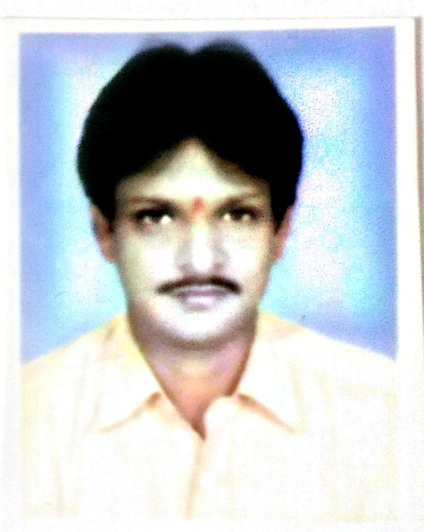
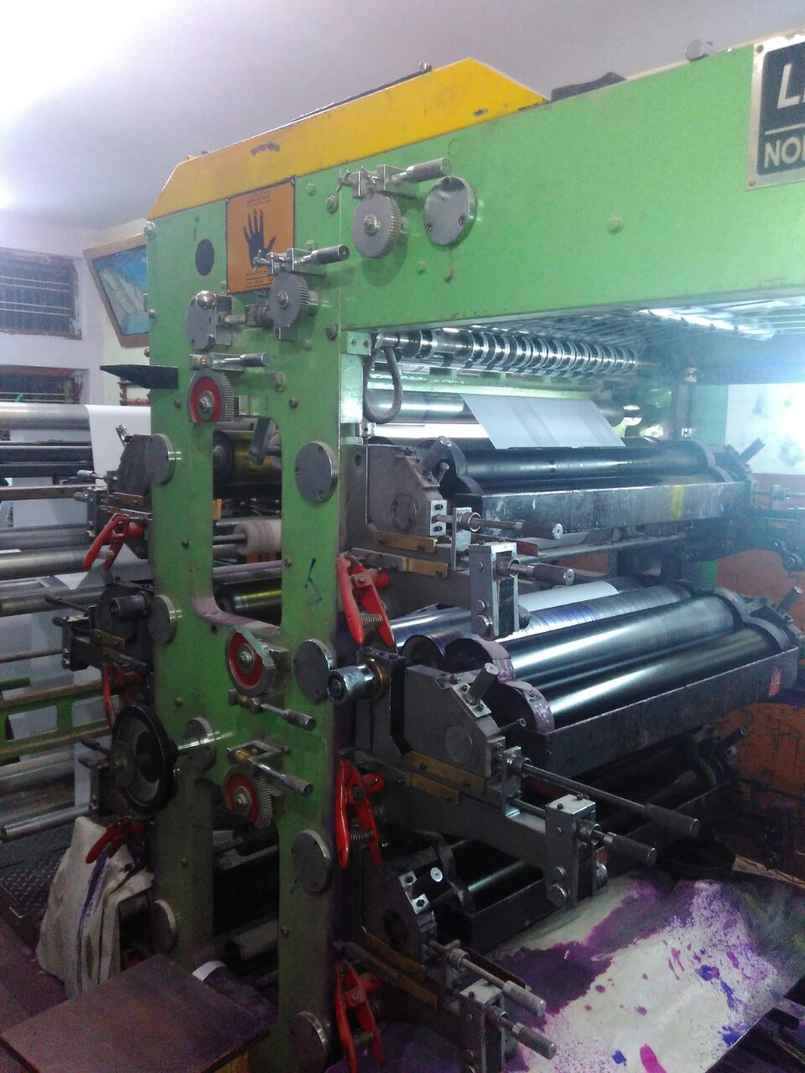
MPFC; Indore
M/s Manish Traders
Shri Manish Agrawal

Slide 58
MPFC; INDORE
M/s Camping Retreats of India Pvt. Ltd.
M/s Camping Retreats of India Pvt. Ltd. was promoted by Shri Gajendra Singh Rathore and Shri Surendra Singh Shekhawat in the year 2007 with financial assistance from MPFC. It runs Tiger Balloon Safaris and is authorized by DGCA (Directorate General of Civil Aviation) to carry out the activity of Hot Air Ballooning on a commercial basis.
The Company has successfully completed more than 5 years of commercial operations with more than 5,000 highly satisfied passengers who have carried back memories of a lifetime. The company’s primary base of operations is at Pench, Madhya Pradesh. However, it has been licensed to fly all over India. Its fleet of balloons have been approved and registered with the DGCA. Maintenance and operations of these are all done in-house.
M/s Camping Retreats of India Pvt. Ltd. has organized many Festivals for State Tourism Departments viz yearly Jal Mahostav festival at Hanwantya, Madhya Pradesh; Bhoj Festival, Bhopal, Madhya Pradesh; Rann Utsav, Gujarat; Taj Balloon Festival, Agra; Tamil Nadu International Balloon Festival, Pollachi; Hot Air Ballooning in Goa.

Slide 59


MPFC; Indore
M/s Camping Retreats of India Pvt. Ltd.
Shri Gajendra Singh Rathore

Slide 60
PIPDIC, Pondicherry
M/s Muthu Food Films
M/s Muthu Food Films was established by Shri V. Pethaperumal in Pondicherry with financial assistance from Pondicherry Industrial Promotion Development & Inv. Corp. Ltd. (PIPDIC) and is one of their good borrowers for the past 18 years. The unit manufactures Polythene Films which are used for packaging food products such has Milk, Oil, Spices, finds application in agriculture as mulch film and greenhouse films. It is also widely used to manufacture Tarpaulins for Trucks and for Human Shelters.
Shri Pethaperumal is also actively involved in social work. He supports mass movements to create awareness amongst Women & Youth; support of environment friendly programs/Industries; promotion of Self-Help Groups (SHGs) for women; and support of entrepreneurship development programs to generate employment in private sector and small and medium enterprises (SMEs).

Slide 61


PIPDIC, Pondicherry
M/s Muthu Food Films
Shri V. Pethaperumal

Slide 62
PIPDIC, Pondicherry
M/s Vcare Pharcos
A first generation woman entrepreneur, Mrs. E Carolin Praba is the Founder & Chairman of VCARE group and is the first Trichologist of South India. She established the unit with financial assistance from PIPDIC on land also developed by PIPDIC. Subsequently the company is being given merit loans for further development and diversification. She has done her Certification in Trichology from International association of Trichologists, Australia and became the 6th successful trichologist of India &1st Woman Trichologist of India. She started Praba’s V Care Health Clinic Pvt. Ltd. in the year 2004, first in Chennai for providing treatment for major hair related problems.
The group has established a state of art manufacturing facility “VCARE PHARCOS” at Pondicherry in the year 2008.In 2009 she established V Care Herbal Concepts Pvt Ltd., the marketing & Distribution division of Vcare Products like Vcare Shampoo Hair Color, Vcare Shikkakai paste, Vcare Herbal Hair oil, VCare gold soap etc.,
Mrs. Praba has co-authored two international presentations on “Asian Hair Disorders” & “Hyper pigmentation” presented at 11th Asian Societies of Cosmetic Scientists Conference at Bali, Indonesia. VCare has focused on the Training and development of its employees’ skills, knowledge and attitudes with a view to enhance organisational effectiveness. VCare has been conferred with ISO 9001: 2015, GMP (Good Manufacturing practice) and ISO 9001: 22716 certifications.
The company has been conferred with “International Quality Summit Award” by Business Initiatives Directions, Spain. The Star Group conferred “Women Entrepreneur Achievers Award” on her. CSR activities include Ms. Reddy’s establishment of charitable trust called “Vcare Health & Education Trust” and an Old Age home at Pattur, Tamilnadu& Educational Trust in the name of Vcare Health Education Propagation & Development Trust.

Slide 63


PIPDIC, Pondicherry
M/s Vcare Pharcos
Mrs. E Carolin Praba

Slide 64
PIPDIC, Pondicherry
M/s Chemin Controls & Instrumentation P. Ltd.
Shri R. Ragu is the Executive Director of M/s Chemin Controls & Instrumentation Pvt. Ltd., an organization offering expert services in the field of Control & Instrumentation which has been established on land developed by PIPDIC, Pondicherry. He joined Chemin C & I in the year 2002. Currently the company has a turnover of Rs.30 crores and target for the year 2016-2017 is Rs.80 crores. With a vision to reach Rs.100 crores turnover within the next five years, Shri Ragu has started two new Divisions in the company: 1) Chemin Solar & Infrastructure division focusing mainly on pre-engineered, pre-fabricated and dismantlable houses, Site Offices, Kiosks, Laboratories etc. with or without solar power; and 2) Automation division which has tied up with Yokogawa for their products as channel partner and with Rockwell automation as their system integrator. The unit is also exporting its products and services. Shri Ragu is passionate about creating and developing his unit as environment friendly.
Chemin C & I is an ISO 9001:2008, EMS 14001:2004 & OHSAS 18001:2007 certified company and is a recipient of many awards. Its CSR activities include manufacture of pre-engineered and pre-fabricated toilet blocks and their installation in about 60 Schools in Bihar State as a support to NTPC’s CSR activities; development of a Green Belt Area in the Industrial Estate; Rain water harvesting implemented in 4 locations in the country.

Slide 65


PIPDIC, Pondicherry
M/s Chemin Controls & Instrumentation P. Ltd.
Shri Rangaraj Ragu

Slide 66
RFC; Jaipur
M/s C&I Callibrations Pvt. Ltd.
Shri Ashok Patni established a small scale unit M/s C&I Callibrations Pvt. Ltd. at Kota in the year 1999 with Micro Investment and Finance from Rajsthan Financial Corporation. The unit was set up for Testing and Calibration of instruments of “Electro-Technical, Mechanical, Fluid Flow, Thermal Fields.” M/s C&I Callibrations Pvt. Ltd. got approval from NABL (National Physical Laboratory), New Delhi for accredition in the year 2000 and is accredited with as NABL ISO/IEC : 17025-2005 certification. Its Calibration & Testing Laboratory is ISO 9001 certified.
The unit has gained good reputation all over the country and has approx 1000 clients in Rajasthan, Madhya Pradesh, Gujarat, Haryana, Punjab, and Maharashtra for ‘on-site’ Testing of Instruments. Its turnover in the Financial Year 2015-16 was Rs.344.58 Lacs. Shri Patni has recently been conferred with Dr. APJ Abdul Kalam Gold Medal Award 2016.
Shri Patni has published many papers related to environment conservation:- Sustainable Management and Conservation of Water Resources; Novel Treatment Process for Dyeing Industries Waste Water and Recycling; A Green Approach to Treat Effluents; and has published a patent on –- A Process for treating dye house waste water for reclamation and reuse.

Slide 67


RFC; Jaipur
M/s C&I Callibrations Pvt. Ltd.
Shri Ashok Patni

Slide 68

RFC, Jaipur
M/s Shakti Scouring & Milling Mills
Shri Shanti Lal Bothra set up M/s Shakti Scouring & Milling Mills in the year 1981 in Bikaner with financial assistance from RFC, Jaipur. The unit is engaged in the activity of Manufacturing and Processing Carpet Woollen yarn. Shri Bothra has been nominated by the State Government as “Member of the District Industrial Advisory Committee, Bikaner”. He is also the founder of SRM Bothra Girls College which was set up in the year 2006. Shri Bothra was honoured by Bikaner Municipal Corporation on Republic Day 2017 for his outstanding social work.
Shri Shanti Lal Bothra

Slide 69
TIIC, Chennai
M/s Hameed Marine Pvt Ltd
M/s Hameed Marine Pvt Ltd was incorporated by Shri Haji. M. Shahul Hameed with financial assistance from TIIC in the year 2014. The unit produces steam sterilized fish meal, fish oil and fish soluble from its modern and fully mechanized plant situated in Radhapuram, Tamilnadu and has a turnover of Rs.78 Crores.
The fish meal and fish soluble which have up to 70 % protein content is used for aqua feed, poultry feed, pet feed and animal feed. Fish Oil is used for human consumption which contains two of the most important omega 3 fatty acids that can be absorbed easily and help in solving heart related problems. Fish oil is also used for soap manufacture in leather tannery industry & Paint industry globally.
The unit’s clients include C.P Aqua Culture India (Thailand based company); Mukka Sea Foods; Blue Line Foods Industries (p) Ltd (Manufacture & Exporters) and Bawa Fish Meal & Oil Company

Slide 70


TIIC, Chennai
M/s Hameed Marine Pvt Ltd
Shri Haji. M. Shahul Hameed

Slide 71
TIIC, Chennai
M/s Guru Scans
Dr. S. Ismail Chelladurai, a first generation entrepreneur, established Guru Scans in Nagercoil, Tamilnadu in the year 1983 with Financial Assistance from TIIC. The unit is engaged in providing high quality diagnostic radiology like Advanced Multislice Computed Tomography (CT); Ultrasonography; Colour Doppler Scans etc.. It has been registered as partnership firm in the year 2012 with partners (1) Dr. S. Ismail chelladurai (2) Dr. I. Prem Solomon and (3) Mrs. Malar Chelladurai.
M/s Guru Scans has lately obtained assistance from TIIC of Rs. 1.15 crore for advanced equipment. Its yearly turnover is around Rs. 2.00 crore. The unit is prompt in its repayment.

Slide 72


TIIC, Chennai
M/s Guru Scans
Dr. S. Ismail Chelladurai

Slide 73
TIIC, Chennai
M/s Advance Fine Materials
Shri S. J. Shankar, established M/s Advance Fine Materials in the year 2014 with financial assistance from TIIC, Chennai. The unit is engaged in the manufacture of Metal Powder. Further expansion was undertaken during the year 2015. The sales turnover during the first half of this year is Rs.1.17 crore and is expected to be around Rs.3.15 crore by year end.
The unit has export orders of Rs.4.50 crores out of which orders worth Rs.2.50 crore have already been executed. Export sales are around 75% of the total turnover. The future plans are to increase the turnover to Rs.12 crore in the next 2 years.

Slide 74

TIIC, Chennai
M/s Advance Fine Materials

Slide 75
TIIC, Chennai
M/s Genau Extrusions Ltd.,
M/s Genau Extrusions Limited, established in the year 1995 by Shri A.K. Venkatasamy, manufactures near net shape or net shape components using Cold Forming/ Extrusion technology. It is located in Hosur, Tamilnadu.
The Company is associated with TIIC since the year 2007and the account is classified under standard category. It is an ISO/TS16949:2009 certified company. The unit recorded a sales turnover of Rs.42 crore in the year 2015-2016. Exports are 15% of the total turnover.
The unit has already received Best in Class Certificate for Excellence in Performance for Quality, Cost and Logistics: 2001-2002 by Motor Industries Co. Ltd. Its future plans are to reach a turnover of Rs.60 crore by the end of Financial Year 2016-2017.

Slide 76




TIIC, Chennai
M/s Genau Extrusions Ltd.,
Shri A.K. Venkatasamy

Slide 77
WBFC, Kolkata
M/s Chemtreat Technologies
M/s Chemtreat Technologies was established in the year 2001 by Dr. Dipankar Sen, with Financial Assistance from WBFC. M/s Chemtreat Technologies is one of the leading manufacturers, exporters, suppliers of electroplating chemicals, powder coating pretreatment chemicals, galvanizing chemicals, anodizing chemicals, steel plant chemicals and refractory chemicals. Under the guidance of Dr. Sen, the organization is now being managed by a dedicated team of young and experienced professionals with zeal and commitment to customer satisfaction and a pragmatic approach to marketing.
M/s Chemtreat Technologies is also exporting its technology & products to Bangladesh and Nepal. Their buyers are automobile ancillaries, cycle industries, garment industries, wire galvanizing units, steel plants, defense workshops and Indian railway workshops. The unit is regular in its repayment schedule. Its turnover is expected to be Rs.2.00 crore for the year 2016-17.

Slide 78


WBFC, Kolkata
M/s Chemtreat Technologies
Dr. Dipankar Sen

Slide 79
WBFC; Kolkata
ATCIS Technology Pvt. Ltd.
Shri Tutul Chowdhury, promoted M/s ATCIS in the year 2011 with financial assistance from West Bengal Financial Corporation (WBFC). The Company availed of term loan of Rs.480.00 Lakh from WBFC and started a call centre in Kolkata in the year 2014. The company has been running satisfactorily and growing steadily. The company subsequently expanded its activities in other premium business areas like Hyderabad and Bangaluru. The company has good repayment record. Its clientele include reputed houses like Reliance Communications, ABP Weddings, Cleartrip.com etc.

Slide 80



WBFC; Kolkata
ATCIS Technology Pvt. Ltd.
Shri Tutul Chowdhury

Slide 81
WBFC; Kolkata
M/s Prayas
M/S Prayas, a partnership firm established by Smt. Chirashree Chakraborty in the year 2016 with financial assistance from West Bengal Financial Corporation (WBFC) to manufacture paper cups. The products are sold both in the local market as well as other cities like Tatanagar, Patna, Hazipur etc. Smt Chakraborty is now thinking of undertaking an expansion programme to meet the growing demand of her products in the market. She is being awarded under the Best Women Entrepreneur category.

Slide 82


WBFC; Kolkata
M/s Prayas
Smt. Chirashree Chakraborty

Slide 83
WBFC; Kolkata
M/s Modern Inns Pvt. Ltd.
M/s Modern Inns Pvt. Ltd. was incorporated by Shri Tejinder Singh Saini with Financial Assistance from West Bengal Financial Corporation (WBFC) to setup a star category hotel in the heart of City of Kolkata. The company implemented the project successfully and started operations under the name of ‘Auris’ in October’2015. The hotel has 55 guest rooms including 8 luxury suites; convention and banquet halls, roof top swimming pool etc. and enjoys a good reputation in the market. The company is regular in its repayment record.

Slide 84


WBFC; Kolkata
M/s Modern Inns Pvt. Ltd.
Shri Tejinder Singh Saini

Slide 85
THANK YOU

