Slide 1


PIPDIC in collaboration with COSIDICI presents
National Award Function – 2021 for
“Outstanding Entrepreneurs”
Funded By State Level Financial Institutions
(On September 06, 2021 At 6.00 p.m. Hotel The Ashok Beach Resort, Puducherry)

Slide 2
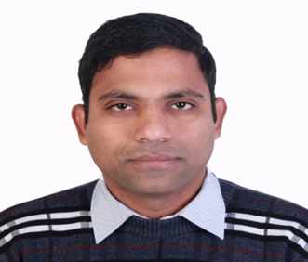
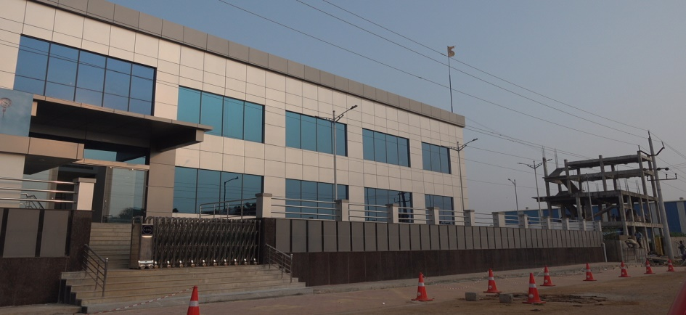
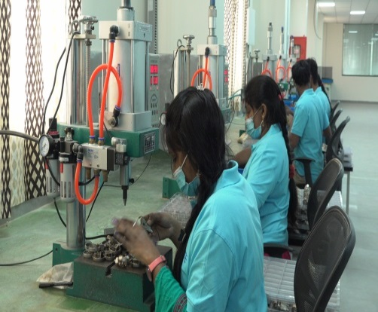
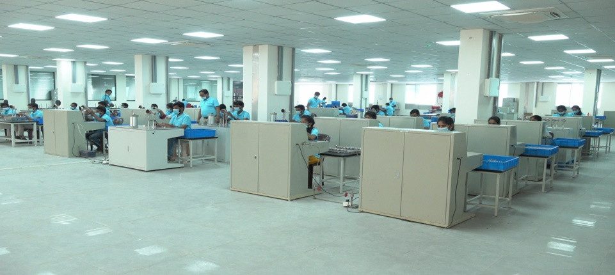
Andhra Pradesh State Financial Corporation {APSFC}, Vijayawada
M/s Elite Instruments
Shri Danda Suryanarayana Reddy

Slide 3
Andhra Pradesh State Financial Corporation {APSFC}, Vijayawada
M/s Elite Instruments
Shri Danda Suryanarayana Reddy established M/s Elite Instruments as a partnership firm with financial assistance from APSFC in Kakinada (AP) in the year 2017 to manufacture Pressure Guages. It is one of the largest facilities in India. The unit exports products to USA / Mexico / UAE / Europe. The promoter established good repayment track record and is being honoured with the “Best Exporting Unit Award”.

Slide 4
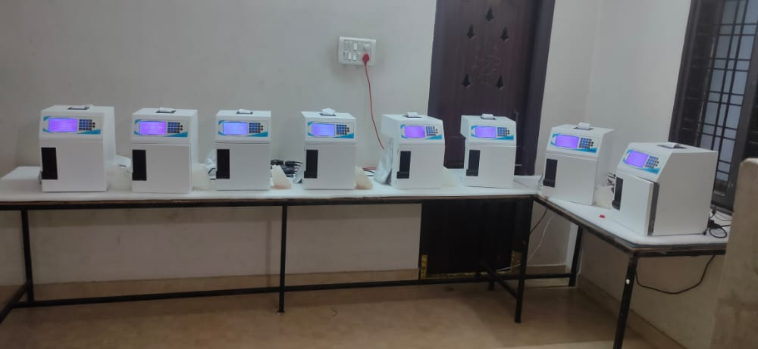
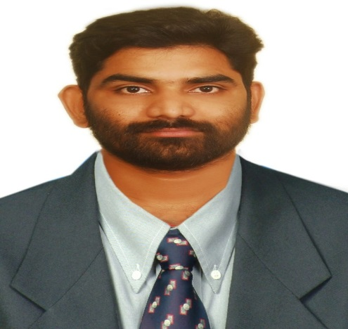
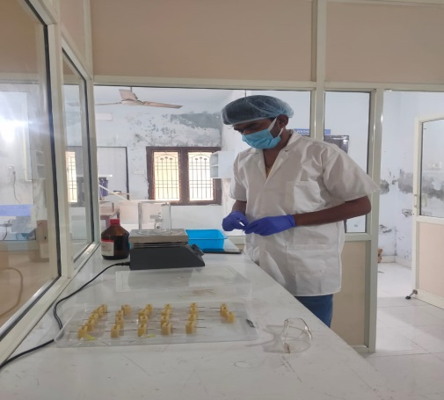
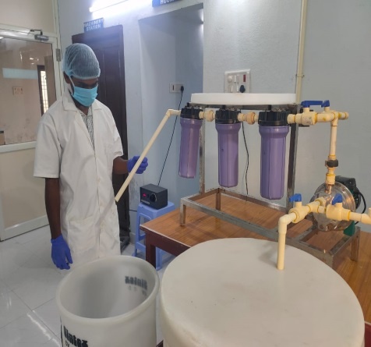
Andhra Pradesh State Financial Corporation {APSFC}, Vijayawada
M/s Labnova Healthcare & Diagnostic Products
Shri Suribabu Tirumalasetti

Slide 5
Andhra Pradesh State Financial Corporation {APSFC}, Vijayawada
M/s Labnova Healthcare & Diagnostic Products
Shri Suribabu Tirumalasetti set up M/s Labnova Healthcare & Diagnostic Products as a proprietary concern with financial assistance from APSFC to manufacture Invitro Diagnostic Analyzers and Reagent kits at Kakinada. The promoter had initially approached different banks but could not get any funding. It is a matter of pride APSFC encouraged him with both Term Loan and Working Capital. The Corporation extended further financial assistance as the unit has become successful bidder to supply the required medical equipment to Covid-19 Hospitals which were setup by Govt. of AP. The unit commenced commercial operations in Dec 2019 at Kakinada Town. The promoter established excellent repayment track record. Recently the unit was allotted land in APIIC Industrial park, Peddapuram near Kakinada and the promoter is proposing to set up a State of the Art building as per USFDA regulations there. He has been nominated for introducing the most innovative product.

Slide 6
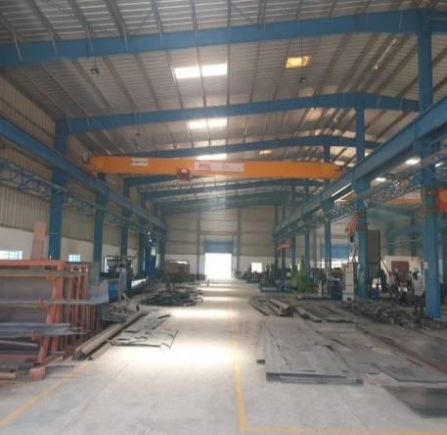
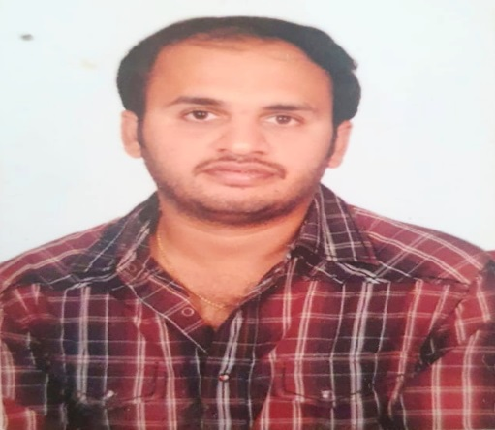
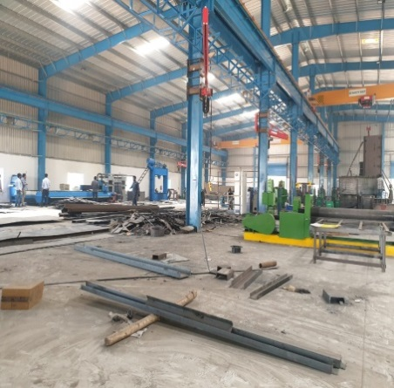
Andhra Pradesh State Financial Corporation {APSFC}, Vijayawada
M/s Sri Sahasra Industries
Shri Kalyan Damera

Slide 7
Andhra Pradesh State Financial Corporation {APSFC}, Vijayawada
M/s Sri Sahasra Industries
Shri Kalyan Damera established M/s. Sri Sahasra Industries as a partnership firm in the year 2019 to manufacture MXE & KXE type industrial blower fans with financial assistance from APSFC and with a capacity of making 4200 blowers per annum. The blower fans are extensively used in Cement Industries, Chemical Industries etc. He studied B.Tech (Mechanical) and Masters in Mechanical Engineering from Stafforshire University, England, UK and has work experience in Kusalava International Limited as a production in-charge. The firm has entered into a contract agreement with M/s.Reitz India Limited, Hyderabad for supply of Blower Fans for the next 10 years with an average supply value of Rs.200.00 lakhs per month.

Slide 8
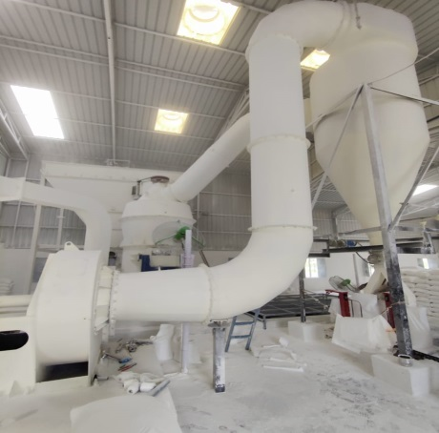
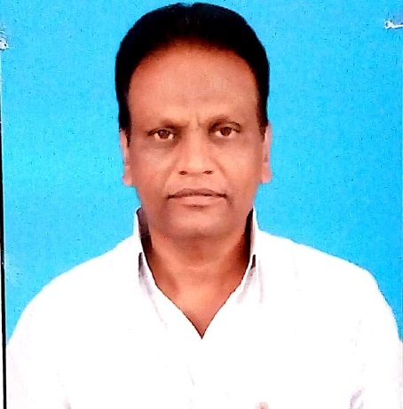
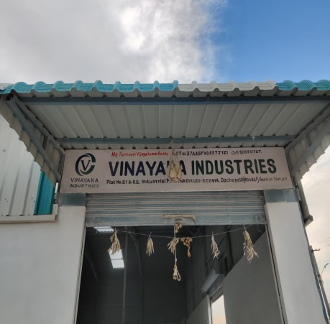
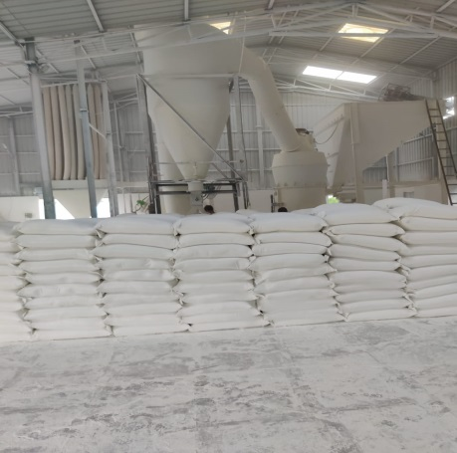
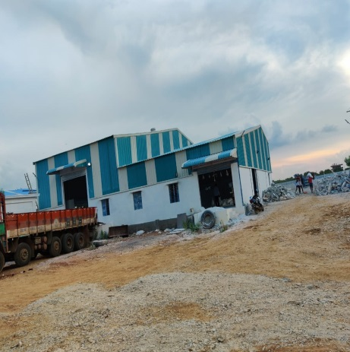
Andhra Pradesh State Financial Corporation {APSFC}, Vijayawada
M/s Vinayaka Industries
Shri Burri Vijaya Kumar

Slide 9
Andhra Pradesh State Financial Corporation {APSFC}, Vijayawada
M/s Vinayaka Industries
Sri Burri Vijaya Kumar established M/s. Vinayaka Industries as a Partnership Firm in Guntur District, AP and commenced operations in March 2020 and is operating successfully. The unit was sanctioned term loan from APSFC to set up a Mineral Pulverizing Unit.

Slide 10
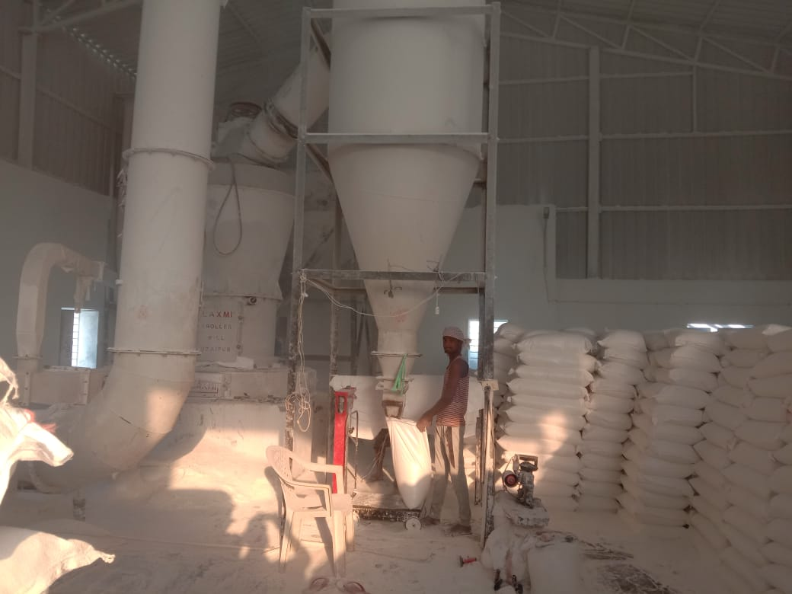
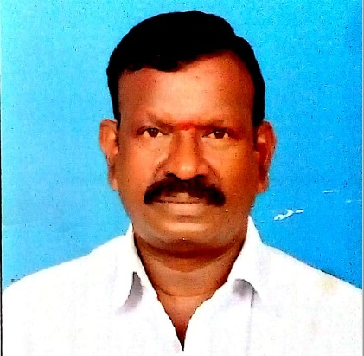
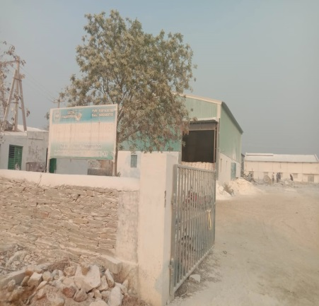
Andhra Pradesh State Financial Corporation {APSFC}, Vijayawada
M/s Palem Micro Mineral Industries
Sri Pallapu Venkateswara Rao

Slide 11
Andhra Pradesh State Financial Corporation {APSFC}, Vijayawada
M/s Palem Micro Mineral Industries
M/s. Palem Micro Mineral Industries was established by Shri Pallapu Venkateswara Rao as a partnership firm in Guntur District (AP). The unit was sanctioned term loan from APSFC to set up a Mineral Pulverizing Unit. The firm commenced the operations of the unit during August, 2020 and is operating successfully. Shri Pallapu Venkateswara Rao is being conferred with the “Best Entrepreneur” Award.

Slide 12
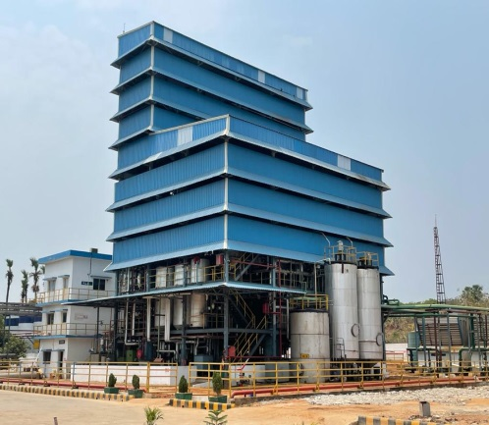
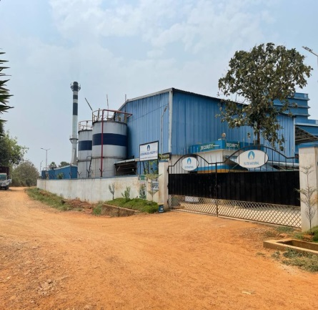
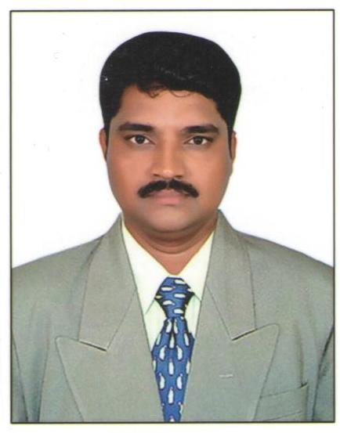
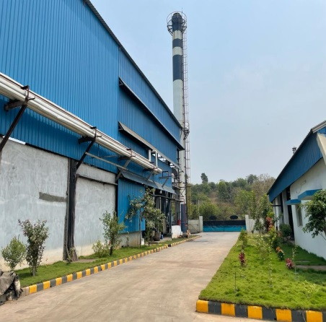
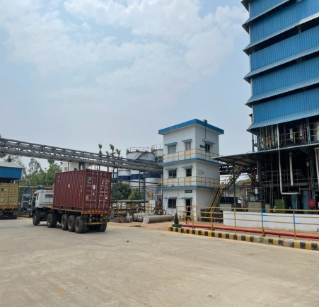
Andhra Pradesh State Financial Corporation {APSFC}, Vijayawada
M/s Elite Natural Oils and Fuels Private Ltd.
Shri Thota. Subrahmanyam

Slide 13
Andhra Pradesh State Financial Corporation {APSFC}, Vijayawada
M/s Elite Natural Oils and Fuels Private Ltd.
Shri Thota. Subrahmanyam established M/s Elite Natural Oils and Fuels Private Limited in East Godavari Dist. In AP with financial assistance from APSFC in the year 2016. The promoter has experience in the manufacture of bio diesel as he worked with M/s Reliance Industries Ltd., Bio fuels Division, Kakinada. During 2013 he visited Belgium, Netherland and Paris to learn bio diesel purification process. APSFC had sanctioned him a term loan when no banker came forward for establishment of Bio-Diesel/Glycerin plant as the promoters did not have a strong background. The company supplies Biodiesel/Glycerin to various customers all over India.
During FY 2019-20 the unit registered a turnover of Rs.75 crores and is growing year on year. The promoter has established excellent repayment track record. Now the company is in the process of diversifying into Edible oil processing. Shri Thota. Subrahmanyam has been conferred with “Best Entrepreneur award”.

Slide 14
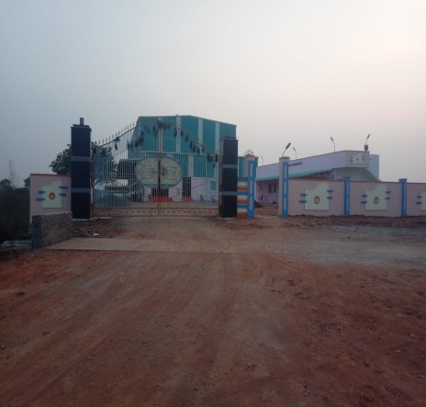
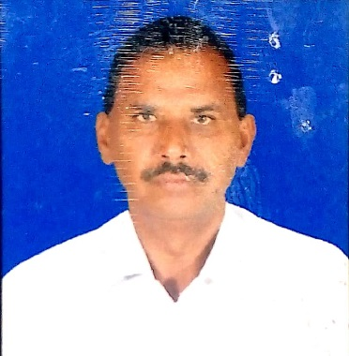
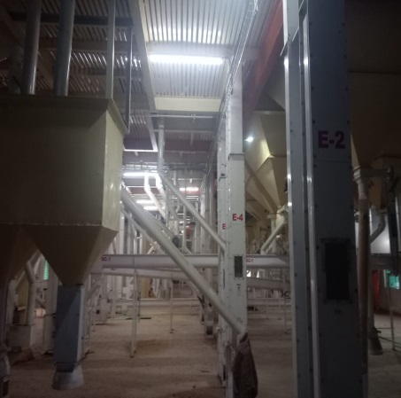
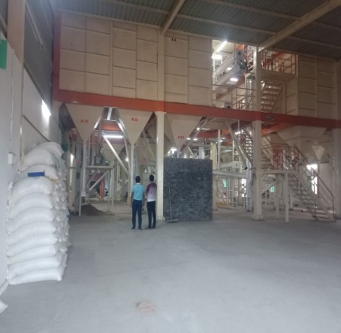
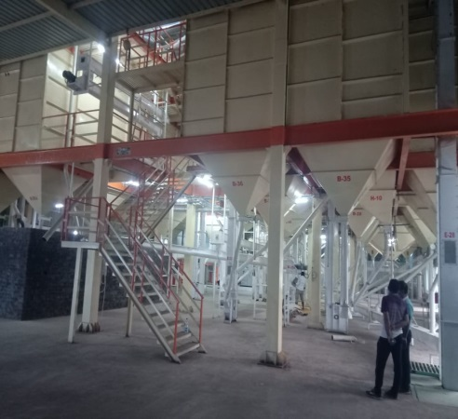
Andhra Pradesh State Financial Corporation {APSFC}, Vijayawada
M/s Sai Hanuman Dall Industries

Slide 15
Andhra Pradesh State Financial Corporation {APSFC}, Vijayawada
M/s Sai Hanuma Dall Industries
M/s. Sai Hanuman Dall Industries was established as a partnership firm by Shri M. Ramalakshmaiah and Sri Y. Gopala Rao along with four other partners. The unit is located in Guntur District, AP. The unit was sanctioned term from APSFC to set up a Dall Milling Unit and commenced its operations in October 2020 and is operating successfully.

Slide 16
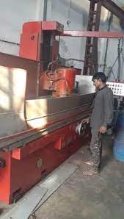
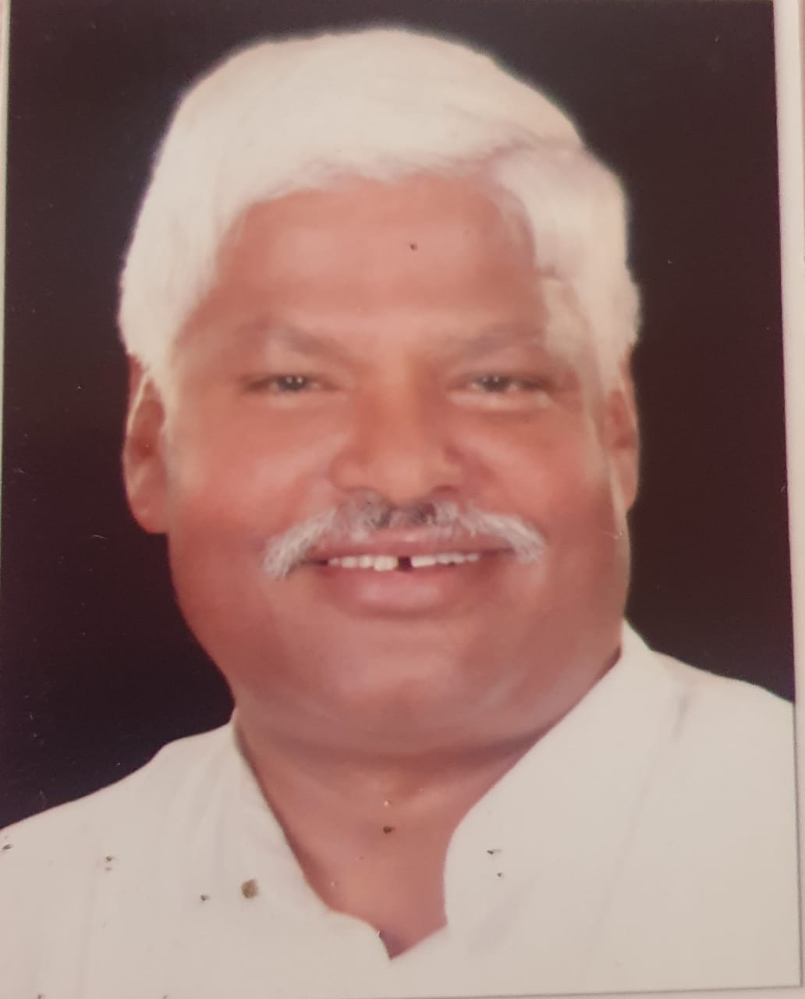
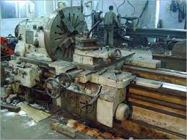
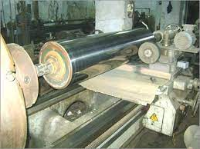
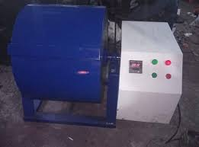
Delhi Financial Corporation {DFC}, New Delhi
M/s India Hardchrome
Shri Mahabal Mishra

Slide 17
Delhi Financial Corporation {DFC}, New Delhi
M/s India Hardchrome
M/s India Hardchrome was established in the year 1990 with financial assistance from Delhi Financial Corporation and achieved consistent growth under the strict supervision of Mr. Mahabal Mishra. It undertakes several services such as Electroplating, Hard Chrome Plating, Machining, Grinding, Gas Nitriding. Hard Chrome Plating is used to reduce friction, improve durability through abrasion tolerance and wear resistance. Many advanced processes, effective use of latest technology and machine upgradation in production system help the unit to provide high quality of services. The unit has the capability to Hard Chrome plate Cast Iron, Stainless Steel, Hardened Steel and Copper. The high quality service provided by the unit is due to its qualified and dedicated team of engineers, designers, technicians, etc. Regular training sessions are given to the workers for upgradation of their skills. The quality control analysts have been appointed to check quality of the products. Third party inspection for quality checks is also done.

Slide 18
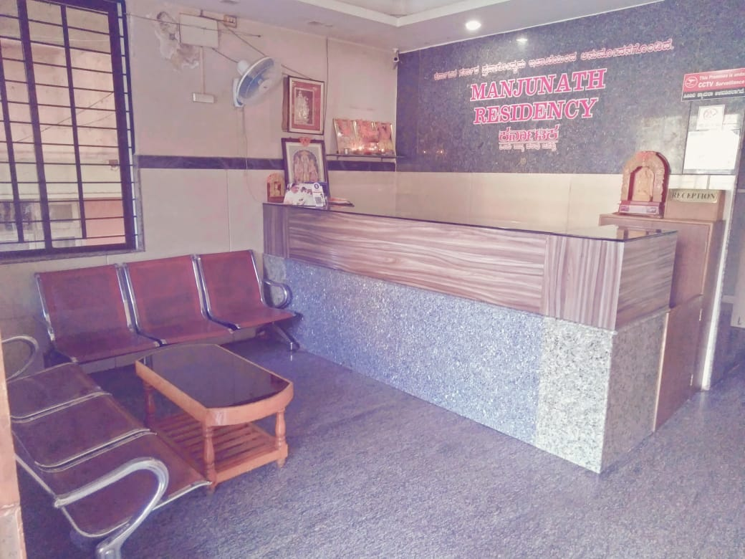
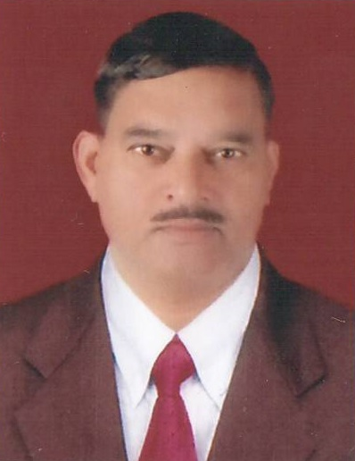
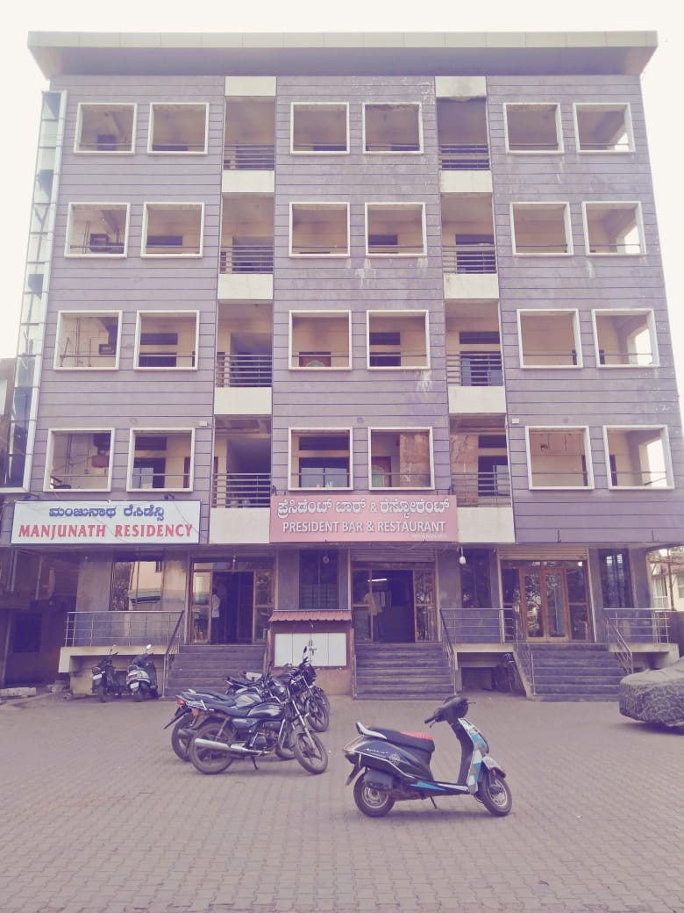
Karnataka State Financial Corporation {KSFC}, Bengaluru
M/s Manjunath Residency
Shri Shivappa J. Mulagund

Slide 19
Karnataka State Financial Corporation {KSFC}, Bengaluru
M/s Manjunath Residency
Shri Shivappa J. Mulagund established Hotel Manjunath Residency in the year 2009 with financial assistance from KSFC. This Hotel has 52 rooms, Conference Hall, Dinning Hall, Bar and Restaurant. The Hotel is located in the heart of Gadag City and has very good facilities with location advantage of being close to the railway station and bus stand. Shri Shivappa J. Mulagund attributes his success to the timely loan sanctioned at a very reasonable interest rate by KSFC and is being conferred the “”Successful Entrepreneur Award.

Slide 20
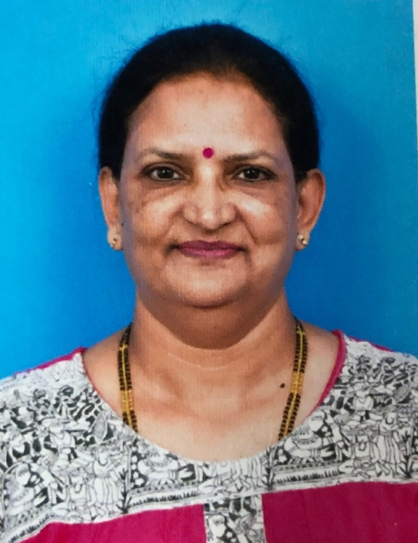
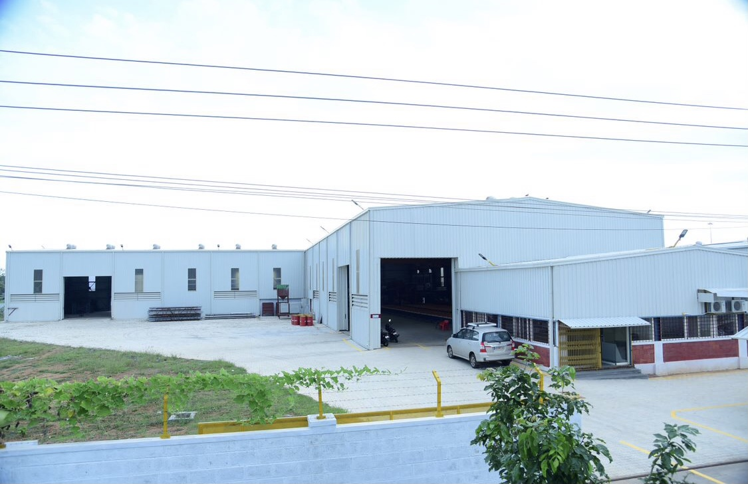
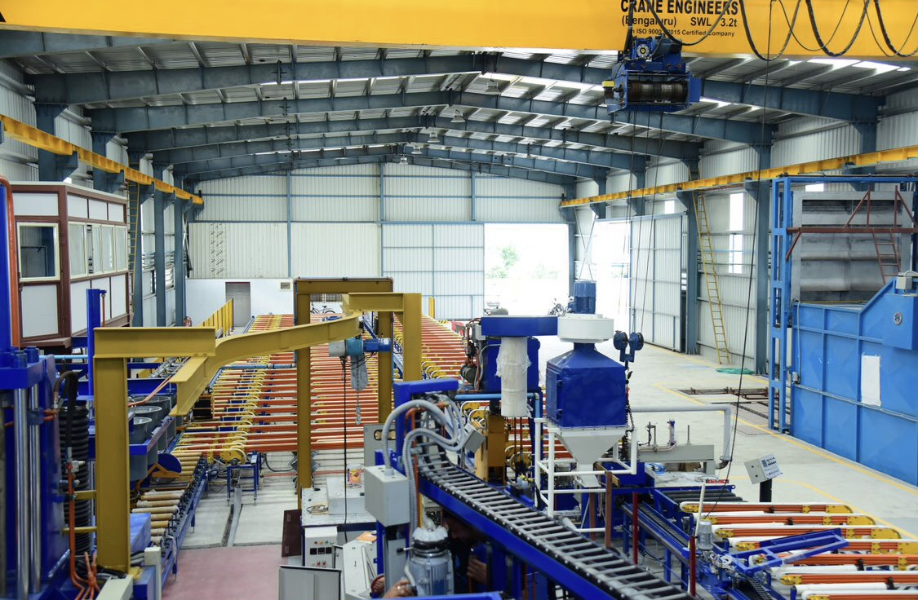
Karnataka State Financial Corporation {KSFC}, Bengaluru
M/s Eureka Extrusions & Finishers
Smt. Madhavilatha Jagadeesha

Slide 21
Karnataka State Financial Corporation {KSFC}, Bengaluru
M/s Eureka Extrusions & Finishers
Ms. Madhavilatha Jagadeesha and Shri Jagadeesha GB established Eureka Extrusions and Finishers with financial assistance from KSFC in the year 2017 to manufacture Aluminium Extrusions. The product is used in industry viz. Automation, Automobiles, Lightings, Solar and General commercial products. Their turnover from July 2020 to March 2021 was Rs.360 lakhs. The unit employs 25 personnel. The plant is equipped with State of the Art modern machinery, all procured in India, with automatic handling system. They feel KSFC has helped them to fulfill their dreams by encouraging Women Entrepreneurs and giving adequate and timely loan at a subsidy. The whole process of sanction was seamless and the concerned officials were very cooperative and friendly. The promoters also intend to train and educate children of the underprivileged in this field to help them stand on their own and contribute to the society.

Slide 22
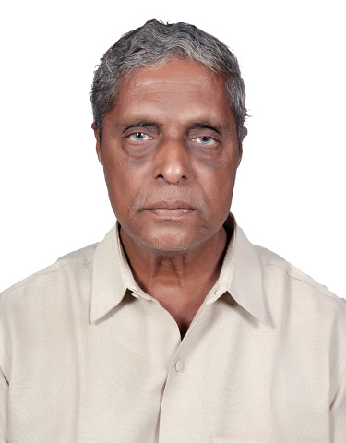
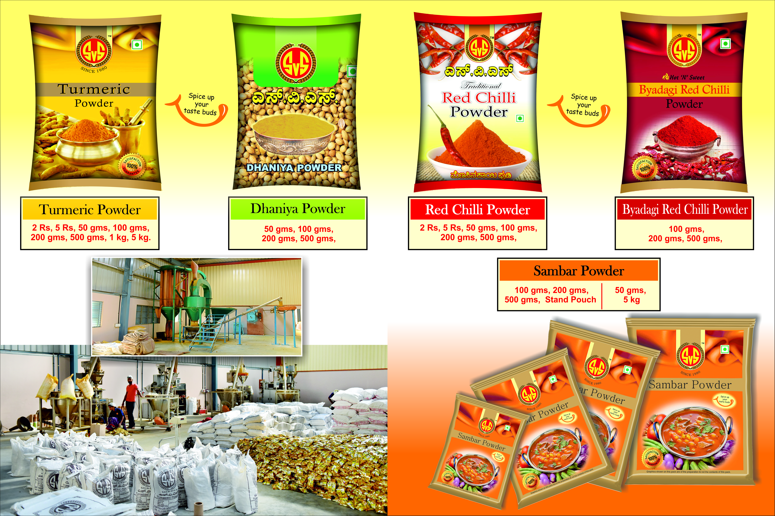
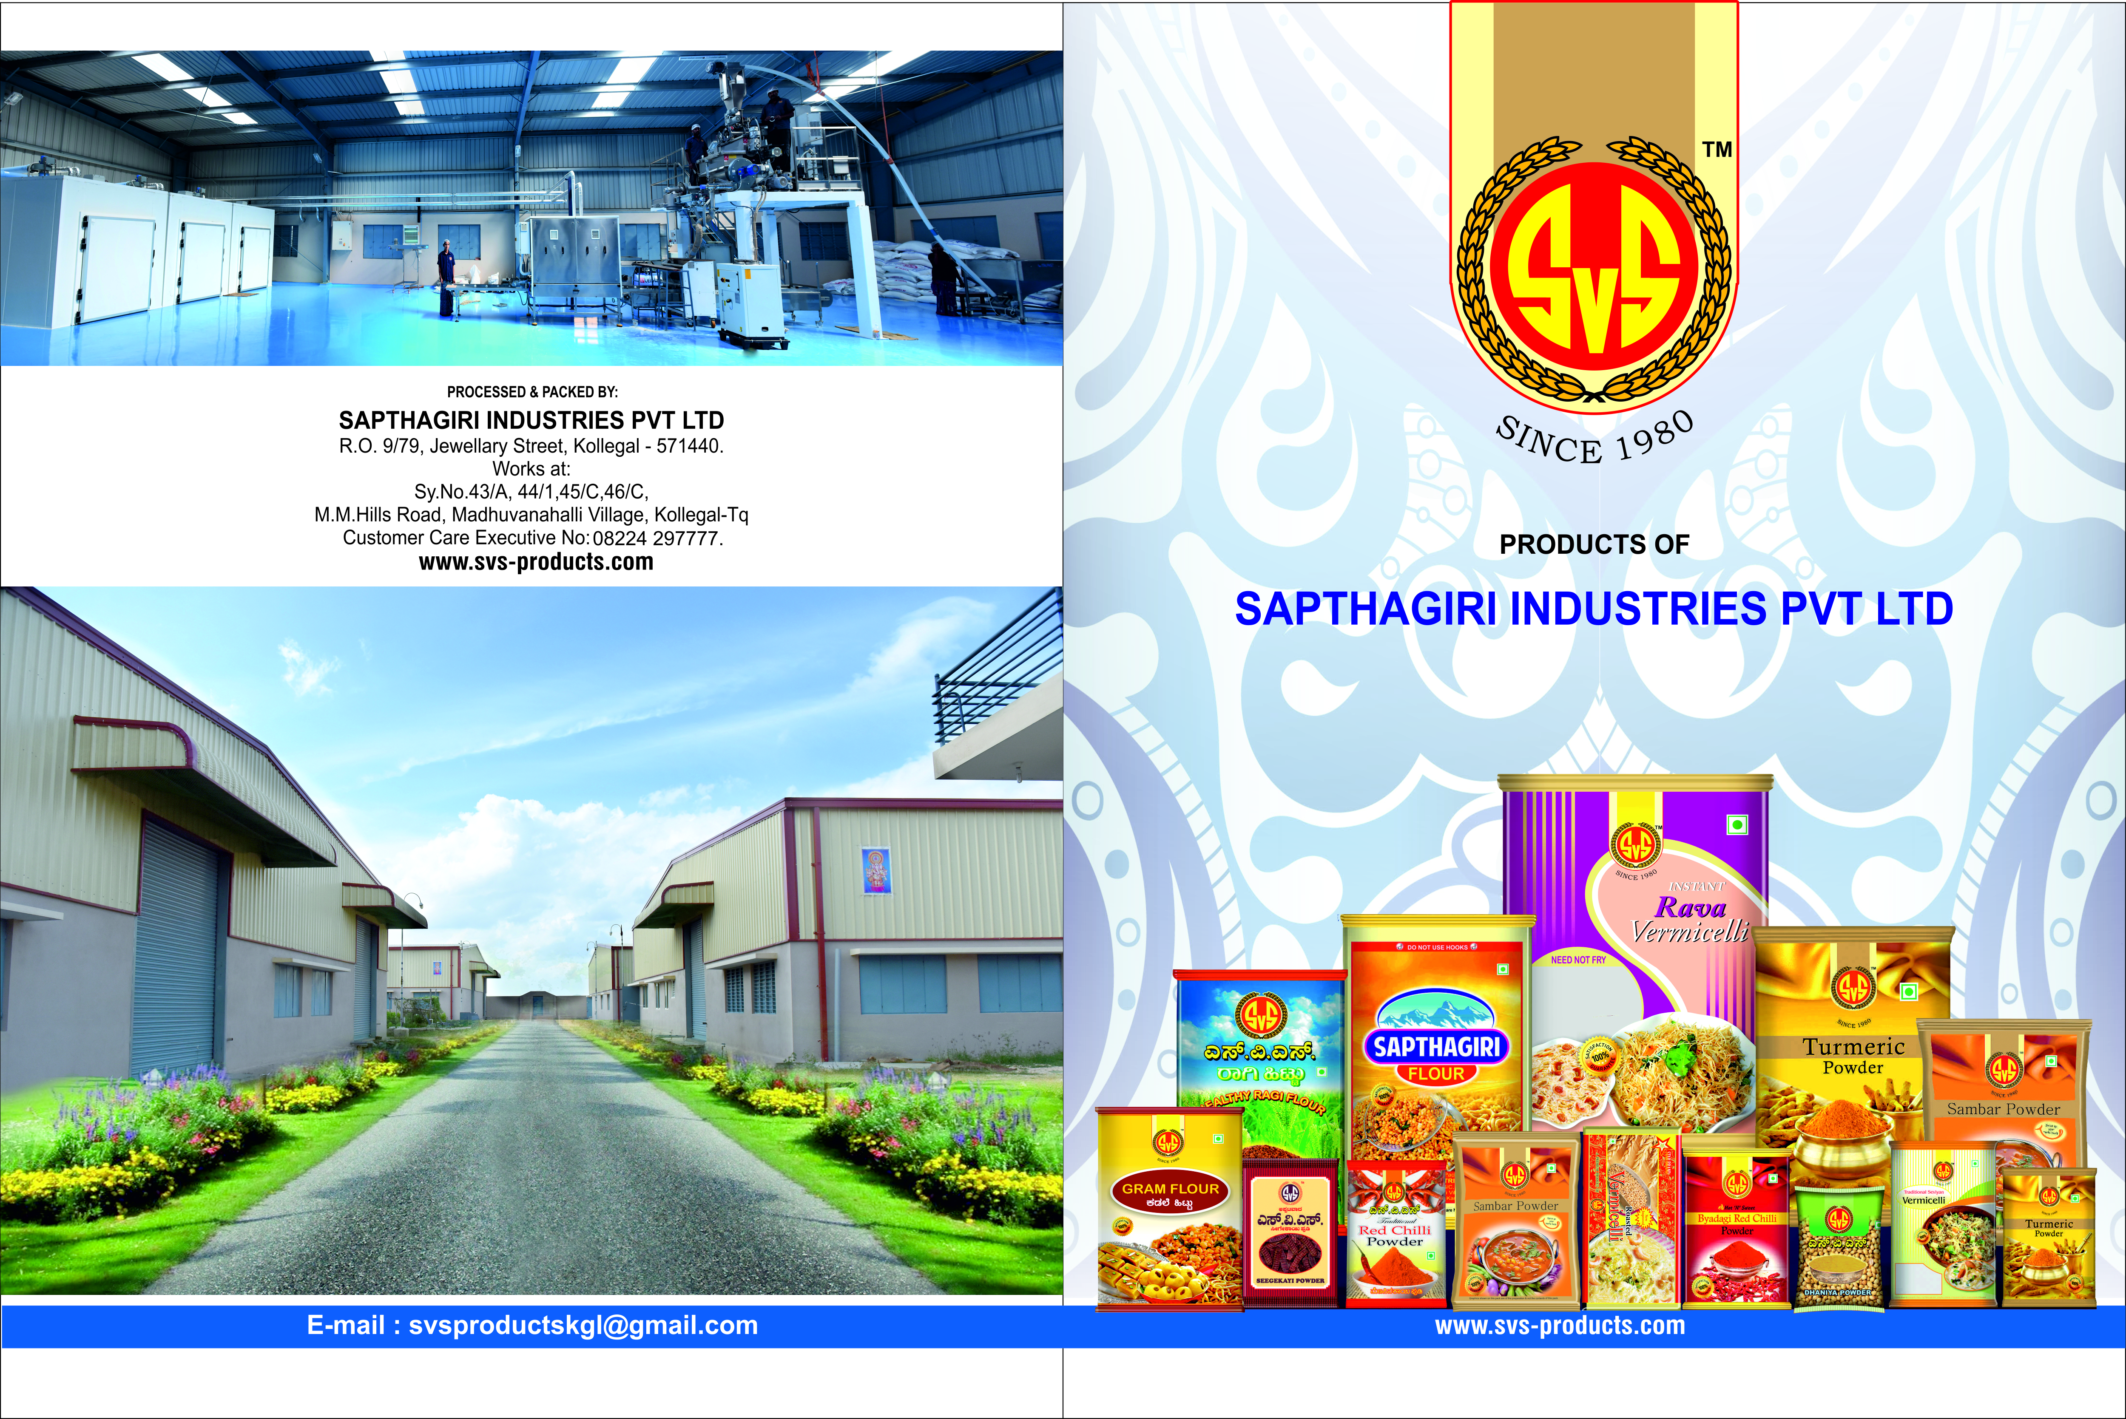
Karnataka State Financial Corporation {KSFC}, Bengaluru
M/s Sapthagiri Industries Pvt. Limited
Shri O.A. Srinivasa Murthy

Slide 23
Karnataka State Financial Corporation {KSFC}, Bengaluru
M/s Sapthagiri Industries Pvt. Limited
Shri O. A. Srinivasa Murthy established Sapthagiri Industries Pvt. Ltd. with financial assistance from KSFC to manufacture Vermicelli, Spice Powders, Masalas, Gram Flour, Ragi Flour and Shikakai Powder. The unit has dealers in Karnataka, Kerala and Tamilnadu and employs 35 personnel. It had a turnover of Rs.1,316 lakh in the year 2020-21.

Slide 24
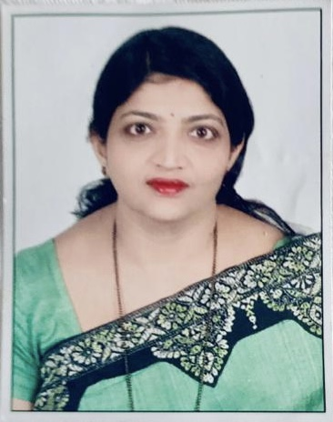
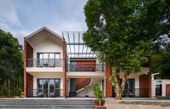
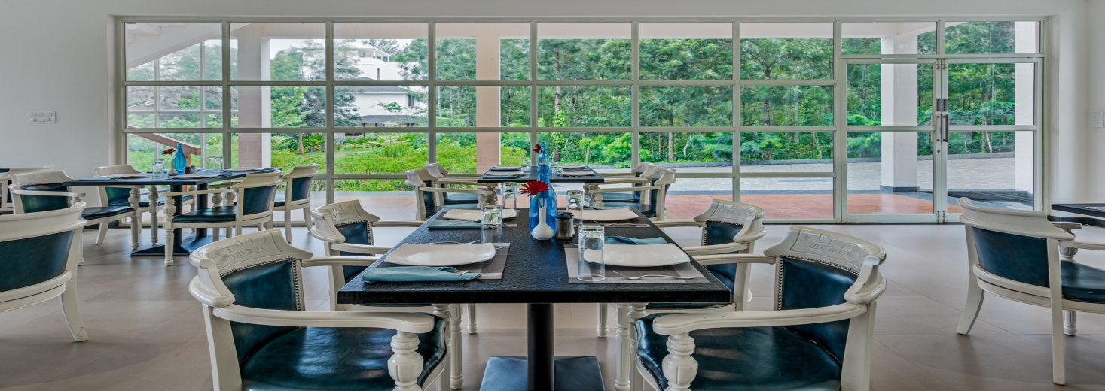
Karnataka State Financial Corporation {KSFC}, Bengaluru
M/s Vismita County
Smt. Latha Srinivas

Slide 25
Karnataka State Financial Corporation {KSFC}, Bengaluru
M/s Vismita County
Ms. Latha Srinivas established Vismita County as a partnership firm with Mr. K. R. Srinivas in the year 2018 in Chikmagalur with financial assistance from KSFC partly under women entrepreneur scheme. The Resort has grown by leaps and bounds and achieved a turnover of Rs. 4 crore in 2020-21. It’s a top rated hotel and credits its success to the support and guidance provided by KSFC officials. It has also received Booking.com traveller choice Award for the previous 2 years.

Slide 26
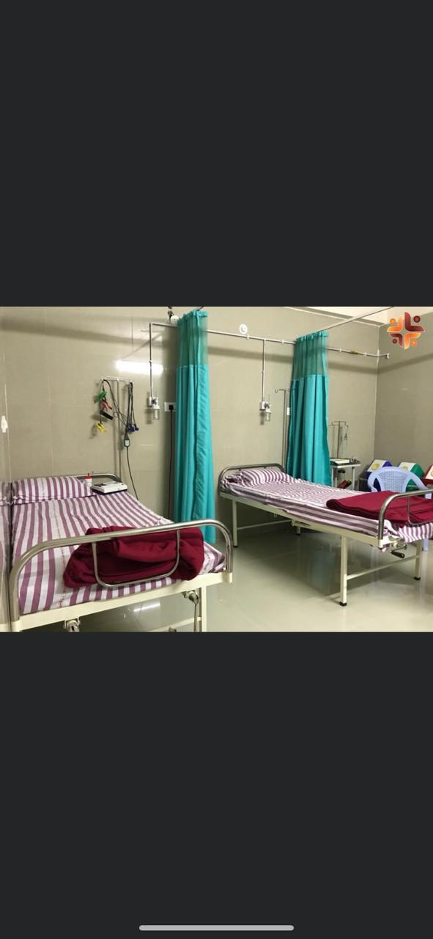

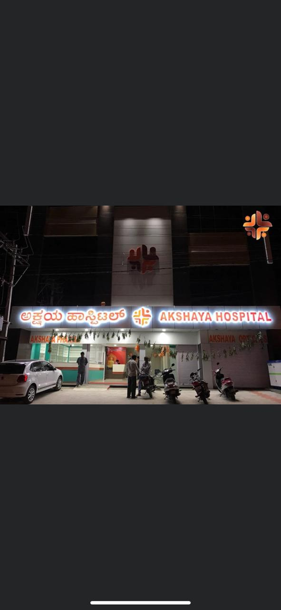
Karnataka State Financial Corporation {KSFC}, Bengaluru
M/s Akshaya Hospital
Dr. Seema N.

Slide 27
Karnataka State Financial Corporation {KSFC}, Bengaluru
M/s Akshaya Hospital
Dr. Seema N established Akshaya Hospital a 30 Bed, Multi Speciality Hospital in Harihar with financial assistance from KSFC under its subsidy scheme for SC loans in the year 2017. The hospital provides good service to patients of Harihar & surrounding villages mainly poor patients, villagers and workers of the nearly small scale and large scale industries. From the time of covid-19 pandemic, the hospital is actively involved in screening patients and giving regular ante natal check up etc.. The hospital has already seen about 5000 out-patients and around 2000 in-patients, 400 deliveries and conducted 300 operative procedures. It employees 17 people and had a turnover of Rs.110 lakhs in the year 2020-21.

Slide 28
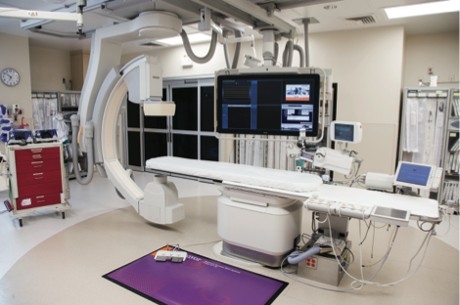
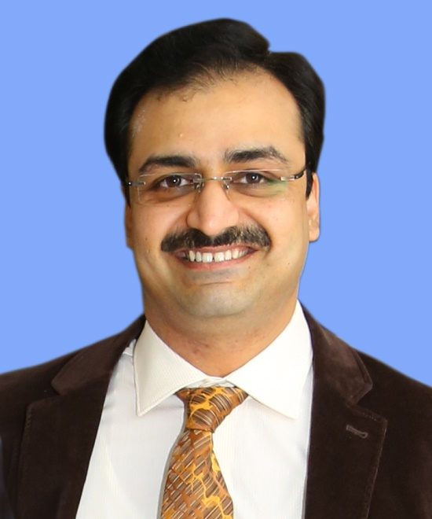

Karnataka State Financial Corporation {KSFC}, Bengaluru
M/s VGK Heart Institute
Dr. Ajit Kulkarni

Slide 29
Karnataka State Financial Corporation {KSFC}, Bengaluru
M/s VGK Heart Institute
Dr. Ajit Kulkarni established VGK Heart Institute in the year 2018 in Raichur with financial Assistance from KSFC. The institute has a Cardiac Catheterisation Laboratory to perform angiography and angioplasty. This is the only full fledged facility in the whole of Raichur district providing 24/7 emergency Cardiac care facilities in the form of primary angioplasty (implantation of stent in case of a Heart attack and thereby saving lives). KSFC helped him in establishing a Cardiac Catheterisation Laboratory in a backward place like Raichur where his father had already been practicing for the past 40 yrs. He is grateful to KSFC for helping him fulfill his dreams of saving lives and providing quality care to the locals and employees of Hutti Gold Mines Ltd, KPTCL, RTPC etc. His turnover last year was Rs.110 lakhs.

Slide 30


Madhya Pradesh Financial Corporation {MPFC}, Indore
M/s Surya Industries
Shri Manoj Patidar

Slide 31
Madhya Pradesh Financial Corporation {MPFC}, Indore
M/s Surya Industries
Shri Manoj Patidar, his father Shri Shantilal Patidar and cousin Shri Dilip Patidar established M/s Surya Industries in Khargone (Madhya Pradesh) in the year 2018 with financial assistance from MPFC. The unit manufactures drip irrigation pipes. Drip irrigation is a type of micro irrigation which provides safe water and nutrients by allowing water to drip slowly to the roots of plants either from above the soil surface or buried below the surface. The goal is to place water directly into the root zone and minimize evaporation thus conserving water. Shri Patidar is being conferred with “Best First Generation Entrepreneur”.

Slide 32




Madhya Pradesh Financial Corporation {MPFC}, Indore
M/s BGL Cylinders Industries
Shri Gopal Krishan Sharma

Slide 33
Madhya Pradesh Financial Corporation {MPFC}, Indore
M/s BGL Cylinders Industries
M/s. BGL Cylinders Industries, Ujjain is a partnership firm constituted by two brothers namely Shri Gopal Krishan Sharma and Shri Krishan Gopal Sharma in October 2016 with financial assistance from MPFC. The firm has set up a unit for the manufacture of High Pressure Empty Cylinder shells for fire extinguisher & Medical uses with an installed capacity of 60,000 cylinders per annum. The family is engaged in manufacturing and trading of different types of fire extinguishers since the last 50 years at Delhi.

Slide 34


Madhya Pradesh Financial Corporation {MPFC}, Indore
M/s Raj Safety Glass
Shri Abbas Mohd. Hussain Itarsiwala

Slide 35
Madhya Pradesh Financial Corporation {MPFC}, Indore
M/s Raj Safety Glass
M/s Raj Safety Glass is a proprietorship concern promoted by Shri Abbas Mohd. Hussain Itarsiwala in Dhar (MP) in the Year 2018 with financial assistance from MPFC. The concern is engaged in manufacturing of Toughened Glass used in buildings and automobile industries. The promoter is regular in his loan repayments to the Corporation and is receiving the “Best Entrepreneur Award”.

Slide 36




Madhya Pradesh Financial Corporation {MPFC}, Indore
M/s H.F. India Pvt. Ltd.
Shri Dinesh V. Pal

Slide 37
Madhya Pradesh Financial Corporation {MPFC}, Indore
M/s H.F. India Pvt. Ltd.
M/s H.F. India (P) Ltd. was established by Shri Ramdhani Pal, Shri Vijay Bahadur Pal, Shri Suraj Pal and Shri Dinesh pal in the year 2018 to manufacture Non Ferrous Machined Electrical Components with financial assistance from MPFC. The promoters were running a unit at Nasik since 1992 and set up this 2nd unit at Pithampur. The company has a good client base and is regular in its loan repayments to MPFC. It is being given the award for “Most Innovative Product”.

Slide 38





PIPDIC, Puducherry
M/s Mass Packagings Pvt. Ltd.
Ms. Nithya
Ms. Vasanthi

Slide 39
PIPDIC, Puducherry
M/s Mass Packagings Pvt. Ltd.
Ms. M. Vasanthi and Ms. G. Nithya promoted M/s Mass Packaging Pvt. Ltd. company to manufacture LD/HM liner and sheets in color/Plain/printed, LD Shrink film Rolls in the year 2016. the production started in July 2017 and the unit achieved a turnover of Rs.595 lakhs in FY 2019-20. The unit has availed Term Loan of Rs.40.00 lakhs from PIPDIC and is located in PIPDIC Industrial Estate, Sedarapet in Puducherry and has already repaid Rs.25.00 lakhs. The promoters plan to expand the Project by adding Multi-layer Extruder machine, Roto Gravure printing machine with Lamination facilities.

Slide 40






PIPDIC, Puducherry
M/s Indofrench Polymers
Shri Babuji Kuruvilla
Ms. Raymol Kuruvilla

Slide 41
PIPDIC, Puducherry
M/s Indofrench Polymers
M/s Indofrench Polymers was established by Shri Kuruvilla Babuji & Shri Antony Sebastian in the year 1993 in PIPDIC industrial estate in Puducherry to manufacture latex foam. Ms. Raymol Kuruvilla joined the business in the year 2000. They have achieved a good market share by maintaining product quality. In India, first pincore design was introduced to minimize latent heat. They introduced the THREE TIME PURIFICATION process with Dunlop technology, which ensures mattress durability & sufficient support to avoid unevenness of surface and back pain. The company plans to expand on pan India basis.

Slide 42




PIPDIC, Puducherry
M/s Safetab Life Science
Ms. R. Meenakshi

Slide 43
PIPDIC, Puducherry
M/s Safetab Life Science
Smt. R. Meenakshi & Smt. P Kasthuri promoted Safetab Life Science in the year 2007 in a plot allotted by PIPDIC which also gave a term loan of Rs.137.58 lakhs. Safetab Life Science started manufacturing tablets, capsules, sachets etc. which include AntiAsthma, Anti-Allergics, Anti-Oxidants, Anti-Ulcerants, Analgesics, Cardiology, Gynaecology, Vitamin Supplements, Anti – Diabetic medicines to serve B2B market with 24 employees. By late 2010 the unit started supplying products to leading national players in the Pharma industry. Their turnover crossed Rs.50 crores in the FY2017-18. Safetab now employs 380 personnel. From a small unit in a single plot the unit now operates from 6 plots. It also acquired a plant in Chennai in the year 2014 viz.“ Archimedis Healthcare Pvt Ltd”. Safetab is also exporting to the International market and has been conferred with WHO-GMP Certification ensuring quality control. Safetab is carrying out various CSR activities in improving the lifestyle of people who reside around the industrial area. The unit paid a direct tax of Rs. 63.7 million in the previous financial year 2019-20.

Slide 44



PIPDIC, Puducherry
M/s Sumuka Hitech Products
Shri Narayanan Krishna

Slide 45
PIPDIC, Puducherry
M/s Sumuka Hitech Products
Shri Narayanan Krishna, Managing Partner is a First Generation Entrepreneur. He started M/s Sumukha Hitech Products Industry during financial year 2001-02 in Sedrapet Industrial Estate, Pondicherry to produce Water based Adhesives & Over Print Coating products used in Printing, Packaging & Publishing. He introduced innovative ideas and tailor made products to suit expectations of customers. He is an approved Vendor of Colgate Palmolive, ITC Classmate note books & has replaced 3 products which were 100% import dependent with domestic range. The unit is ISO certified with focus on Social Responsibility and awareness and is exporting to the Gulf countries. The unit has generated employment for 30+ skilled as well as unskilled people. Shri Krishan plans to establish his own network of dealers and sales team and have branches across India. He is working on reducing consumption of plastic in tooth brush and wood in pencils.

Slide 46



Rajasthan Financial Corportaion {RFC}, Jaipur
M/s Multi Color Minerals
Smt. Poonam Sukhwal

Slide 47
Rajasthan Financial Corportaion {RFC}, Jaipur
M/s Multi Color Minerals
Smt. Poonam Sukhwal established M/s Multi Color Minerals in Udaipur for mineral grinding in the year 2016 having availed loan of Rs. 90 lakh under YUPY scheme. Since then she is running the unit successfully and is regular in payment of installments and had become ‘Good Borrower’. A further loan of Rs.56 lakh under Gold Card scheme was availed by her in March 2021. She is being awarded as “Best First Generation Entrepreneur”.

Slide 48


Rajasthan Financial Corportaion {RFC}, Jaipur
M/s I. S. Constructions Pvt. Ltd.
Shri Ishwinder Singh

Slide 49
Rajasthan Financial Corportaion {RFC}, Jaipur
M/s I S Constructions Pvt. Ltd.
M/s I.S. Constructions Pvt. Ltd. was established by Shri Ishwinder Singh as pvt. ltd. co. in the year 1992. The company is State of the Art fully automatic marble tiles plant and manufactures ready to fix marble tiles. The product is fully exported. The promoter made its first expansion in the year 1996 and thereafter, in the year 2006. Further in the year 2020 the company again made major expansion and set a very modem fully automatic granite slabs plant with two multi cutter with fully automatic resin and polishing plant. The company also put up a jumbo size marble Gangsaw for export. Shri Ishwinder Singh is a Technocrat with BE, MBA Degree and experienced in this line. The promoter has availed seventeen loans under different schemes of the Corporation and maintained a good track record. He is being conferred with “Best Entrepreneur Award”.

Slide 50


Rajasthan Financial Corportaion {RFC}, Jaipur
M/s Qualitech Metal Industries
Shri Kamal Mehta

Slide 51
Rajasthan Financial Corportaion {RFC}, Jaipur
M/s Qualitech Metal Industries
Shri Kamal Mehta established M/s Qualitech Metal Industries in Jodhpur with financial assistance from RFC. Shri Mehta is a self made entrepreneur and has been regular in repayments. The account is, therefore, standard category. He is being conferred with “Best Entrepreneur Award”.

Slide 52



Rajasthan Financial Corportaion {RFC}, Jaipur
M/s Kamlesh Devi
Smt. Kamlesh Devi

Slide 53
Rajasthan Financial Corportaion {RFC}, Jaipur
M/s Kamlesh Devi
Smt. Kamlesh Devi established M/s Kamlesh Devi as a proprietorship concern in Alwar to manufacture cement pipes for heaters in the year 2011 with financial assistance from RFC under its Saral Scheme. She is a good borrower and has achieved sales of Rs.24.56 lakhs in the year 2019-20. She is being given the “Best Women Entrepreneur” award.

Slide 54


Rajasthan Financial Corportaion {RFC}, Jaipur
M/s Hotel Atithi Palace
Shri Madan Singh Chouhan

Slide 55
Rajasthan Financial Corportaion {RFC}, Jaipur
M/s Hotel Atithi Palace
Shri Madan Singh Chouhan established Hotel Atithi Palace as a proprietorship concern in Dungarpur in the year 2003 by availing financial assistance from RFC. Since than he is running the hotel successfully. Later on he has availed loans under various good borrower schemes of the Corporation for expansion/ modernisation of hotel and remained most regular in repayment. The account is categorized as Standard Assets. Hence he is being awarded for “Best Unit in Service Industries”.

Slide 56




Rajasthan Financial Corportaion {RFC}, Jaipur
M/s Arun Art Exports
Shri Narayan Lal Suthar

Slide 57
Rajasthan Financial Corportaion {RFC}, Jaipur
M/s Arun Art Exports
M/s Arun Art Exports was established by Shri Narendra Lal Suthar in Jodhpur in the year 2015 for manufacture of Wooden Handicrafts. The unit is partnership firm and makes decorative items which also used all over the world in residential as well as commercial buildings. It was sanctioned financial assistance by RFC under YUPY scheme. The concern is making its payments regularly and account is categorized as Standard. The unit is exporting its products and has, therefore, been conferred the “Best Exporting Unit/Most Innovative Products” award.

Slide 58



Tamilnadu Industrial Investment Corp. Ltd. {TIIC}, Chennai
M/s Sustainably Crafted Clothing Pvt. Ltd.
Shri Sreeranga Samy Rajan

Slide 59
Tamilnadu Industrial Investment Corp. Ltd. {TIIC}, Chennai
M/s Sustainably Crafted Clothing Pvt. Ltd.
M/s. Sustainably Crafted Clothing Private Limited, was incorporated in the year 2019 by Shri Sreeranga Samy Rajan to manufacture high quality apparels/readymade garments with sustainably produced fibers in Krishnagiri. The unit has an installed capacity of 13,82,400 pieces of readymade garments and has achieved sales of Rs. 44.92 crores. The company employs 411 workers and is making shirts for M/s. Aditya Birla Groups, M/s. Aravind Limited, M/s. Knowledge Cotton apparel, Denmark, M/s. Nudle Jeans, Sweden and M/s.Galleries Lafayate, France. The unit is also engaged in the manufacture of Bio-Suit under COVID-19 and supplies PPE kits for Doctors/Nurses all over India. The production facility of the unit is a State of the Art facility and its garments are exported to Denmark, Sweden & France.

Slide 60


Tamilnadu Industrial Investment Corp. Ltd. {TIIC}, Chennai
M/s A.K. Associates
Smt. S. Vishalakshi

Slide 61
Tamilnadu Industrial Investment Corp. Ltd. {TIIC}, Chennai
M/s A.K. Associates
M/s. A. K. Associates was promoted by Smt. S. Vishaalakshi in the year 1995 to manufacture Industrial gloves, masks etc. in Hosur with financial assistance from TIIC. The unit achieved a turnover of Rs.560 lakhs as on March 21, 2020 and has obtained ISO 9001:2008 certification. It has earned profit continuously for the previous 4 years. M/s A K Associates is meetings its repayment obligation to the Corporation “Promptly” and remains in the “Standard Category” since inception.

Slide 62



Tamilnadu Industrial Investment Corp. Ltd. {TIIC}, Chennai
M/s Yagappa Readymix Concrete
Shri Johnpaul Yagappa

Slide 63
Tamilnadu Industrial Investment Corp. Ltd. {TIIC}, Chennai
M/s Yagappa Readymix Concrete
M/s Yagappa Readymix Concrete was established by Shri P. Johnpaul Yaggappa with financial assistance from TIIC under its NEED scheme to set up a unit for manufacturing ready mix concrete at Thanjavur. He is being awarded for his hard work as the “Best Entrepreneur”. Track record of the loan is good. All the loan accounts are under standard category. He achieved sales of Rs. 1,735 lakh in 2019-20 and profit of Rs.20.61 lakhs. The unit has obtained ISO-9000 series 22000 certificate for Ready Mix manufacturing & delivery. Shri Yagappa plans to supply optimum level in all construction fields i.e. he has proposed to manufacture paver blocks, hallow blocks, solid blocks, quality fly ash bricks etc.

Slide 64


Tamilnadu Industrial Investment Corp. Ltd. {TIIC}, Chennai
M/s Friends Tyres
Shri A. Ragupathy

Slide 65
Tamilnadu Industrial Investment Corp. Ltd. {TIIC}, Chennai
M/s Friends Tyres
Shri A. Ragupathy established " FRIENDS TYRES" in the year 2015 with financial assistance from TIIC under its NEED scheme. FRIENDS TYRES is one of the leading service providers in Trichy with a satisfactory customer service history of more than 15,000 cars till date. Advanced technical machinery & hard core dedication towards the business are the key factors towards its success. The services provided include Tyre changing, wheel alignment, wheel balancing ,nitrogen inflation, A.C. gas filling & multiple brand sale of tyres. It has dealership tie-up with Goodyear Tyres taking the business to the next level. Shri A. Ragupathy is being awarded the “Best First Generation Entrepreneur”. Future plans include opening of branches in the neighbouring towns to provide International Standard services to customers and generate employment opportunities.

Slide 66


Tamilnadu Industrial Investment Corp. Ltd. {TIIC}, Chennai
M/s Abhinav Fabrics
Shri P. Nallamuthu

Slide 67
Tamilnadu Industrial Investment Corp. Ltd. {TIIC}, Chennai
M/s Abhinav Fabrics
The company was started in the year 2005 by Shri P. Nallamuthu, an Industrial Engineer turned first generation entrepreneur with financial assistance from TIIC and a special focus on supplying quality textile products to medical sector. It has client base of over 5000 Hospital Customers. Workforce consists of 120 employees put together in shop floor and middle level management. ABHINAV FABRICS has joined hands with a Swiss Company “HeiQ” to implement the AntiViral Technology in fabrics through an MoU. The Brand VIRO VETO focuses on diversified medical textile products like Face Masks, scrub suits, Coveralls , Surgeon Aprons etc.
The Nano Chemicals used in VIRO VETO has the capability of disrupting the virus and eventually the virus becomes inactive (considered as destroyed) HeiQ Viroblock has been tested effective 99.99% in 30 minutes against SARS-CoV-2, the COVID-19 causing virus
The chemical substances will remain on the fabric upto 50 washes, with intense effectiveness on virus for 25 washes. The finish is applied on 100% cotton fabric. Hence the fabric is breathable and comfortable besides antiviral property and has been found to be safe on skin.
The company has already been awarded various certifications viz. Antibacterial activity value (ISO 20743:2013) (SGS) and Antiviral activity of fabric (AATCC 100-2012) (Biotech,Mumbai).
It has shown 94.32% reduction of virus in 2 hours.

Slide 68


Kerala Financial Corporation (KFC), Thiruvananthapuram
M/s Yemvees
Shri V. K. Varghese

Slide 69
Kerala Financial Corporation (KFC), Thiruvananthapuram
M/s Yemvees
Shri V.K. Varghese started Yemvees Prosthetic and Orthotic Centre in the year 1982 with financial assistance from KFC. Shri Varghese is a Prosthetist and Orthotist and is recognized by the Rehabilitation Council of India (a statutory body under the ministry of Social justice & Empowerment, Govt. of India) & also by State Govt. of Kerala. The Centre manufactures Artificial Limbs & Orthopedic Appliances. Shri Varghese is now building a multi-storied building with modern technology in the field of Prosthetics & Orthotics with further assistance from KFC.

Slide 70



Kerala Financial Corporation (KFC), Thiruvananthapuram
M/s Genrobotic Innovation Pvt. Ltd.

Slide 71
Kerala Financial Corporation (KFC), Thiruvananthapuram
M/s Genrobotic Innovation Pvt. Ltd.
Shri Vimal G. and his partners established Genrobotics Innovation Pvt. Ltd. which is a National award-winning start-up with primary focus on designing and developing robotic solutions to address the various sanitation and healthcare issues such as manual scavenging, rehabilitation of paraplegic patients, etc. with financial assistance from KFC. Genrobotics is an inventor of world's first manhole cleaning robot Bandicoot. The bandicoot is designed in such a way that it can be accessible to any type of sewer manhole cleaning. It is rooted to mechanize the conventional sanitation system of the country and rehabilitate the existing sanitation workers to Robot operators through the initiative Mission Robohole. This initiative will change the concept from Manholes to Roboholes and foster a safer working environment for the sanitation workers.

Slide 72


Kerala Financial Corporation (KFC), Thiruvananthapuram
M/s Star Pipes
Ms. Faina Anto

Slide 73
Kerala Financial Corporation (KFC), Thiruvananthapuram
M/s Star Pipes
STAR Group headed by Ms. Faina Anto was set up to manufacture PVC pipe fittings in 1984 in Thrissur with financial assistance from KFC. The aim was to manufacture high quality pipe fittings and market them. Till then, this field was dominated by North Indian companies. Within a short span of time, the company made inroads in to the South Indian and North Indian markets. Now, the annual turnover of the Group is more than Rs.430.00 crores.

Slide 74


Kerala Financial Corporation (KFC), Thiruvananthapuram
M/s Vythiri Retreat Resorts
Shri Mohammed Firoz PM

Slide 75
Kerala Financial Corporation (KFC), Thiruvananthapuram
M/s Vythiri Retreat Resorts
Shri Mohammed Firoz PM, established Vythiri Retreat Resorts a premium boutique resort in Wayanad, located 3300 ft above sea level in the Chembra peak Hills in Wayanad, with financial assistance from KFC. Vythiri Retreat Resort, is a place where history and iconic elegance mingles with new-world sophistication. The resort is spread over 20 acres, atop a hill and offers breathtaking views of beautiful sunrise and sunset. Vythiri Retreat continues to be one of Kerala’s finest destinations.

Slide 76


Kerala Financial Corporation (KFC), Thiruvananthapuram
M/s Akshay Plastics
Smt. Omana G.

Slide 77
Kerala Financial Corporation (KFC), Thiruvananthapuram
M/s Akshay Plastics
Smt. Omana G. established Akshay Plastics in 1999 at Thiruvananthapuram with the assistance from Kerala Financial Corporation. Their primary activity is the manufacture and supply of plastic household and office products all over the state of Kerala. During 2018-19, they have modernised their unit again with assistance from KFC.

Slide 78


Kerala Financial Corporation (KFC), Thiruvananthapuram
M/s Vijay Traditional
Shri Vijayan P.

Slide 79
Kerala Financial Corporation (KFC), Thiruvananthapuram
M/s Vijay Traditional
Shri Vijayan P. established Vijay traditional Ayurveda and foot therapy Center which is a “Ayurdiamond” certified Ayurvedic Centre situated on the banks of Karamana river in Choozhattukotta, Trivandram in the year 2004 as a small enterprise, and now has a client base of about 500 guests in a year, It is equipped with 18 guest rooms and 4 treatment rooms with a well maintained kitchen, restaurant and a spacious ayurvedic herbal garden. Kerala Financial Corporation is the chief financier of the Centre since inception.

Slide 80


Kerala Financial Corporation (KFC), Thiruvananthapuram
M/s Camelot Cordiality Hotels Pvt. Ltd.
Sri. Hari Sugunendran

Slide 81
Kerala Financial Corporation (KFC), Thiruvananthapuram
M/s Camelot Cordiality Hotels Pvt. Ltd.
Shri Hari Sugunendran, a UK based doctor established Camelot Cordiality Hotels Pvt. Ltd. a business class luxury hotel, at Pathirappalli with financial assistance from KFC. The hotel is strategically located on the highway and offers modern facilities to both the leisure and business traveller. It has an indoor swimming pool, restaurant and WiFi facility.

Slide 82




Award for Outstanding SIIDCs
Rajasthan State Industrial Development & Investment Corp. Ltd. {RIICO}, Jaipur
Plug And Play Facility At SEZ, Jaipur
Shri Ashutosh A.T. Pednekar, IAS
MD, RIICO
Fintech Park Jaipur
Convention Centre At Bhiwadi

Slide 83
Award for Outstanding SIIDCs
Rajasthan State Industrial Development & Investment Corp. Ltd. {RIICO}, Jaipur
Rajasthan State Industrial Development & Investment Corporation Limited (RIICO), a Government of Rajasthan undertaking, was set up on 28th March 1969 and completed its Golden Jubilee last year. In order to have synergy with other state SIDCs and SFCs, RIICO took the lead in incorporating the idea of COSIDICI and is one of its founder members and has been at the forefront of supporting the organisation.
Since inception RIICO has sanctioned Financial Assistance of Rs. 4156.97 Cr. to the industry which catalysed an investment of Rs.9539.77 Cr. and generated employment for 1,12,386 persons.
RIICO has developed industrial areas in 147 sub-divisions out of 294 sub-divisions in Rajasthan and plans to launch 68 industrial areas in the remaining sub- divisions in FY 2021-22.
Launched special zones dedicated to the MSME sector. Created 15 new Industrial Areas in FY 2020-21.
MSE areas in Raghunathpura (Ajmer), Badgaon (Sirohi) and Uniyara (Tonk) established.
RIICO publishes monthly calendar for E-auction of plots to help entrepreneurs plan their investment.
RIICO’s has been making efforts towards environment management by keeping land reserve in every Industrial area for viz. e-waste recycling industries; hazardous waste recycling industries; general waste recycling industries; dumping yard in every Industrial area and land for CETP

Slide 84
  RIICO (Contd…)
  Conducted webinar with Europe Business Group Federation (EBG), Indo-French Chamber of Commerce (IFCCI), American Chamber of Commerce (AMCHAM), Japan etc. to discuss the investment opportunities in Rajasthan.
To invite investment in Rajasthan, RIICO has sent personalized letters alongwith various State Govt Policies and RIICO Brochures to the Non Resident Rajasthani entrepreneurs (big corporates) in India and abroad and other well performing companies in India.
  RIICO granted a relief package to industries during COVID-19 pandemic to the extent of Rs.273 crore. This package contained exemptions of payment, waiving of penalties, time extensions, reduction in interest, increase in installments for payment of land etc.
RIICO is developing a world-class FinTech Park in the heart of Jaipur city spread over 100 acres land which would accommodate companies from IT, Finance and other related service sectors. The Park will catalyse an investment of approx. Rs.3000 crore and will generate employment for approx. 50,000 persons.
RIICO has been appointed as Regional Development Authority (RDA) for Delhi Mumbai Industrial Corridor (DMIC) in Rajasthan.
During previous three years, RIICO’s CSR activities were in health care, medical, education, environment sustainability. The CSR budget in 2019-20 was Rs.327.5 crore and Rs.480.64 crore in 2020-21.

Slide 85
Thank You

