Slide 1
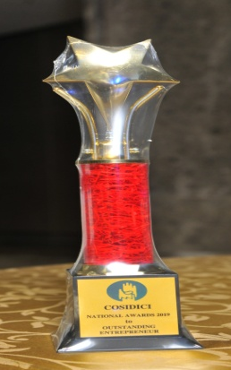


KSFC in collaboration with COSIDICI
presents
National Award Function – 2019
for
“Outstanding Entrepreneurs”
Funded By State Level Financial Institutions
(On January 21, 2019 At 6.00 p.m. Hotel Shangri-La, Bengaluru)

Slide 2
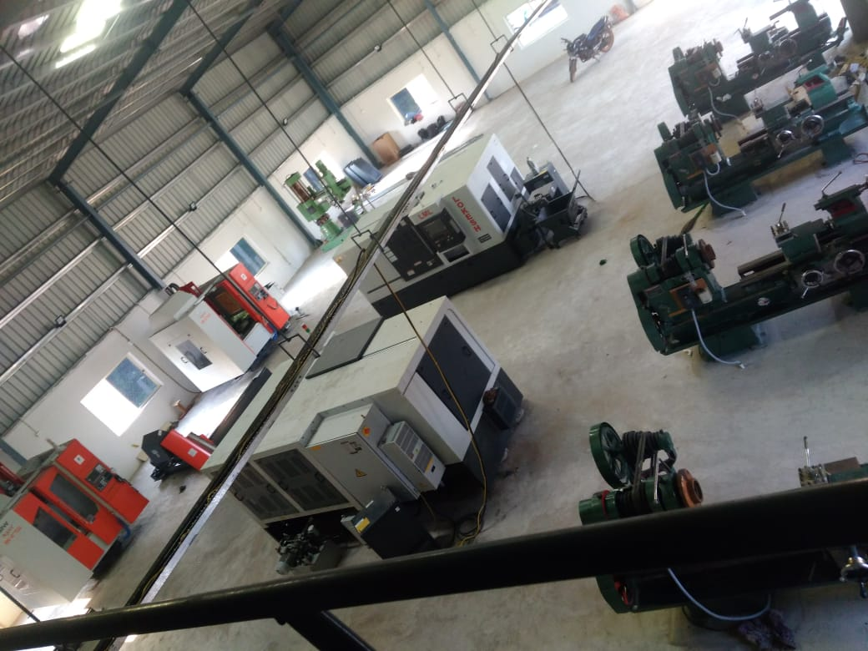
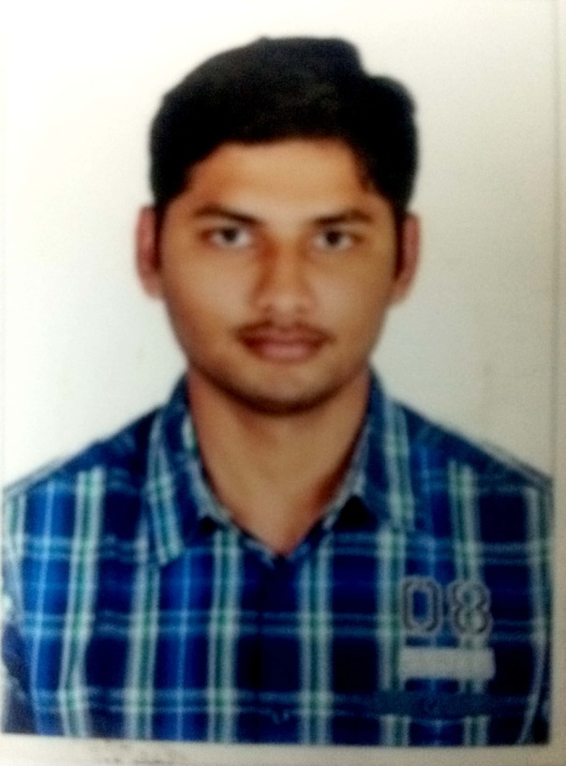
Andhra Pradesh State Financial Corporation {APSFC}, Vijayawada
M/s Pioneer Machining Solutions
Shri V. Sai Sreenivasulu Reddy

Slide 3
Andhra Pradesh State Financial Corporation {APSFC}, Vijayawada
M/s Pioneer Machining Solutions
M/s Pioneer Machining Solutions was established by Shri V. Sai Sreenivasulu Reddy & Shri V. Syamsunder Reddy, in Nellore, Andhra Pradesh with financial assistance from APSFC. The unit is involved in manufacturing of Precision Engineering Components. Its clients include M/s Nelcast and the OEMs located in Nellore and Chennai regions.

Slide 4
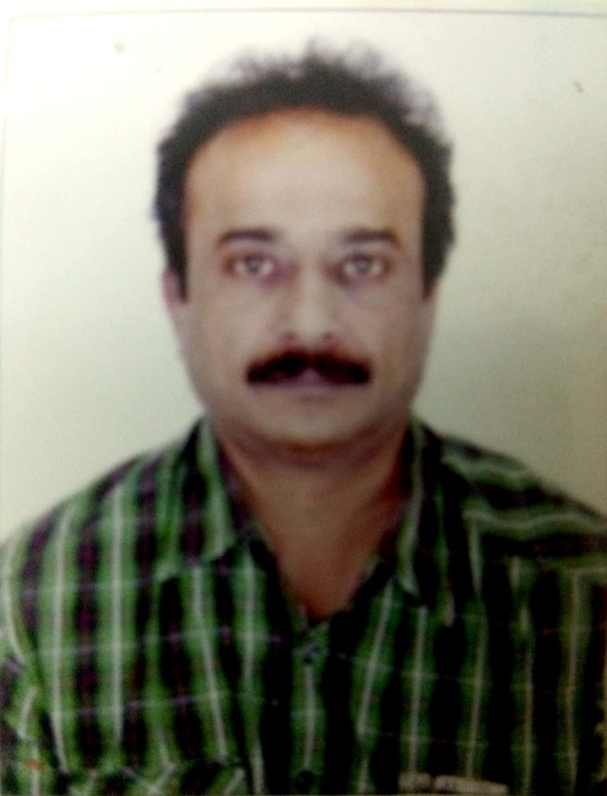
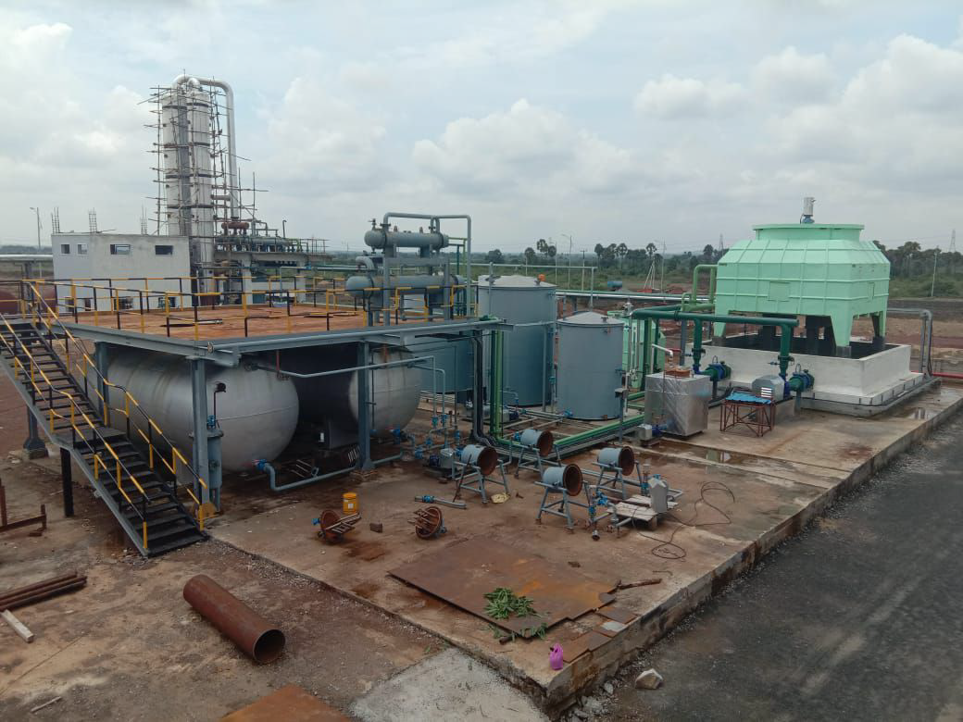
Andhra Pradesh State Financial Corporation {APSFC}, Vijayawada
M/s Allegro Specialty Chemicals Pvt. Ltd.
Shri Ravipati Shantisagar

Slide 5
Andhra Pradesh State Financial Corporation {APSFC}, Vijayawada
M/s Allegro Specialty Chemicals Pvt. Ltd.
M/s. Allegro Specialty Chemicals Pvt Ltd. was established by Shri Ravipati Shantisagar and Ms. Niyatee Ravipati in the year 2015 with financial assistance from APSFC at Industrial Park developed by APIIC in Nellore. It is involved in manufacture of sodium methoxide.

Slide 6
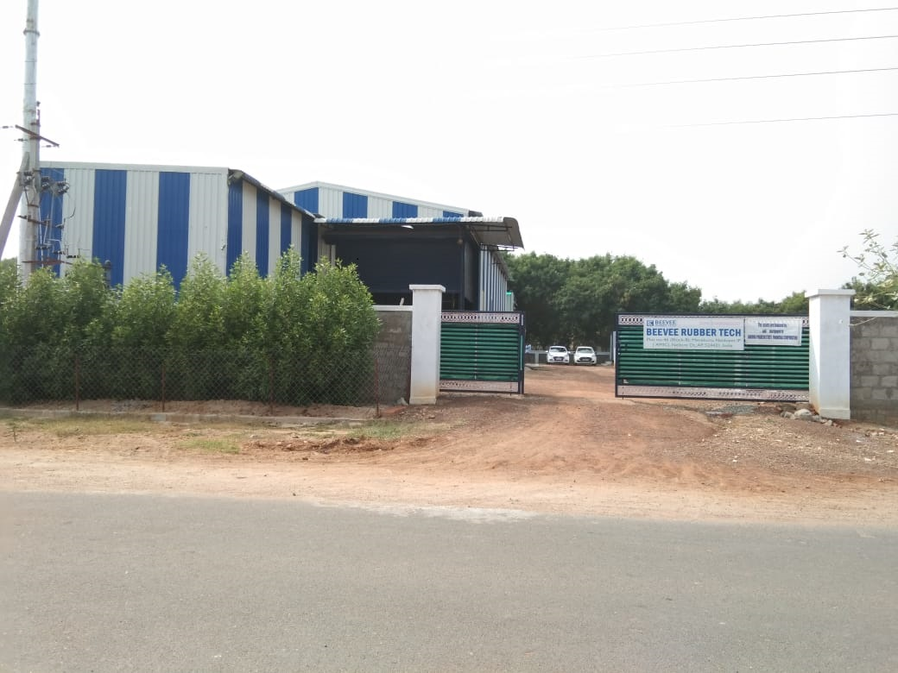
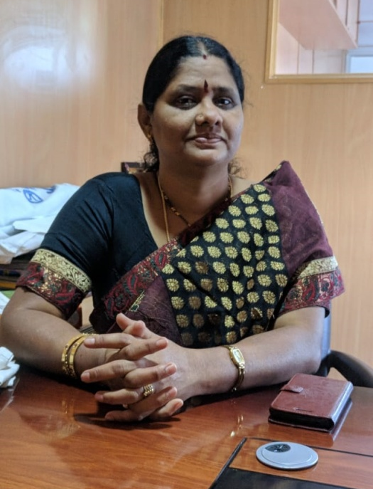
Andhra Pradesh State Financial Corporation {APSFC}, Vijayawada
M/s Beevee Rubber Tech
Smt T. Sulochana

Slide 7
Andhra Pradesh State Financial Corporation {APSFC}, Vijayawada
M/s Beevee Rubber Tech
M/s. Beevee Rubber Tech was established by Smt T. Sulochana & Smt T. Mamatha as a partnership firm in the year 2018 with financial assistance from APSFC at an industrial park developed by APIIC in Nellore. It manufactures Industrial Rubber Products(Pulley Lagging Rubber Sheets, Conveyor Care Rubber Products Etc.)

Slide 8
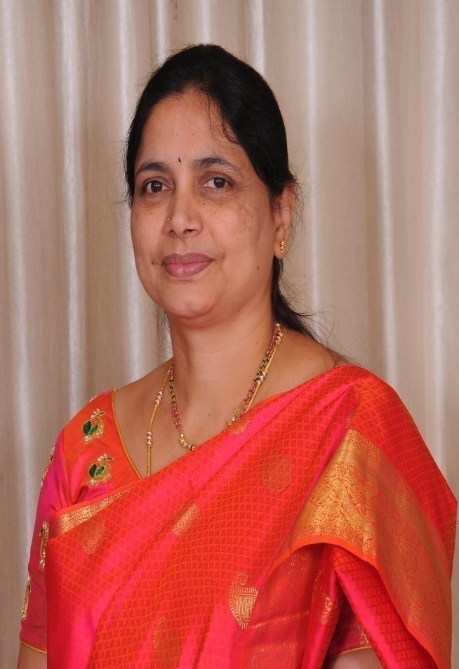
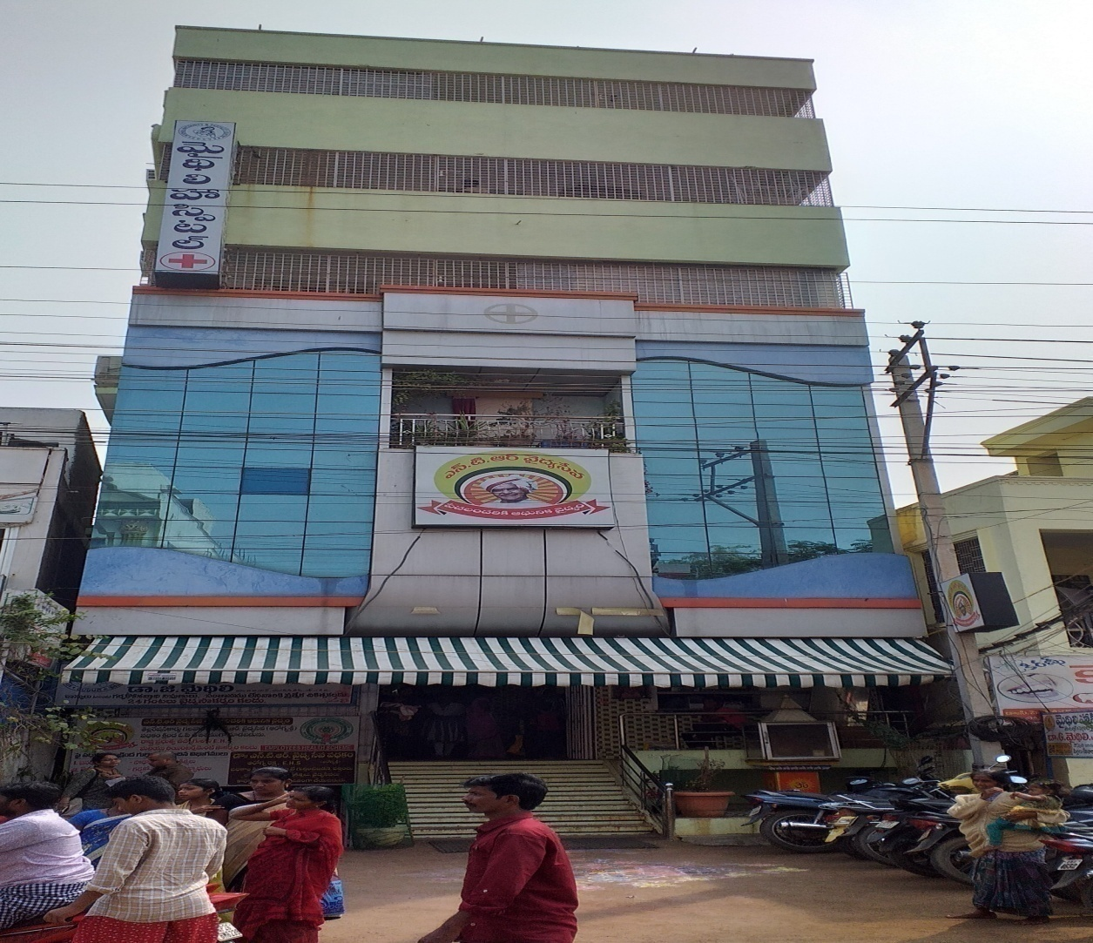
Andhra Pradesh State Financial Corporation {APSFC}, Vijayawada
M/s Mydhili Hospitals
Dr. Gurram Mydhili

Slide 9
Andhra Pradesh State Financial Corporation {APSFC}, Vijayawada
M/s Mydhili Hospitals
M/s. Mydhili Hospitals was established as a partnership firm by Dr. Gurram Mydhili, Shri L. V. Ramana Babu and Ms. L. Hithaishi with financial assistance from APSFC. It is a multi specialty hospital with 100 bed capacity. The Hospital is well established and is having good reputation in Gudur and surrounding areas. It is a Panel Hospital for public sector undertakings in the area and approved Hospital for many insurance TPAs. The hospital is prompt in its repayment schedule.

Slide 10
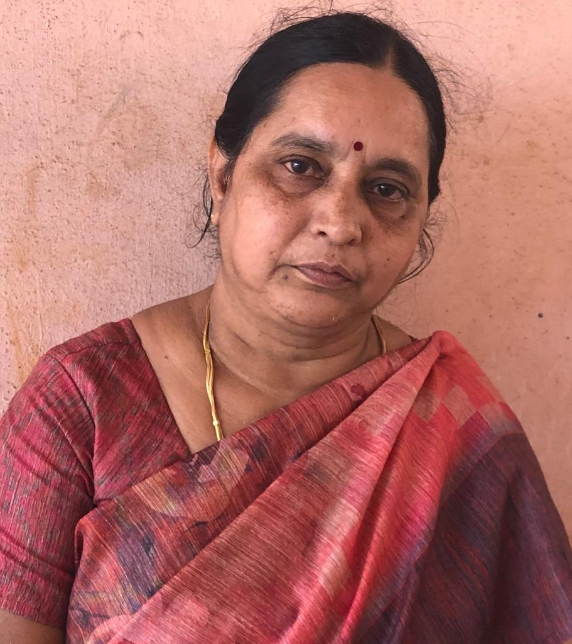
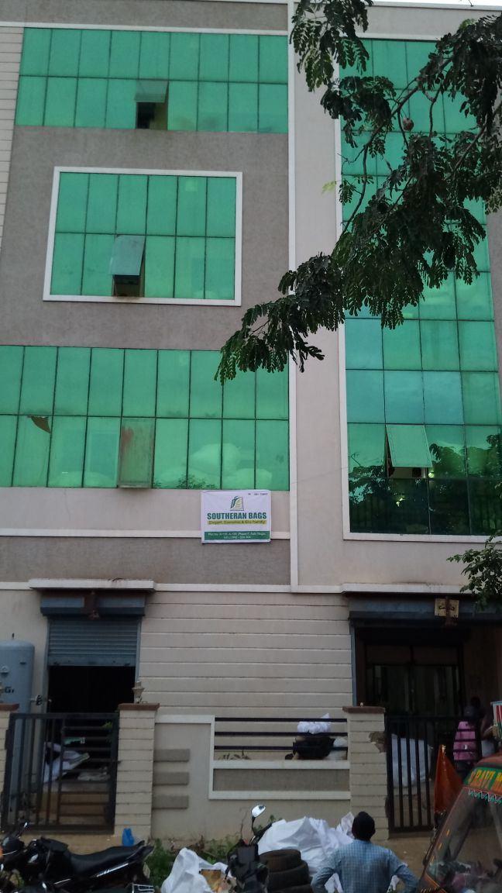
Andhra Pradesh State Financial Corporation {APSFC}, Vijayawada
M/s Southern Bags
Smt. Sannareddy Neeraja Reddy

Slide 11
Andhra Pradesh State Financial Corporation {APSFC}, Vijayawada
M/s Southern Bags
M/s Southern Bags was started as a partnership firm by Smt. Sannareddy Neeraja Reddy, Smt. Sannareddy Triveni, Smt. Sannareddy Suneethamma and Smt. Pelluru Sudha Rani in the year 2011 with financial assistance from APSFC. It manufactures PP Printed, Plain Non-woven Fabric Bags.

Slide 12
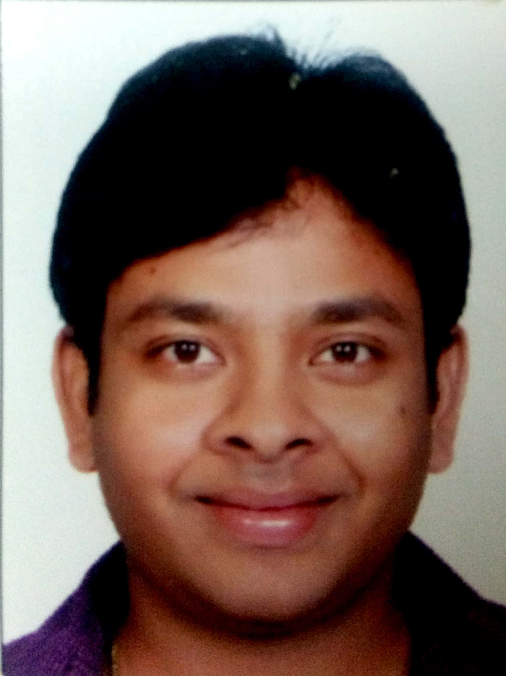
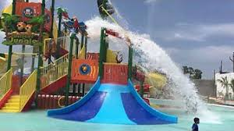

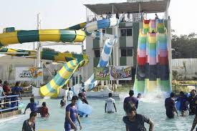

Andhra Pradesh State Financial Corporation {APSFC}, Vijayawada
M/s Fun Park
Shri Pothuri Srinivasulu

Slide 13
Andhra Pradesh State Financial Corporation {APSFC}, Vijayawada
M/s Fun Park
M/s. Fun Park was started as a partnership firm by Shri Pothuri Srinivasulu, Smt. Pothuri Padmavathi, Shri Pothuri Ranganatha Sai and Smt. Pothuri Samyuktha in the year 2014 in Nellore with financial assistance from APSFC. The park has both dry & wet rides and is very popular.

Slide 14
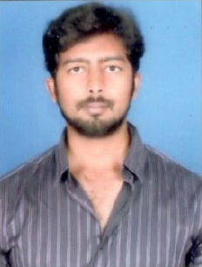
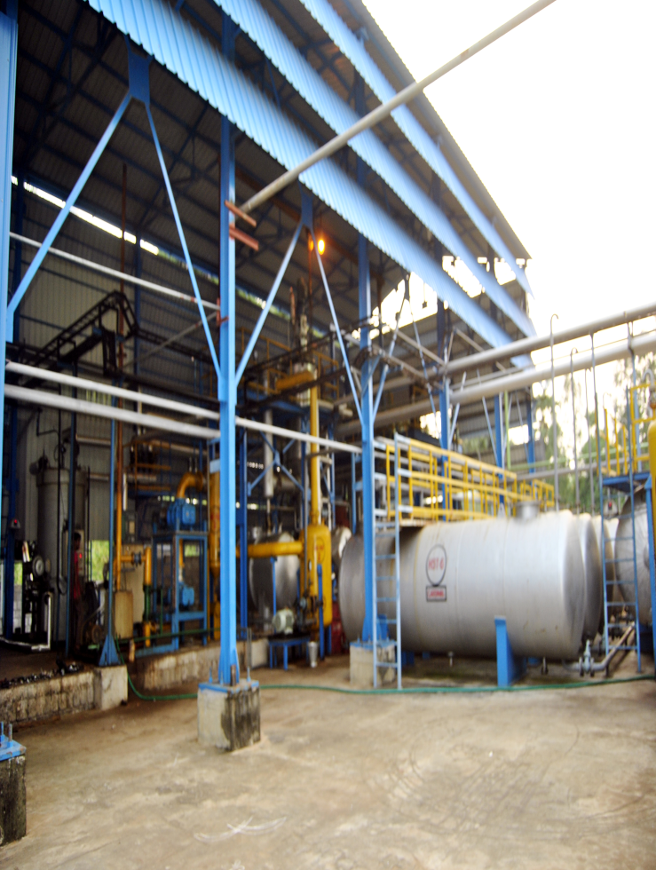
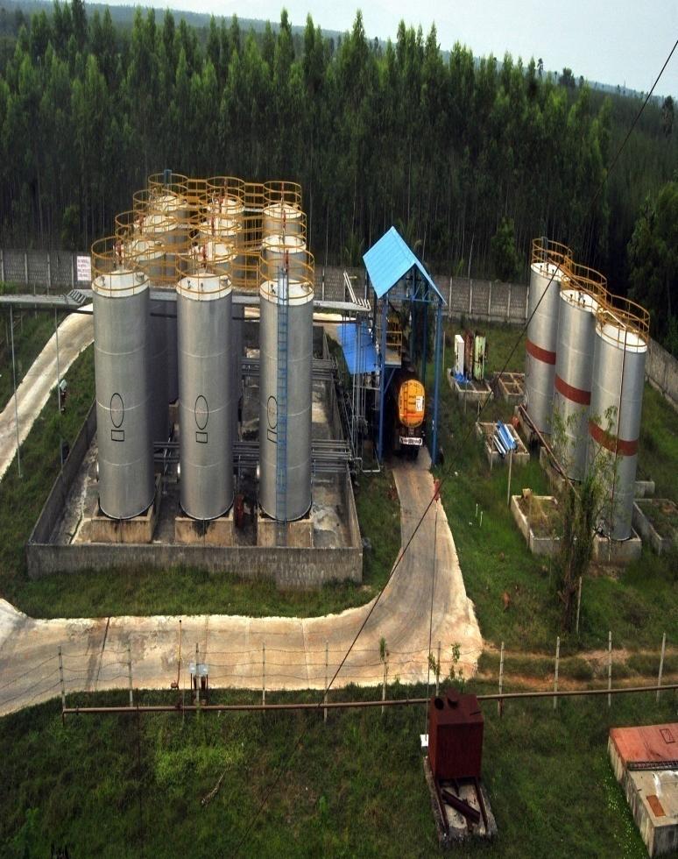
Andhra Pradesh State Financial Corporation {APSFC}, Vijayawada
M/s ARC India Petroleum Pvt. Ltd.
Shri G. Krishna Chitanya Varma

Slide 15
Andhra Pradesh State Financial Corporation {APSFC}, Vijayawada
M/s ARC India Petroleum Pvt. Ltd.
Shri G. Krishna Chitanya Varma and Shri G. Appala Raju established M/s ARC India Petroleum Pvt. Ltd. at Vishakhapatnam which started its commercial production in the year 2014 with financial assistance from APSFC. The plant handles waste oils, used oils, sandy oil sludge and bio diesel. The Company has developed inhouse technology for making the unit environment friendly. ARC India Petroleum Pvt. Ltd. has been conferred with ISO 9001 certification. It has also been given the Explosive license (both for process and storage), Solvent license from the district collector and AP Pollution control board license.

Slide 16
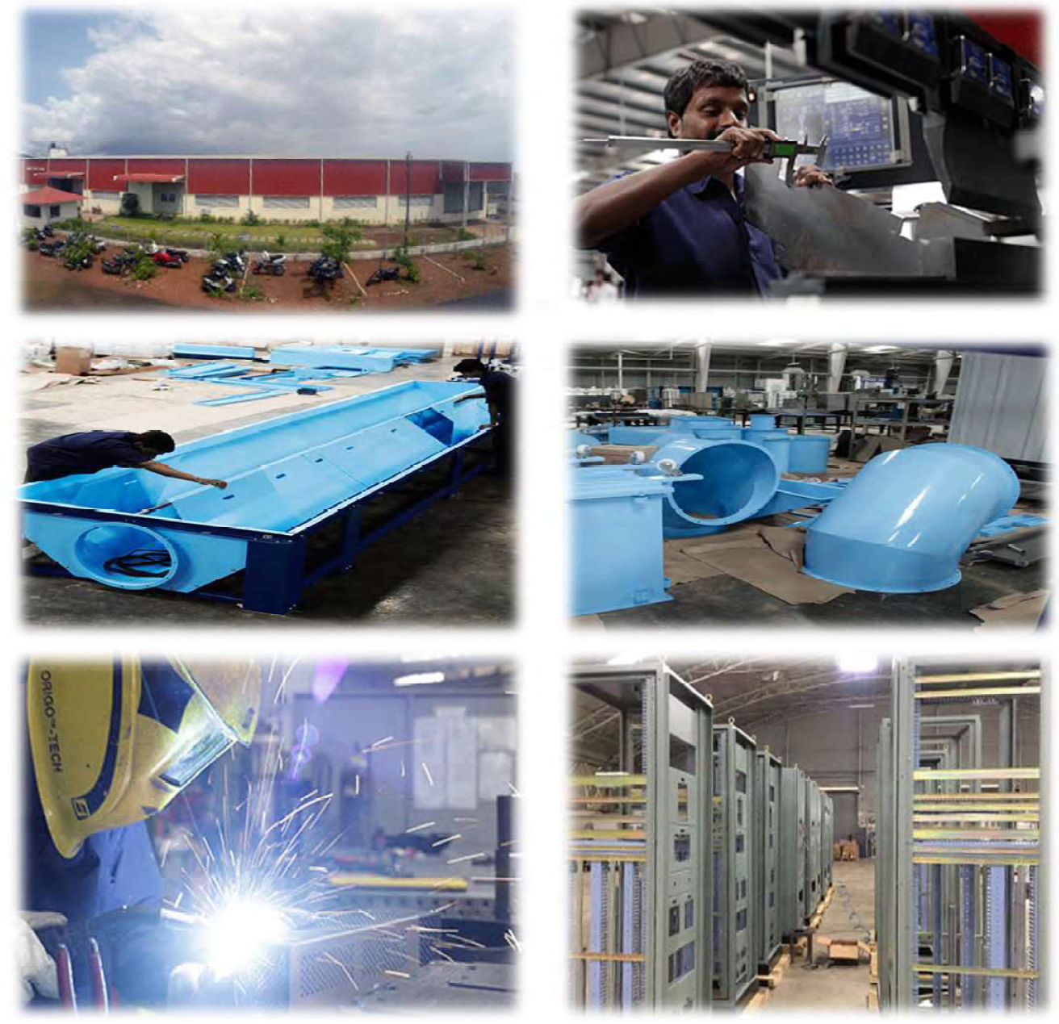
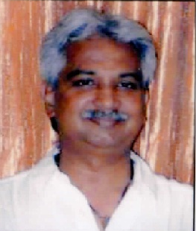
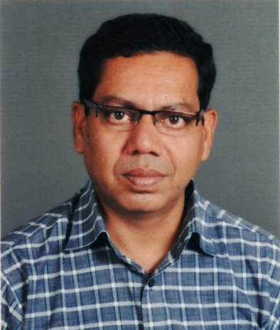
EDC Ltd., Goa
M/s Astra Metal Systems Pvt. Ltd.
Shri Satish Shinde
Mr. Charles Charlton Collaco

Slide 17
EDC Ltd., Goa
M/s Astra Metal Systems Pvt. Ltd.
Mr. Satish A. Shinde and Mr. Charles Charlton Collaco established Astra Metal Systems Limited (AMSL) in the year 1997 with financial assistance from EDC Ltd., Goa. The unit is engaged in the activity of Precision Sheet Metal Components manufacturing and has 4 units in Goa. The company has a turnover of about Rs.50crs and a work force of 120-150. The unit also exports its products.

Slide 18
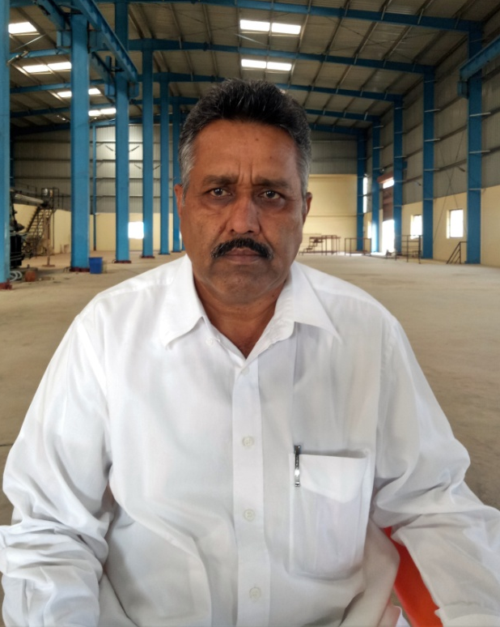
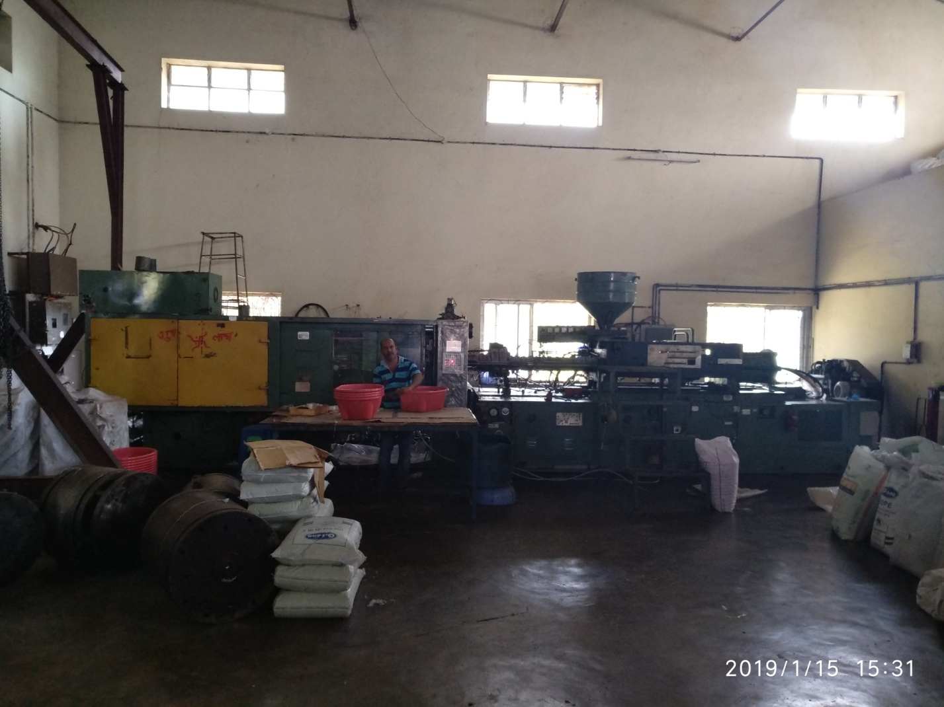
EDC Ltd., Goa
M/s Ramdev Plastic Industries
Shri Mohanlal Bisnoi

Slide 19
EDC Ltd., Goa
M/s Ramdev Plastic Industries
Ramdev Plastic industries was promoted by Shri Mohanlal Bishnoi (a first generation entrepreneur) in the year 1998 with financial assistance from EDC Ltd., Goa. The unit is a manufacturer of Plastic Injection and Blow Moulded articles for common household and industrial products like buckets, mugs, bottles, plastic furniture items in the Konkan Belt of India. It manufactures 150 products which are marketed in Goa, Karnataka, and Maharashtra. The company now has 3 units and employs around 75 direct employees.

Slide 20
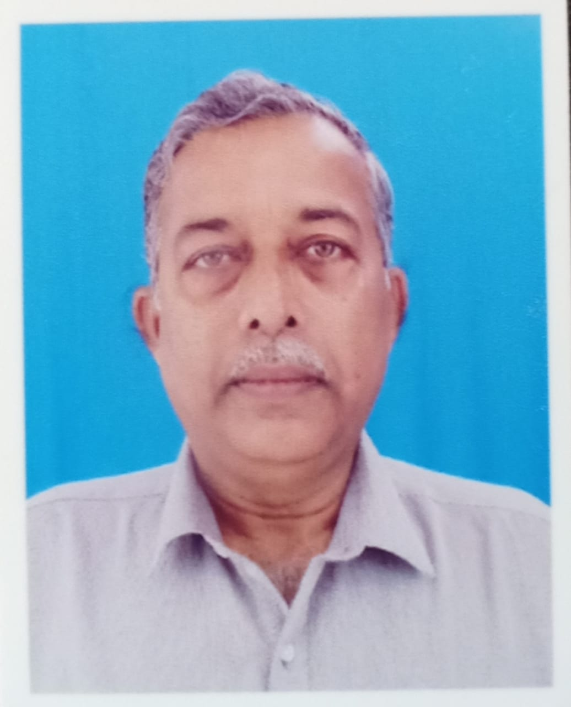
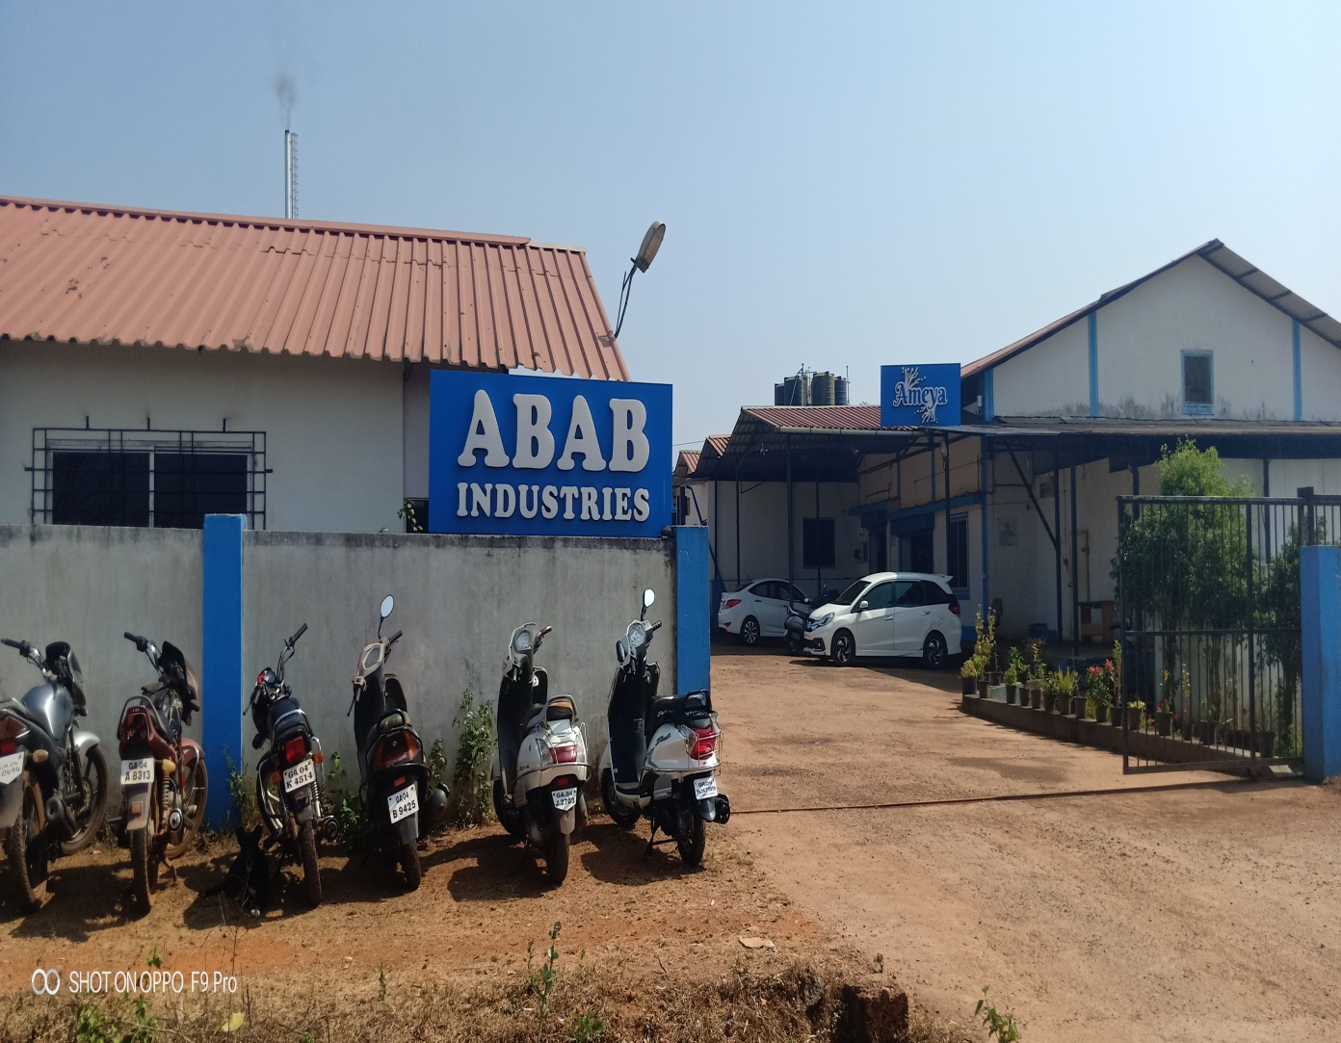
EDC Ltd., Goa
M/s ABAB Industries
Shri Ladu Bablo Gawas

Slide 21
EDC Ltd., Goa
M/s ABAB Industries
Shri Ladu B. Gawas started M/s ABAB Industries in 1987 to supply ACGL, a subsidiary of Tata Motors, with Fabricated Sheet Metal components with financial assistance from EDC, Goa. The unit has a full fledged state of the art technology fabrication setup in Goa and offers a wide range of in house services in sheet metal, tube and pipe fabrication. M/s Abab is also the only company in Goa to have a hot dip galavanizing set up and to manufacture Storage racks for supermarkets and ware houses. At present M/s Abab has 5 units with a turnover of Rs.19 crores .

Slide 22
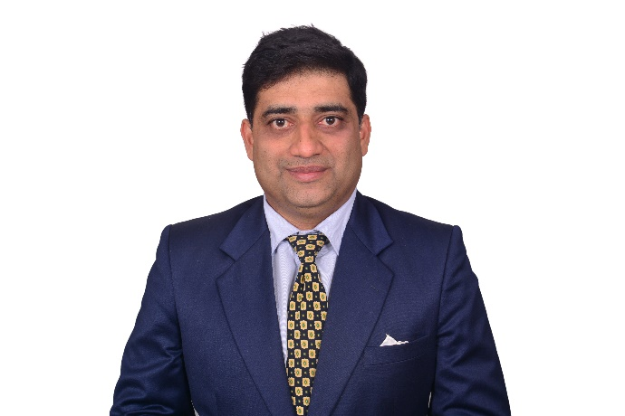
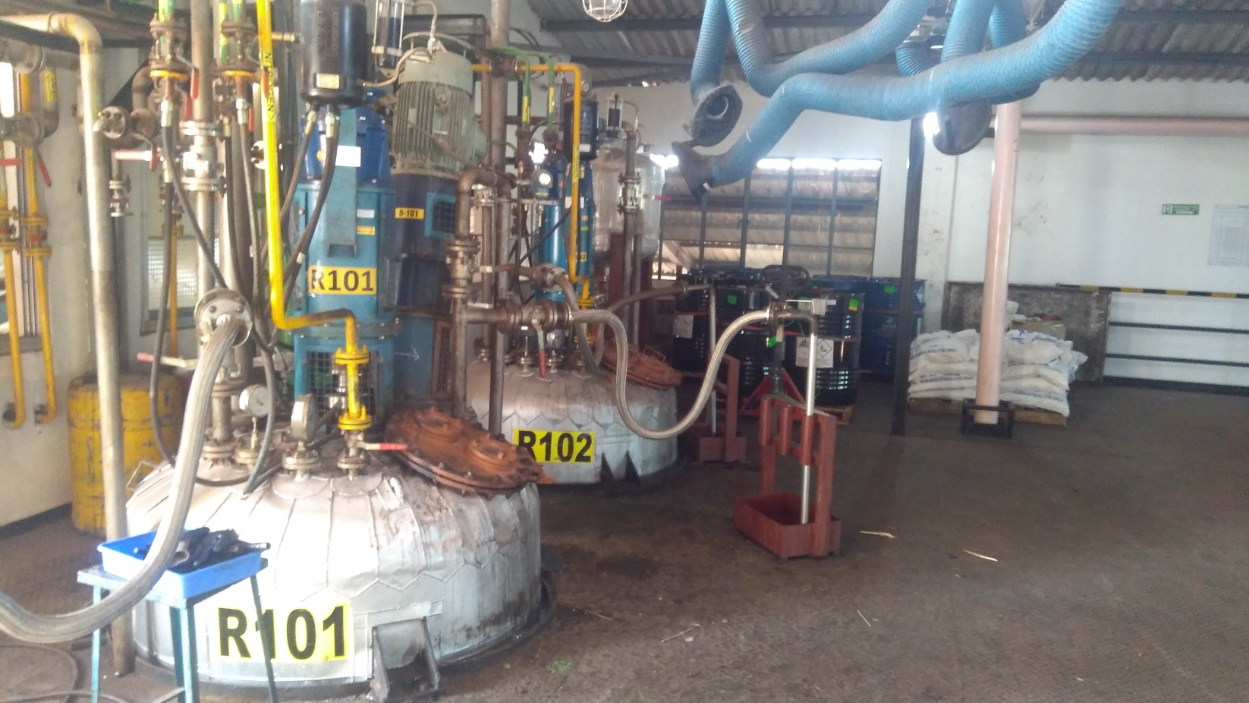
EDC Ltd., Goa
M/s Shri Mahalsa Plastic
Shri Laxman Vaman Kelekar

Slide 23
EDC Ltd., Goa
M/s Shri Mahalsa Plastic
Shri Laxman Vaman Kelekar promoted his own enterprise M/s Shri Mahalsa Plastic at the age of 19 in the year 1998 with financial assistance from EDC Ltd., Goa. The unit is manufacturing plastic containers and supplies to Ciba, Vicco Laboratories, Marico Industries etc.. Shri Kelekar diversified his activities in the year 2011 and started manufacturing premium quality Epoxy Putty & Construction Chemicals to supply to multinational companies. Standard Epoxy Materials, an associate firm, was started in 2014 and works as a business partner of Huntsman, a US based global MNC. It is engaged in formulation and packing of Epoxy Resins and Hardeners, with manufacturing capacity of 400 tons per month. Both the units together have a turnover of Rs.13 crores and employ 150 employees.

Slide 24
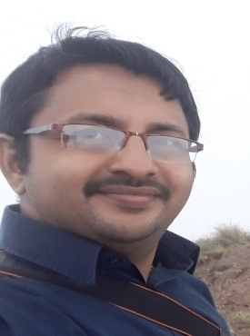
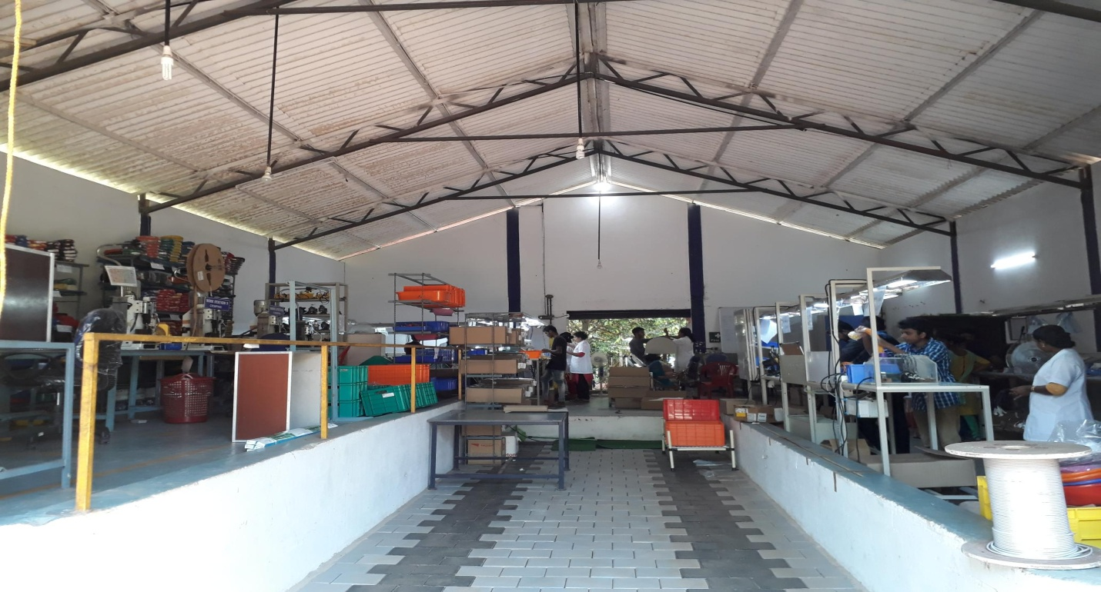
Kerala Financial Corporation {KFC}, Thiruvananthapuram
M/s Kurlis
Shri Eldho Kuriakose

Slide 25
Kerala Financial Corporation {KFC}, Thiruvananthapuram
M/s Kurlis
M/s Kurlis was established by Shri Eldho Kuriakose as a proprietary firm with financial assistance from KFC. The unit manufactures electrical wiring harness with dedicated program management support. M/s Kurlis is a leading contract manufacturer in providing customized cable assemblies for industrial, Medical, Automotive, and Aerospace application.

Slide 26
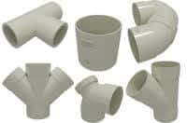
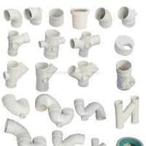
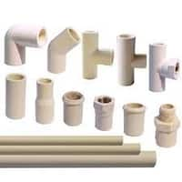
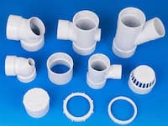

Kerala Financial Corporation {KFC}, Thiruvananthapuram
M/s Arrow Polymers

Slide 27
Kerala Financial Corporation {KFC}, Thiruvananthapuram
M/s Arrow Polymers
M/s Arrow Polymers was established by Shri Anil Kumar S as a proprietory concern at Murukkumpuzha and is engaged in the manufacture of PVC pipes & fittings. The unit had taken financial assistance from KFC and is prompt in repayment of its loans.

Slide 28
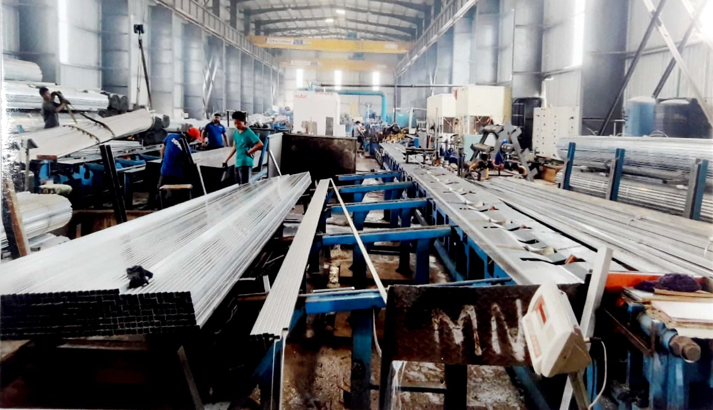
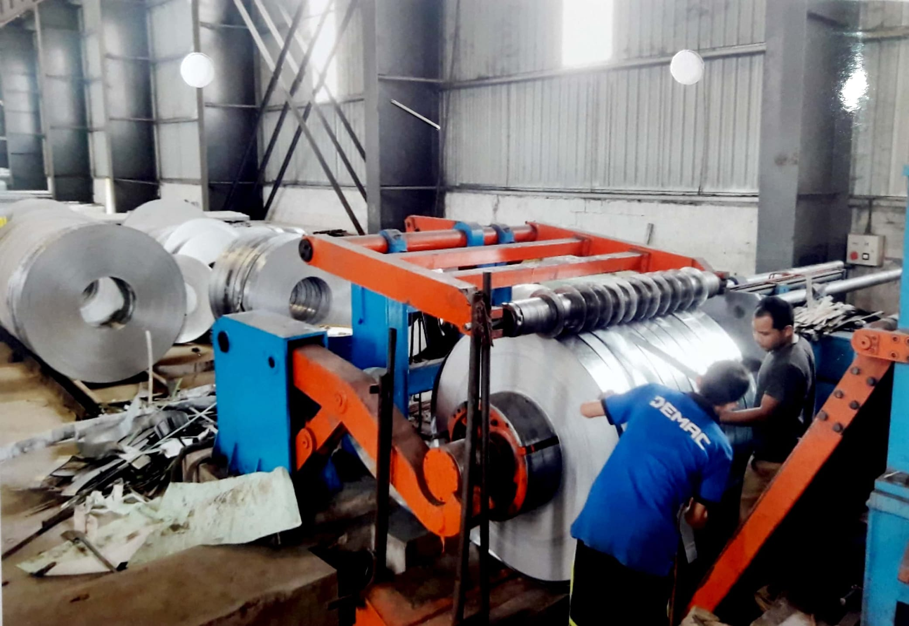
Kerala Financial Corporation {KFC}, Thiruvananthapuram
M/s New Malayalam Steel (P) Limited

Slide 29
Kerala Financial Corporation {KFC}, Thiruvananthapuram
M/s New Malayalam Steel (P) Limited
M/s New Malayalam Steel (P) Limited is an ISO 9001:2015 concern producing ISI branded Zinc coated steel structural piped and allied products. The unit was set up by Shri V D Varghese during the year 2014-2015 with financial assistance from KFC. M/s New Malayalam Steel (P) Limited markets its products under the brand name "DEMAC STEEL".

Slide 30
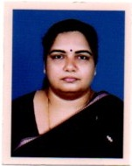
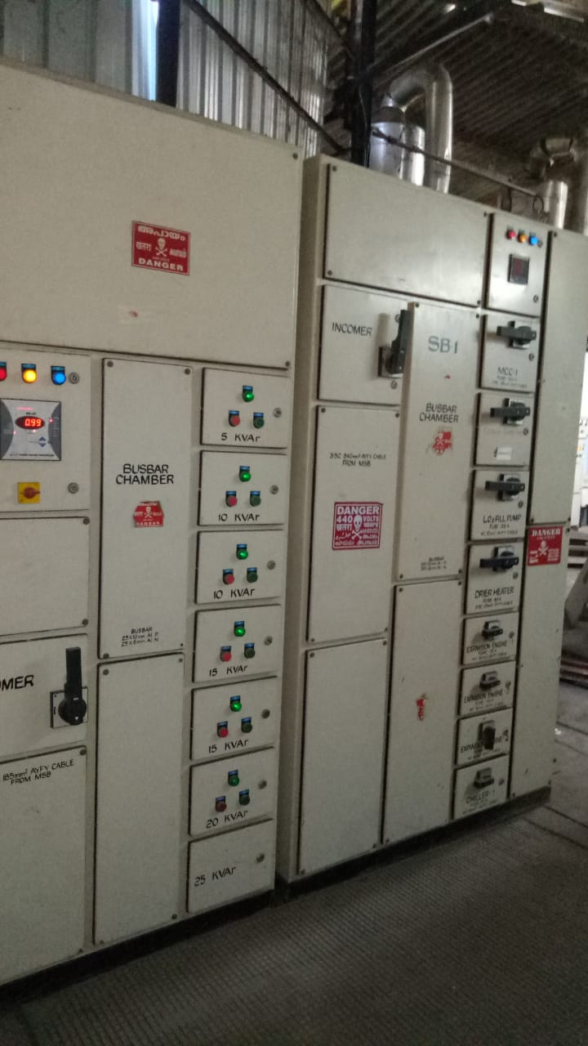
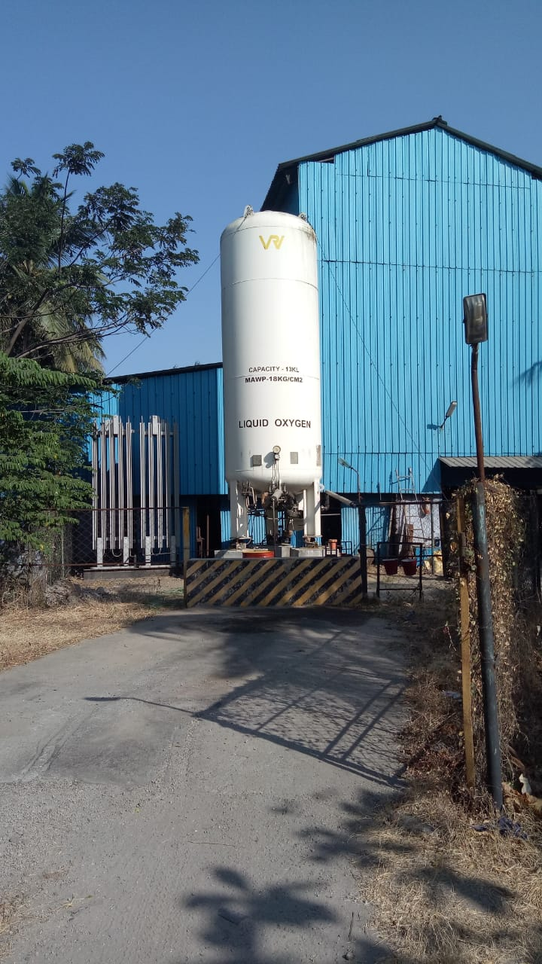
Kerala Financial Corporation {KFC}, Thiruvananthapuram
M/s Premier Gases
Smt. Radha Sreekrishnan

Slide 31
Kerala Financial Corporation {KFC}, Thiruvananthapuram
M/s Premier Gases
M/s Premier Gases is one of the largest manufacturers and distributors of Industrial and Medical Oxygen in Kerala. Mrs. Radha Srikrishnan established the unit in the year 1983 with financial assistance from KFC and supplies to all the Major Hospitals. M/s Premier Gases has an extensive and effective distribution network enabling it to give timely delivery.

Slide 32
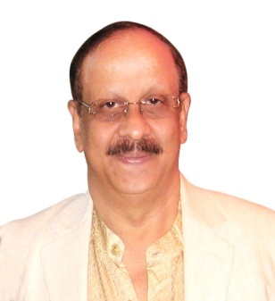
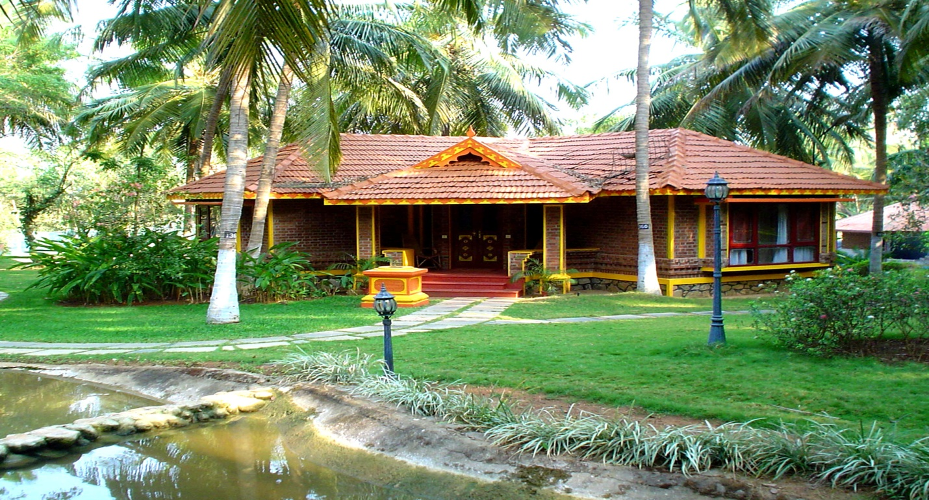
Kerala Financial Corporation {KFC}, Thiruvananthapuram
M/s Kairali Ayurvedic Health Resort Pvt. Ltd.
Shri K V Ramesh

Slide 33
Kerala Financial Corporation {KFC}, Thiruvananthapuram
M/s Kairali Ayurvedic Health Resort Pvt. Ltd.
Kairali Ayurvedic was established by Joint Managing Directors, Smt. Gita Ramesh and Shri K.V. Ramesh, with financial assistance from KFC. The group has an Ayurveda research and development Centre. Shri Ramesh is one of the fore-runners in promoting Ayurveda globally.

Slide 34
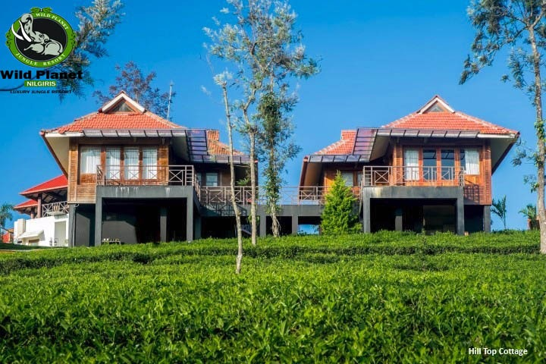
Kerala Financial Corporation {KFC}, Thiruvananthapuram
M/s Wild Planet (P) Ltd

Slide 35
Kerala Financial Corporation {KFC}, Thiruvananthapuram
M/s Wild Planet (P) Ltd
M/s Wild Planet (P) Ltd was established by Shri Vivekanand and his sons with financial assistance from KFC. The Resort near Devala of Nilgiris District is ideally located in 100 Acres of land in Malappuram Dist. Kerala and is surrounded by coffee Tea estate and verdant green forests with unobstructed view on all sides. The resort is a plantation retreat and targets high-end customers from India and abroad who come to enjoy and experience the serenity and marvellous landscape of the Nilgiris Mountain Range.

Slide 36
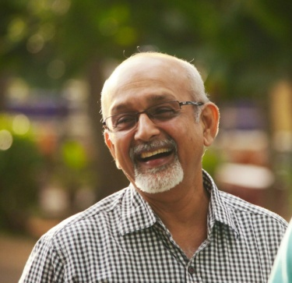
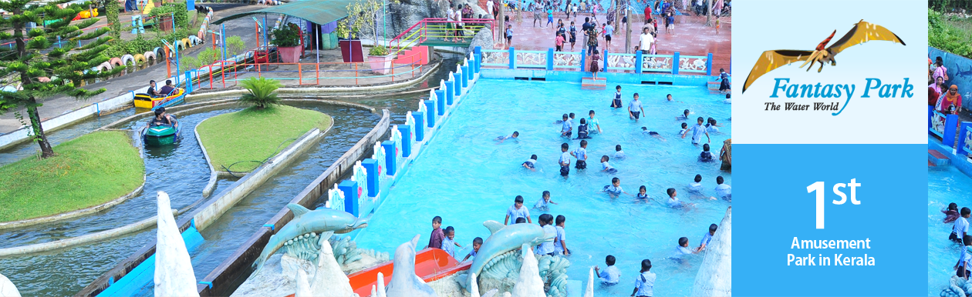
Kerala Financial Corporation {KFC}, Thiruvananthapuram
M/s Neo Tech Amusements And Resorts P. Ltd
Captain T. S. Asokan

Slide 37
Kerala Financial Corporation {KFC}, Thiruvananthapuram
M/s Neo Tech Amusements And Resorts P Ltd
M/s Neo Tech Amusements and Resorts Pvt Ltd was incorporated in the year 1995 with financial assistance from KFC. Their Fantasy Park is situated in the foot hills of the beautiful, Western Ghats. Fantasy Park stands out for its serenity, enchanting beauty and the rare blend of scenic ingredients. In 2005 a major revamp was carried out by introducing water games like Wave pool, water slides and a 40ft high water fall. The park has recently introduced a Haunted House. It also has a Planetarium for imparting information about the stars and planets. Quality of water for all the wet rides, water fall and rain dance is ensured with online testing and automatic dousing equipment.

Slide 38
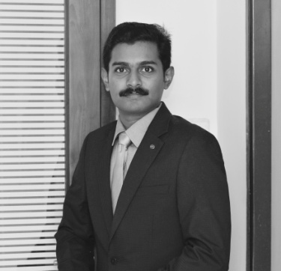
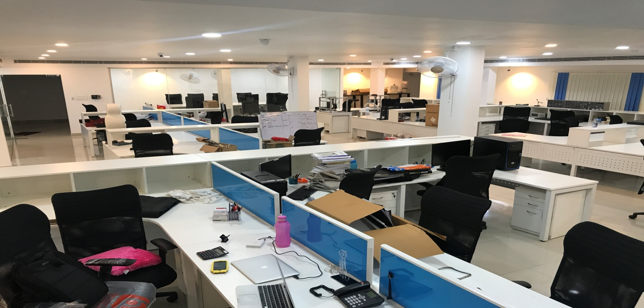
Kerala Financial Corporation {KFC}, Thiruvananthapuram
M/s Sastra Robotics India (P) Ltd
Shri Aronin P

Slide 39
Kerala Financial Corporation {KFC}, Thiruvananthapuram
M/s Sastra Robotics India (P) Ltd
M/s Sastra Robotics India (P) Ltd. was promoted by Shri Aronin P with financial assistance from KFC and manufactures Robots and Robotic Equipments with headquarters at Cochin. Since 2013, these innovative products are being used by OEMs and Service Providers to expedite test cycles and reduce the time-to-market for their products. The unit has been rated as one among the Top 50 in the World, as per TiE Silicon Valley’s evaluation of Technology Startups in 2017. Sastra Robotics provides 100% guaranteed after sale support for 5 years. The unit has been awarded the Future Kerala Best Startup Award; KFC Best First Line Entrepreneur Award 2018; Innovation Growth Programme (IIGP) 2.0 Award by DST- Lockheed Martin- Tata Trusts India Innovation Growth Programme (IIGP) 2.0 Award and also won the first prize at the pitchfest conducted by the Forge Accelerator Coimbatore.

Slide 40
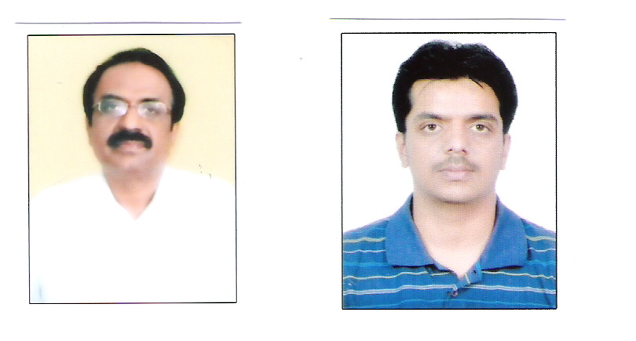
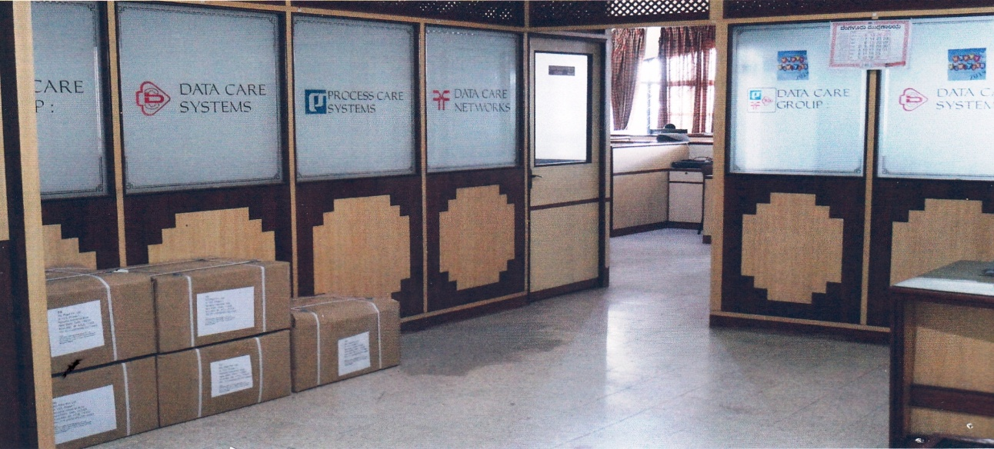
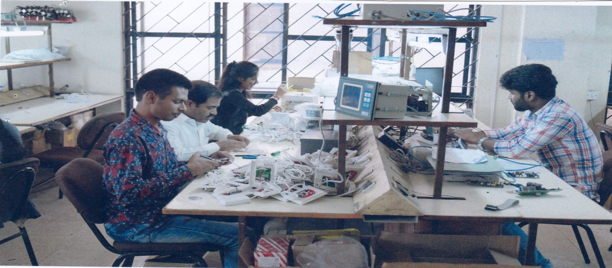
Karnataka State Financial Corporation {KSFC}, Bengaluru
M/s Data Care Systems (P) Ltd.
SHRI NAGESH K.V.,
SHRI RAKSHITH K.N.

Slide 41
Karnataka State Financial Corporation {KSFC}, Bengaluru
M/s Data Care Systems (P) Ltd.
M/s Data Care Systems Pvt. Ltd. was established by Shri Nagesh K.V. and Shri Rakshith K.N., as a Private Limited Company in 1989 at Rajajinagara for manufacture of Electronic Components with financial assistance of Rs.482.50 lakhs from KSFC. The Company is a Pioneer in Queue management systems, engine monitoring in railways, electronics for heavy vehicles. Its major clients are BHEL, NTPC, HAL and Indian Railways.

Slide 42
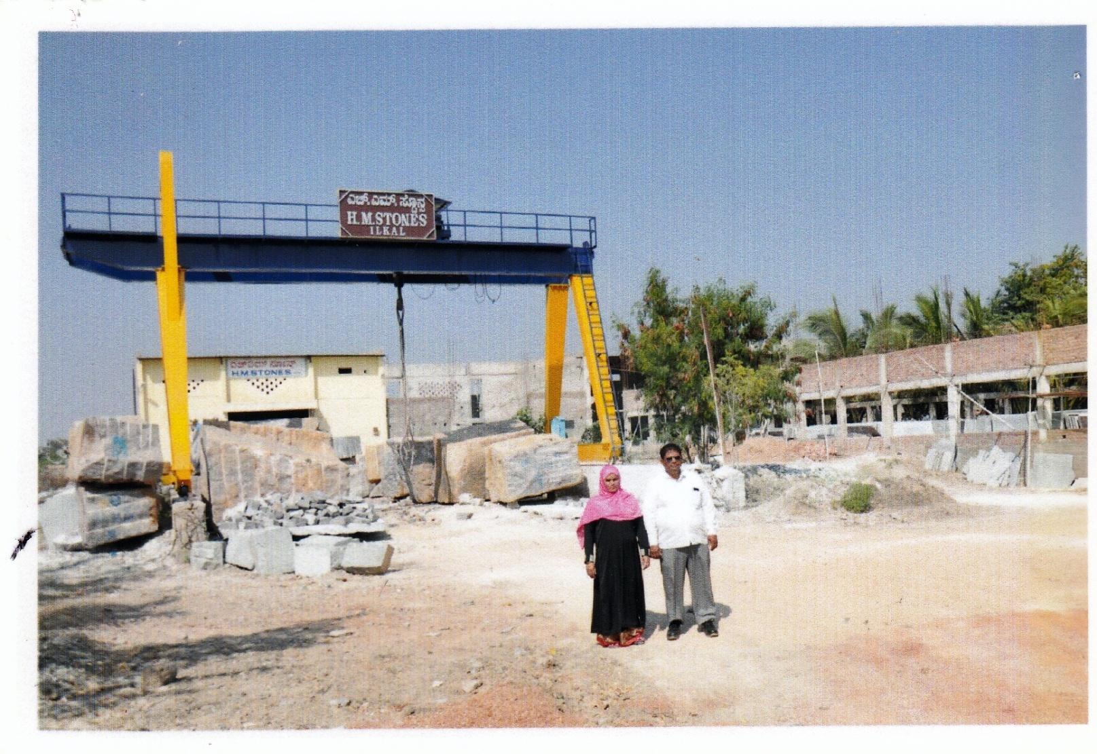
Karnataka State Financial Corporation {KSFC}, Bengaluru
M/s H. M. Stones
Smt. Nasimbanu M. Marbasari, Shri Mohammadiakl D. Marabasari

Slide 43
Karnataka State Financial Corporation {KSFC}, Bengaluru
M/s H. M. Stones
M/s H.M. Stones was incorporated by Smt. Nasimbanu M. Marbasari and Shri Mohammadiakl D. Marabasari as a partnership firm in the year 2012 with financial assistance of Rs.100 lakhs for KSFC at Bagalkote. It is involved in the activity of granite cutting & polishing and is one of the leading granite units in the district.

Slide 44
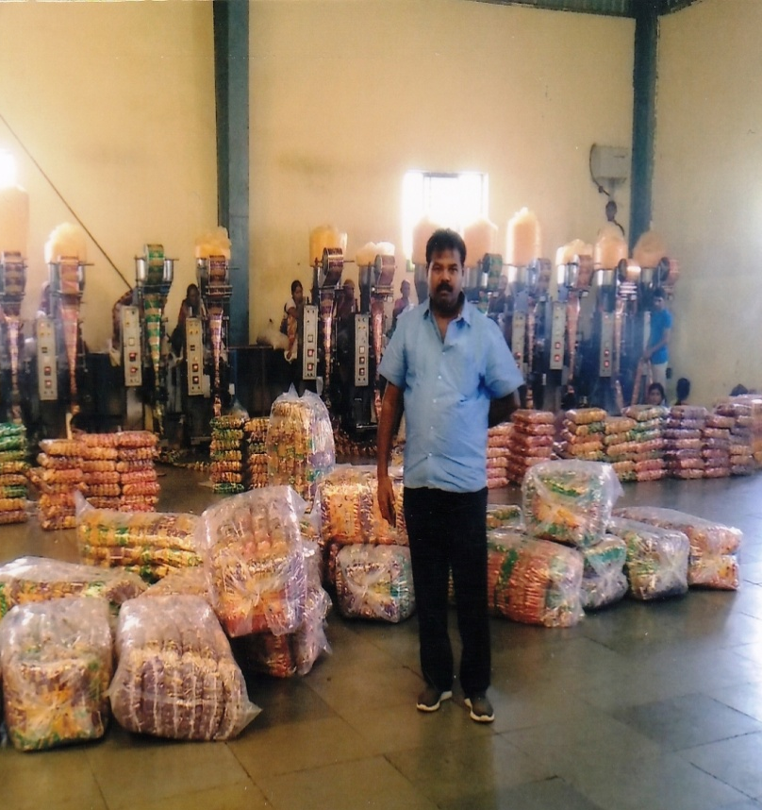
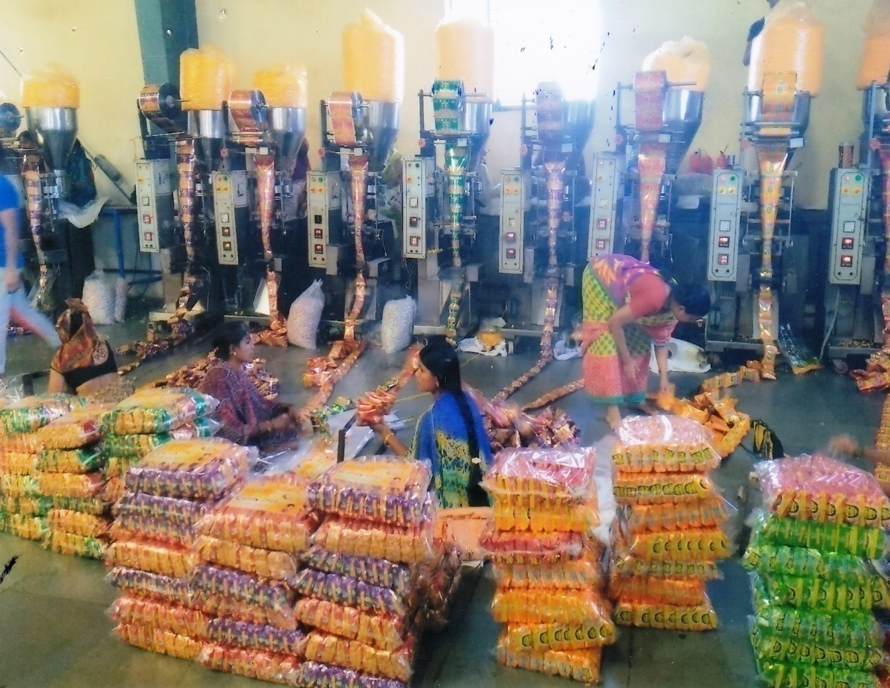
Karnataka State Financial Corporation {KSFC}, Bengaluru
M/s Shalom Food Products
Shri Vincent Jayaraj Nadar

Slide 45
Karnataka State Financial Corporation {KSFC}, Bengaluru
M/s Shalom Food Products
M/s Shalom Food Products is a proprietory firm involved in manufacturing of condiments. It was started at Vijayapura by Shri Vincent Jayaraj Nadar with initial financial assistance of Rs.138 lakhs from KSFC in the year 2015. The unit is supplying to entire Vijayapura, Belagavi, Kalaburagi & adjoining Sholapura.

Slide 46



Karnataka State Financial Corporation {KSFC}, Bengaluru
M/s Rayon Designs

Slide 47
Karnataka State Financial Corporation {KSFC}, Bengaluru
M/s Rayon Designs
M/s Rayon Designs was started in the year 2005 as a partnership firm by Shri Rangaswamy R. and Shri Hithysi R. at Jayanagara with financial assistance of Rs.185 lakhs from KSFC in the year 2005. The unit exports garments and silk fabrics. Its major clients are M/s Sai Exports, Mulbery Silks, Ethnic Silk Mills, Renram Fashions (I) Pvt. Ltd.

Slide 48


Karnataka State Financial Corporation {KSFC}, Bengaluru
M/s Sri Shakthi Gravures
Shri Narayanaswamy

Slide 49
Karnataka State Financial Corporation {KSFC}, Bengaluru
M/s Sri Shakthi Gravures
M/s Sri Shakthi Gravures was established by Shri Narayanaswamy in Bengaluru Rural with financial assistance of Rs. 750 lakhs from KSFC in the year 2008. It is a proprietory concern and is involved in a very specialised activity of manufacturing of Rotogravure Printing. It is the second such unit in India. Its Clientele includes Aricent, Roto Printers, Champion Packaging etc.

Slide 50


Karnataka State Financial Corporation {KSFC}, Bengaluru
M/s Shri Venkateshwara Steels
Shri Lingappa T. Odeyarahalli

Slide 51
Karnataka State Financial Corporation {KSFC}, Bengaluru
M/s Shri Venkateshwara Steels
M/s Shri Venkateshwara Steels was established by Shri Lingappa T. Odeyarahalli at Dharwad as a partnership firm in the year 1992 with financial assistance of Rs.184 lakhs from KSFC. Major clients of the unit are Kirloskar Electric Co. and BDK Group, Hubli. The firm has a turnover of Rs. 251.70 lakhs.

Slide 52


Karnataka State Financial Corporation {KSFC}, Bengaluru
M/s Sara Coffee Processing Centre

Slide 53
Karnataka State Financial Corporation {KSFC}, Bengaluru
M/s Sara Coffee Processing Centre
M/s Sara Coffee Processing Centre was started by Smt. Blossom Saldana as a proprietory firm in Chikkamagaluru with financial assistance of Rs.318.50 lakhs from KSFC in the year 2000. Its turnover is Rs.324 lakhs.

Slide 54


Karnataka State Financial Corporation {KSFC}, Bengaluru
M/s Venkateshwara Nursing Home
Dr. Suvarna G. R

Slide 55
Karnataka State Financial Corporation {KSFC}, Bengaluru
M/s Venkateshwara Nursing Home
M/s Venkateshwara Nursing Home was started in the year 1996 by Dr. Suvarna G.R. at Yadagiri. She is a leading obstetrician & gynecologist in the region. The nursing home availed loan worth Rs.110 lakhs from KSFC.

Slide 56


Karnataka State Financial Corporation {KSFC}, Bengaluru
M/s Pujar Process
Smt. Nagaratna A. G.

Slide 57
Karnataka State Financial Corporation {KSFC}, Bengaluru
M/s Pujar Process
M/s Pujar Process was established by Smt. Nagaratna A.G. at Davanagere with financial assistance from KSFC of Rs.75 lakhs in the year 2004. The firm makes Anadised Alluminium Name Plates and has a turnover of Rs.237.12 lakhs. Its clients include BEL, BMEL, BHEL & ACE Designs.

Slide 58


Karnataka State Financial Corporation {KSFC}, Bengaluru
M/s Abhi Hospital
Dr. Shashidhara P. K.

Slide 59
Karnataka State Financial Corporation {KSFC}, Bengaluru
M/s Abhi Hospital
M/s Abhi Hospital was started in the year 2014 by Dr. Shashidhara P.K. at Ramanagara. The hospital availed loan worth Rs. 90.50 lakhs from KSFC. The Nursing Home has received Life Time Achievement Award for Global Peace" from USA.

Slide 60


Karnataka State Financial Corporation {KSFC}, Bengaluru
M/s Navchetan Micro Fin. Services P. Ltd.
Shri Nagendra V. Mali

Slide 61
Karnataka State Financial Corporation {KSFC}, Bengaluru
M/s Navchetan Micro Fin. Services P. Ltd.
M/s Navchetan Micro Fin. Services Pvt. Ltd. was started in Haveri in the year 2006 with financial assistance of Rs.1,477 lakhs from KSFC. It is involved in the activity of providing micro finance. It was promoted by Shri Nagendra V. Mali with the objective of enhancement of livelihood opportunities for the urban/rural poor women in Haveri. Presently, the company has spread its micro finance activity to Davanagere, Dhaward, Shivamogga, Gadag, Belgaum and also few districts of neighbouring Maharashtra State. Its turnover is 159.32 lakhs.

Slide 62

Karnataka State Financial Corporation {KSFC}, Bengaluru
M/s SLV Boarding & Lodging
Shri T. Raju

Slide 63
Karnataka State Financial Corporation {KSFC}, Bengaluru
M/s SLV Boarding & Lodging
M/s SLV Boarding & Lodging was established at Mandya by Shri T. Raju & Smt. Gangamma as a partnership firm in the year 2009 with financial assistance of Rs.258 lakhs from KSFC. It is one of the leading hotels in the locality.

Slide 64


Karnataka State Financial Corporation {KSFC}, Bengaluru
M/s Gorich Energy Pvt. Ltd.
Shri Rajaiah M.V.

Slide 65
Karnataka State Financial Corporation {KSFC}, Bengaluru
M/s Gorich Energy Pvt. Ltd.
M/s Gorich Energy Pvt. Ltd. was established in 2016 for Solar Power Generation in Chamarajanagara by Shri Rajaiah M.V., Shri Hamsaraj M.R. & Smt. Vachana M.R. and availed loans worth Rs. 575 lakhs from KSFC. The unit is engaged in Green Energy generation and supplies to KPTCL. Its turnover at present is Rs.130lakhs.

Slide 66

Karnataka State Financial Corporation {KSFC}, Bengaluru
M/s Maxima Fashions Exports Pvt. Ltd.

Slide 67
Karnataka State Financial Corporation {KSFC}, Bengaluru
M/s Maxima Fashions Exports Pvt. Ltd.
M/s Maxima Fashions Exports Pvt. Ltd. was established in Belagavi as a Private Limited company by Shri Manish S. Sharma & Smt. Kalpana M. Sharma with financial assistance of Rs.300 lakhs from KSFC in the year 2014. Employment was given to rural women. The entire production is exported.

Slide 68


Karnataka State Financial Corporation {KSFC}, Bengaluru
M/s Sri Durga Granites
Shri R. L. Rathod

Slide 69
Karnataka State Financial Corporation {KSFC}, Bengaluru
M/s Sri Durga Granites
M/s Sri Durga Granites was started in 2008 in Koppal by Shri R. L. Rathod with financial assistance of Rs.514 lakhs from KSFC in the year 2008. The unit is exporting granite to Taiwan & China and has a turnover of Rs.1,062 lakhs.

Slide 70



MANIDCO, Imphal
M/s Thangjam Agro Industries Pvt. Ltd.
Shri Thangjam
Joykumar Singh

Slide 71
MANIDCO, Imphal
M/s Thangjam Agro Industries Pvt. Ltd.
M/s Thangjam Agro Industries Pvt. Ltd. founded by Shri Thangjam Joykumar Singh in 1991 with financial assistance from MANIDCO. The Unit is a Small Scale Food Processing Company, based in Imphal, Manipur and manufactures a large range of food products and beverages under the flagship brand "Likla". The company has been conferred with an ISO 9001:2008 certification and is registered under the Foods Safety and Security Act licensed by Bureau of Indian Standards. The company employs over two hundred people for production and another fifty for sales and distribution. Shri Singh was presented with the Entrepreneurship Appreciation Award from the Chamber of Small Industry Association (COSIA) in 2010 and conferred with the Governors Trophy for best entrepreneur in 2012

Slide 72


Madhya Pradesh Financial Corporation, {MPFC} Indore,
M/s Rudraksh Technologies Pvt. Ltd.
Shri Amit Gupta

Slide 73
Madhya Pradesh Financial Corporation, {MPFC} Indore,
M/s Rudraksh Technologies Pvt. Ltd.
M/s Rudraksh Technologies Pvt. Ltd. was started by Shri Amit Gupta and Shri Dilip Shrivastava at Indore with financial assistance of Rs.250 Lakhs from MPFC in the year 2014. The unit manufactures Encoders, Decoders, Transcoders, Audio Amplifiers and allied Software. The products are also exported to select countries.

Slide 74

Madhya Pradesh Financial Corporation, {MPFC} Indore,
M/s Peptech Constructions Pvt. Ltd.
Shri Niraj Chourasiya

Slide 75
Madhya Pradesh Financial Corporation, {MPFC} Indore,
M/s Peptech Constructions Pvt. Ltd.
M/s Peptech Constructions Pvt. Ltd. was started by Shri Niraj Chourasiya with financial assistance from MPFC at Chhatarpur. The company is involved in the activity of Real Estate Development and Multiplex. MPFC had advanced 8 term loans to the company out of which 5 loans have been fully repaid and other loan accounts are satisfactory.

Slide 76



Madhya Pradesh Financial Corporation, {MPFC} Indore,
M/s Abika Hotel
Shri Aditiya Jhalani
Shri Bharat Jhalani

Slide 77
Madhya Pradesh Financial Corporation, {MPFC} Indore,
M/s Abika Hotel
M/s Abika Hotel was started by Shri Ashok Jhalani, Shri Umeash Chandra Jhalani and Shri Mahesh Jhalani with financial assistance of Rs.600 lakhs from MPFC in Ujjain in the year 2016. The hotel has 54 rooms, Banquet Hall, Restaurant, a Coffee Shop, Marriage Garden and is ideally located.

Slide 78



Madhya Pradesh Financial Corporation, {MPFC} Indore,
M/s Dev Cow and Milk Farms Pvt. Ltd.

Slide 79
Madhya Pradesh Financial Corporation, {MPFC} Indore,
M/s Dev Cow and Milk Farms Pvt. Ltd.
M/s Dev Cow & Milk Farms Pvt. Ltd. was established in the year 2017 by Shri Devendra Singh and Shri Arvind Singh in Jabalpur with financial assistance of Rs. 400 lakhs from MPFC. The entire dairy farm is run with State of the Art Mechanized Equipment and Systems. The unit has automatic milking system, automatic feeding system, manure handling equipment and Automatic Heat monitoring systems for Cows in the sheds. A computerized herd management system and a fully automated milking parlour enables milking of 8 cows simultaneously. The milking parlour is so designed that it records all the information such as identification of the cow, quantum of milk, time taken for milking etc. The promoters are being awarded for having installed the Most Innovative Process.

Slide 80



PIPDIC, Pondicherry
M/s Sri Shanthi Polymers Pvt. Ltd.
Shri S Swaminathan

Slide 81
PIPDIC, Pondicherry
M/s Sri Shanthi Polymers Pvt. Ltd.
Shri S. Swaminathan started M/s Sri Shanthi Polymers Pvt. Ltd. on the land developed by PIPDIC. The firm manufacturs plastic components viz. injection moulding plastic components for Godrej LTD and Marico Ltd. and has 30 employees.

Slide 82



PIPDIC, Pondicherry
M/s Swathi Organics & Specialities Pvt. Ltd.
Shri K. Swaminathan

Slide 83
PIPDIC, Pondicherry
M/s Swathi Organics & Specialities Pvt. Ltd.
M/s Swathi Organics & Specialities Pvt. Ltd. (SOSPL) was established in 1994 in Pudhucherry by Shri K. Swaminathan in technical & financial collaboration with multinational Ciba - Geigy with assistance from PIPDIC. It manufactures Textile chemicals & formulations; Synthetic Tanning Agent; Blended Dye stuff; Plastic Injection Moulding etc. The unit has a well equipped quality control lab and has been conferred with ISO 9001: 2005 certification.

Slide 84



PIPDIC, Pondicherry
M/s S. S. Digital Colour Lab
Smt. A. Vidjealatchoumy

Slide 85
PIPDIC, Pondicherry
M/s S. S. Digital Colour Lab
M/S SS digital colour lab was started in the year of 1997 by Smt. A Vidjealatchoumy with financial assistance from PIPDIC and was the first of its kind in puducherry. Later the promoter implemented new technologies of digital printing and set up 3 more colour lab in puducherry.

Slide 86


PIPDIC, Pondicherry
M/s Eshwar Packaging
Smt. B. Bavani

Slide 87
PIPDIC, Pondicherry
M/s Eshwar Packaging
Smt. B. Bavani started M/s Eshwar Packaging in the year 2015 at PIPDIC Industrial Estate, Puducherry with loan from PIPDIC. The unit manufactures HMHDPE, LDPE, BIO Compostable bags which are supplied throughout Tamilnadu. The unit is prompt and regular in its repayments to PIPDIC.

Slide 88

PIPDIC, Pondicherry
M/s Meena Fiberglass Industries
Shri G. Ganesan

Slide 89
PIPDIC, Pondicherry
M/s Meena Fiberglass Industries
M/s Meena Fiberglas Industries was established by Shri G Ganesan in the year 1993 with assistance from PIPDIC. The unit manufactures furniture, fishing boats, chemical storage tanks, industrial items, modular car parking segments, cable trays, amusement park items, cooling tower related products etc.. The unit has now added pultrusion technology for manufacture of FRP Pultruded profiles. Its clients include HLL, Godrej, TVS, Larson & Toubro Ltd., NTPC, Integral Coach Factory, CPWD, Neyveli Lignite Corporation etc. The unit has been conferred with ISO 9001:2015 certification.

Slide 90


Rajasthan Financial Corporation {RFC}, Jaipur
M/s Shiv Villas Resort
Shri Raj Bihari Sharma

Slide 91
Rajasthan Financial Corporation {RFC}, Jaipur
M/s Shiv Villas Resort
Shri Jagannath Sharma promoted M/s Shiv Villas Resort in Jaipur in the year 2000 with financial assistance from RFC. Shiv Villas is a royal luxury resort built on the lines of the architecture of the historic palaces and forts of Rajasthan. The Resort opened its gates to guests in October 2006 with a staff of about 200 to run the show. Over the years the unit has sought many loans which have been repaid on time. Today Shiv Vilas has a room inventory of 126 Rooms. Its Sheesh Mahal restaurant is among the best in world. The resort is providing direct employment to almost 300 people and in-direct employment to 700 People.

Slide 92

Rajasthan Financial Corporation {RFC}, Jaipur
M/s Shreenath Minerals
Smt. Shakuntala Toshniwal

Slide 93
Rajasthan Financial Corporation {RFC}, Jaipur
M/s Shreenath Minerals
M/s Shreenath Minerals was established in 1996 as a partnership concern by Smt. Shakuntala Toshniwal and Sh. Radhey Shyam Toshniwal at Udaipur with financial assistance from RFC to make mineral based products. Subsequently as the production expanded the unit took further assistance from the Corporation. The unit has been prompt in repayment of its loans.

Slide 94



Rajasthan Financial Corporation {RFC}, Jaipur
M/s AHA 3D Innovations Pvt. Ltd

Slide 95
Rajasthan Financial Corporation {RFC}, Jaipur
M/s AHA 3D Innovations Pvt. Ltd
Aha 3D was founded in 2010 in Jaipur by Shri Aakash with financial assistance from RFC. The company is involved in developing 3D printing technologies, and also serves as a platform for high technology indigenous research and offers globally competitive features. The Aha3D machines has been certified with ISO 9001:2008 certification. The company is developing in-house design for machine design which includes embedded firmware, application software, core electronics and mechatronics.

Slide 96


Tamilnadu Industrial Investment Corporation Limited {TIIC}, Chennai
M/s Excellent Hi-Care Pvt. Ltd.
Shri M. Thirupathy

Slide 97
Tamilnadu Industrial Investment Corporation Limited {TIIC}, Chennai
M/s Excellent Hi-Care Pvt. Ltd.
Shri M. Thirupathy is a first generation entrepreneur. He established M/s Excellent Hi Care Pvt. Ltd. in the year 2012 with financial assistance from TIIC and makes Premium Intraocular Lenses and Opthalmic Surgical Blades and is one of the leading Intraocular Lenses manufacturers in India. The “Optima” brand of products made by the unit are sold all over India and exported to 39 countries. The unit has been awarded European quality certificate (CE), FDA-India, ISO 13485.

Slide 98


Tamilnadu Industrial Investment Corporation Limited {TIIC}, Chennai
M/s Numaan Industries
Shri S. Ravindran

Slide 99
Tamilnadu Industrial Investment Corporation Limited {TIIC}, Chennai
M/s Numaan Industries
M/s Numann Industries was promoted in the year 1998 by Shri S. Ravindran as a proprietorship concern with financial assistance from TIIC. The unit has developed more than 500 components applicable to two/four wheelers and heavy vehicles. Because of its excellent design and development of its components and timely delivery, the concern has now became TIER-I vendor to MNC’s such as TENNECO, MANN+HAMMEL, SOGEFI-MNR, etc.

Slide 100


Tamilnadu Industrial Investment Corporation Limited {TIIC}, Chennai
M/s World Innovation Technologies
Smt. Princy Anitha

Slide 101
Tamilnadu Industrial Investment Corporation Limited {TIIC}, Chennai
M/s World Innovation Technologies
M/s World innovation technologies was setup by Smt. Princy Anitha in Coimbatore with financial assistance from TIIC for manufacture of Waste Water Treatment and Recycling Plants. They also manufacture Flow Dying Machine, Compactor, Squeezer etc.. World innovation technologies is equipped with all modern infrastructure facilities to take up any kind of Fabrication, automation & commissioning, conforming to customer quality standards and delivery requirement on regular basis. The Company supplies its products to Indian Railways, Amaraja Batteries, Hectar Beverages etc. It also exports its products to Africa. World innovation technologies is an ISO 9001-2015 certified Company.

Slide 102

THANKS

